Slide 2
Who are the Back Bay Amateur Astronomers?
The BBAA . . .
Notes:
6-minute automated slide show with “Star Wars” music.

Slide 3
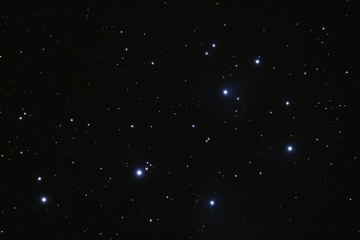
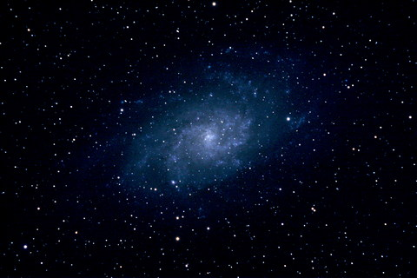
Astronomy is the science of objects and phenomena outside the earth’s atmosphere such as . . .
Stars,
Planets,
and Galaxies.

Slide 4
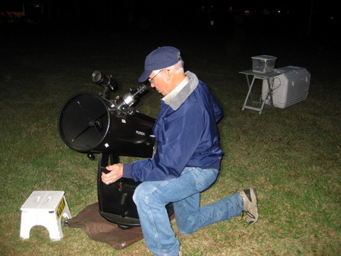
Amateur (French amateur "lover of", from Latin amatorem nom. amator, "lover") : a person attached to a particular pursuit, study, or science without formal training [and without pay]. (Wikipedia)
Amateur astronomers love looking at the stars, planets, and other celestial objects.

Slide 5
Who are the Back Bay Amateur Astronomers?
The BBAA . . .
club was started December 14,1978.
Motto:
“Bringing Astronomy to the People…”

Slide 6
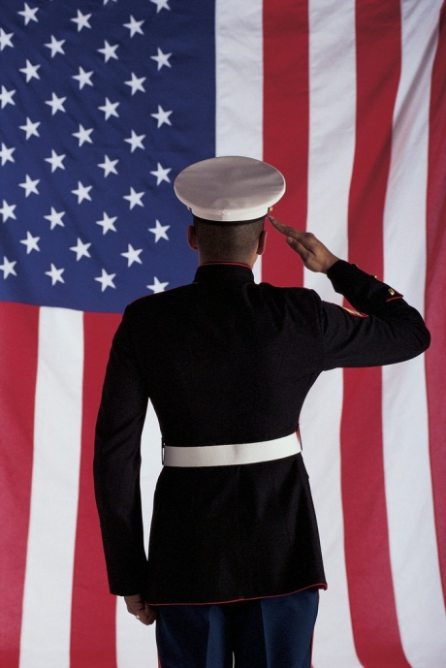
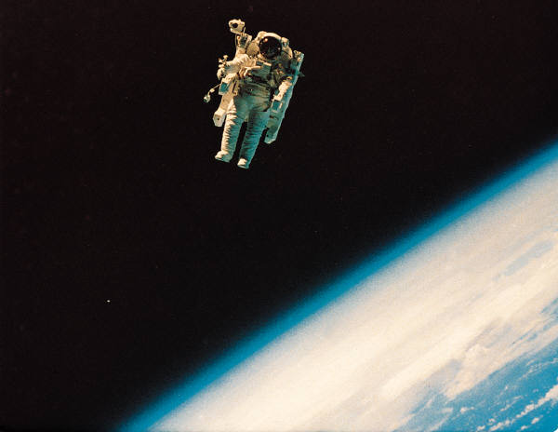
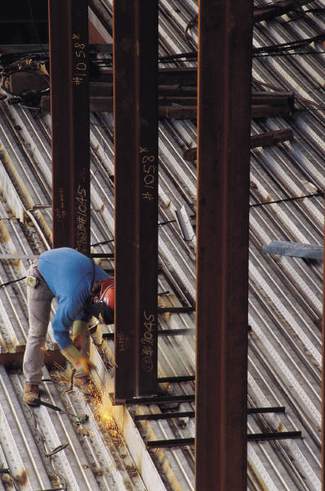
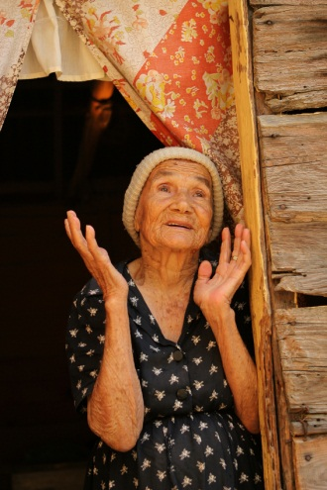
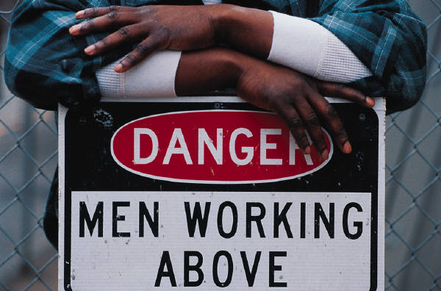
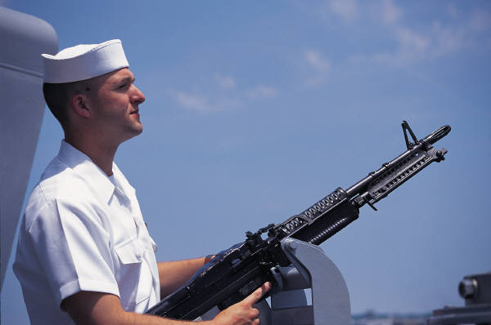
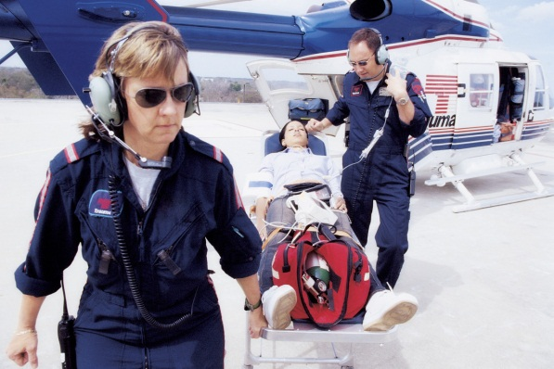
BBAA members are…
Engineers, teachers, civil servants, scientists, moms and dads, students, retired folks, day job workers, doctors, shipyard workers, office workers, military veterans, and active duty servicemen and women from all walks of life.

Slide 7
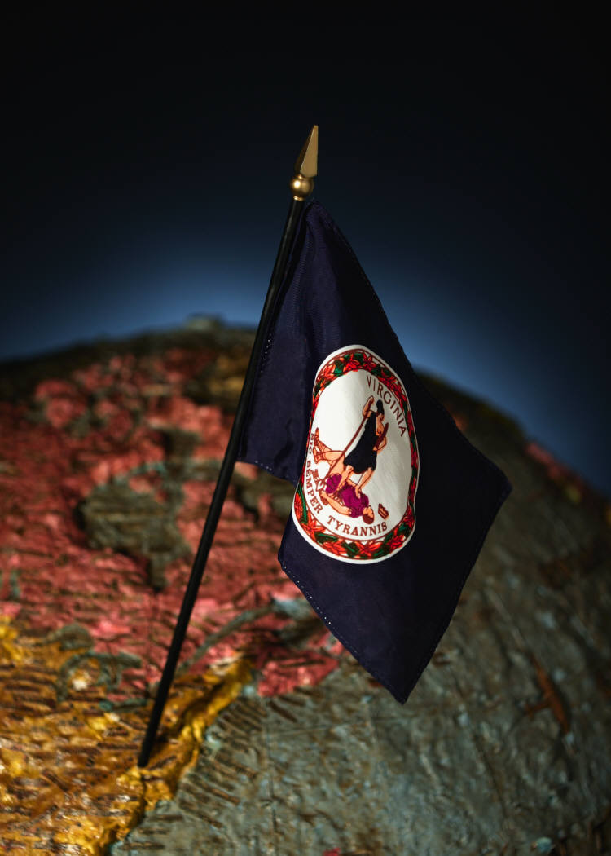
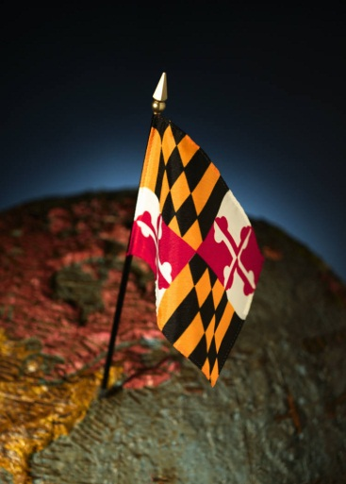
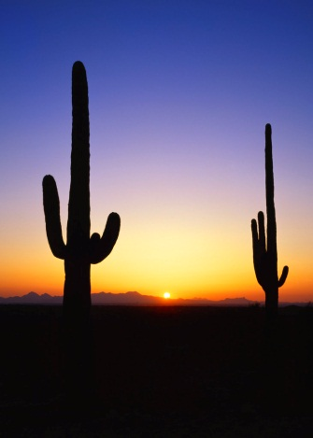
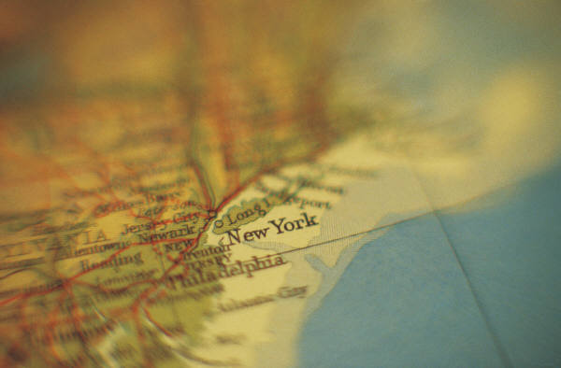
BBAA members are…
From Norfolk, Virginia Beach, Chesapeake, Portsmouth, Suffolk, Hampton, Newport News, and other parts of Virginia. We even have members in New York, Maryland, North Carolina, and Arizona!

Slide 8
BBAA has a Web site . . .
www.backbayastro.org
. . . a Yahoo technical group . . .
https://groups.yahoo.com/neo/groups/backbayastro/info
. . . a Facebook group . . .
http://www.facebook.com/groups/164636817828/
. . . a Facebook page . . .
https://www.facebook.com/BackBayAstro/
. . . and a Night Sky Network presence . . .
https://nightsky.jpl.nasa.gov/club-view.cfm?Club_ID=1591

Slide 9
What do Back Bay Amateur Astronomers do?
?

Slide 10
Astronomy “Outreach”
Garden Stars
Monthly Skywatch
Boardwalk Astronomy
Saturday “Sun” Day
Movie Nights at City Parks
National Astronomy Day
Special Requests – Scouts and others
Scholarship Awards
We also do some stargazing…
“Nightwatch” -- Saturday closest to New Moon
“Cornwatch” – two Friday nights a month
Star Parties

Slide 11
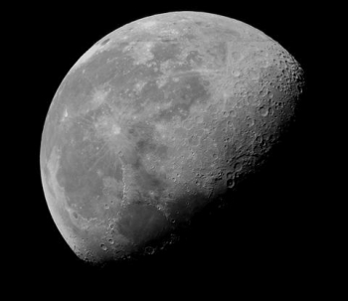
Garden Stars
at Norfolk Botanical Garden
Once or twice each quarter
Date and Time: 7:00 PM - 9:00 PM
Location: Norfolk Botanical Garden
Categories: No Categories
Come out for an evening under the stars & join the Back Bay Amateur Astronomers as they take us on a tour of the solar system. After a brief indoor presentation, step outside and observe the skies above us through high-powered telescopes. Bring a flashlight; involves some walking. (.2 CEU credit hours)

Slide 12
Monthly Skywatch at Northwest River Park in Chesapeake
One Saturday each month (weather permitting) on the Saturday nearest the
Last Quarter Moon

Slide 13
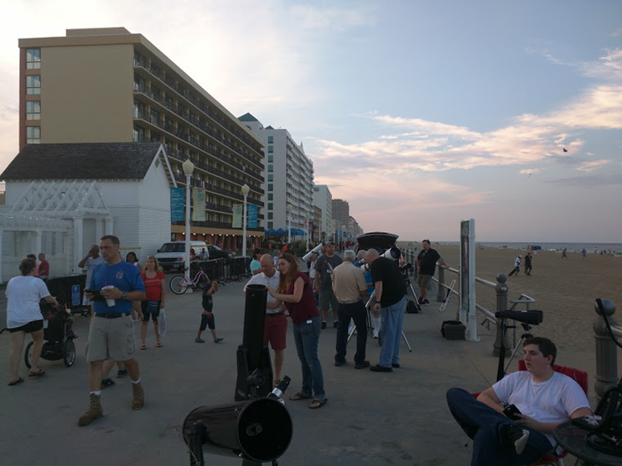
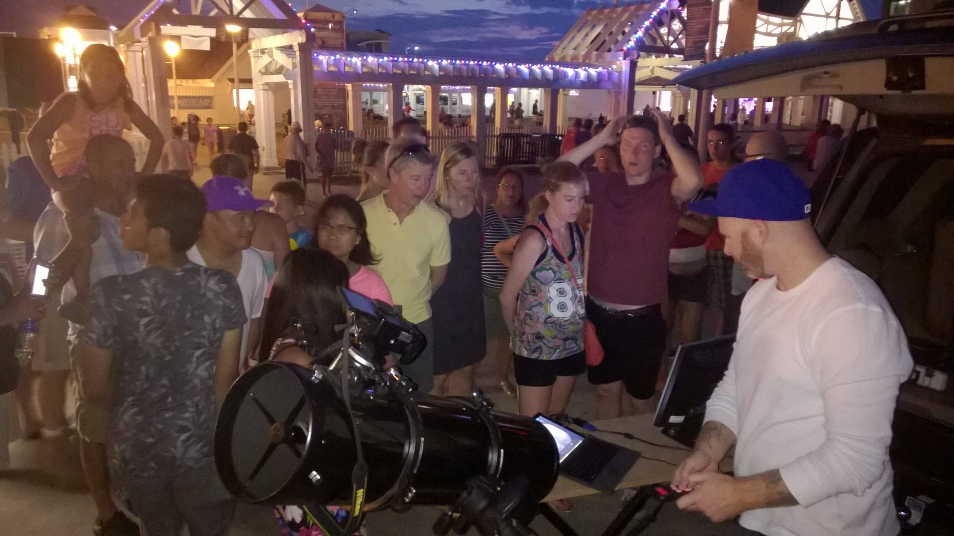
Boardwalk Astronomy in the Summer

Slide 14
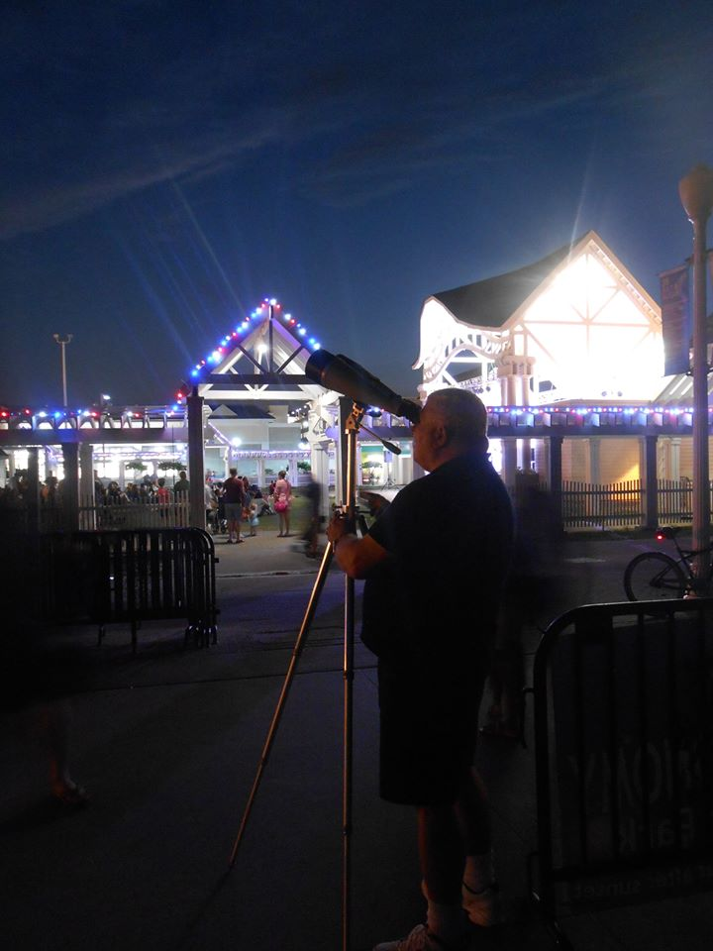
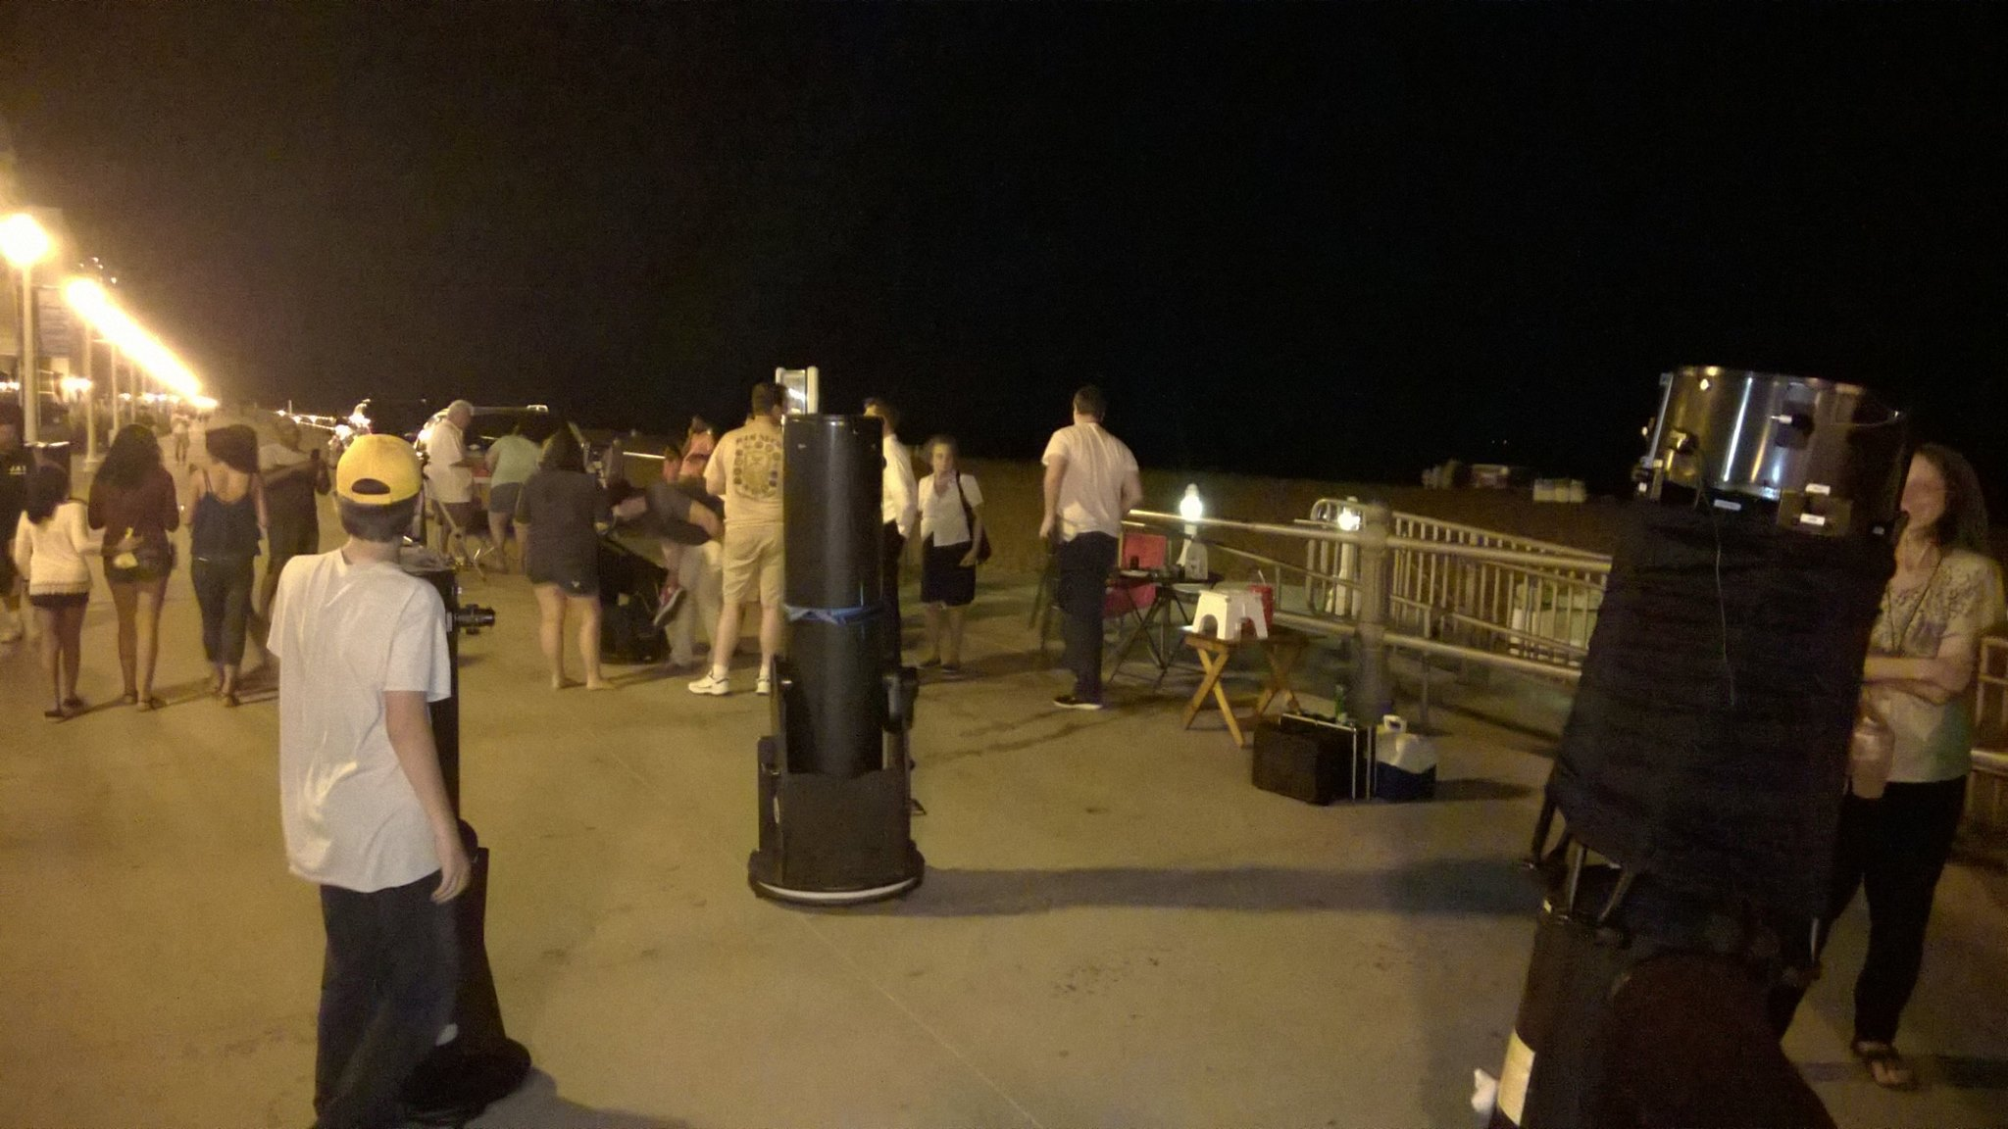
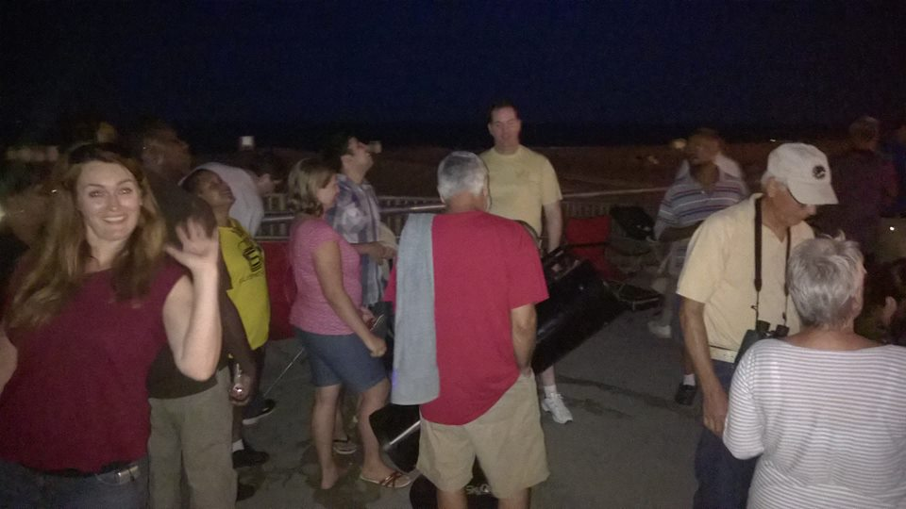
Boardwalk Astronomy one Tuesday each month from May to September
In cooperation with BeachEvents
and Mr. Chuck Dibbs, Virginia Beach City Planetarium Director.

Slide 15
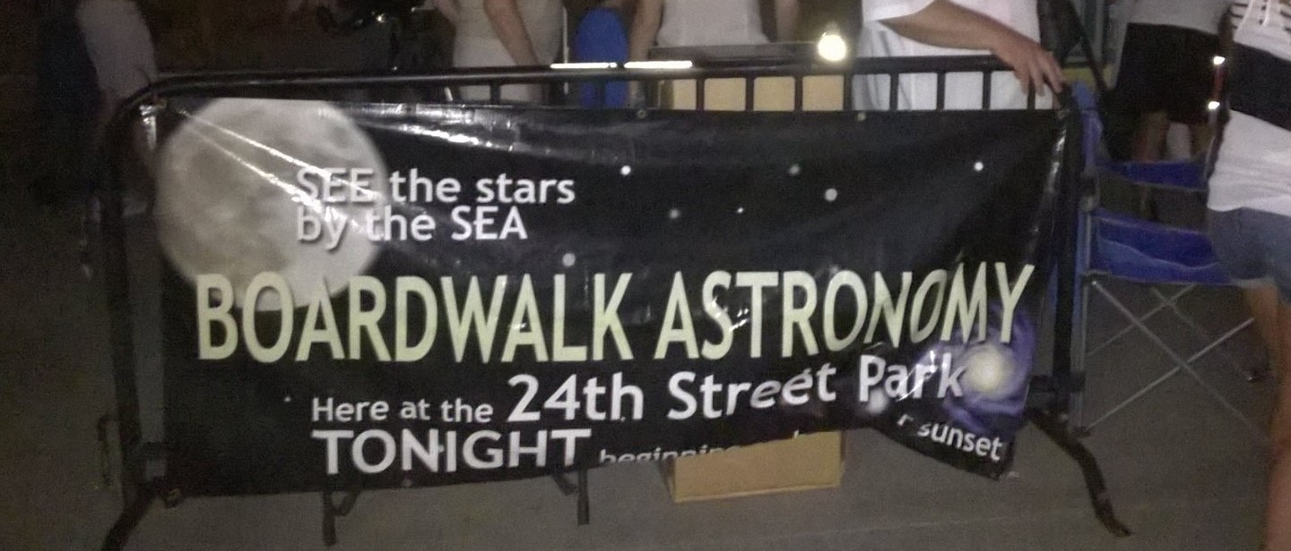
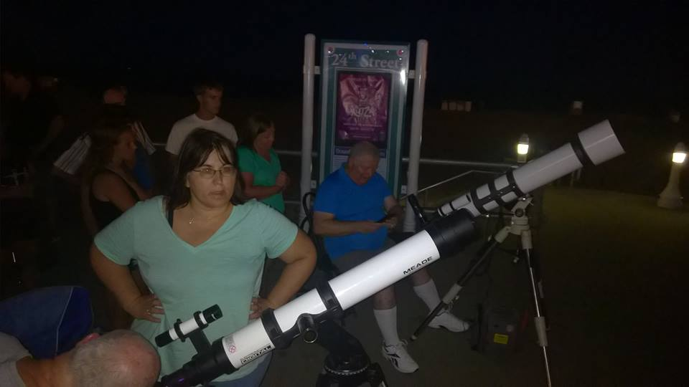
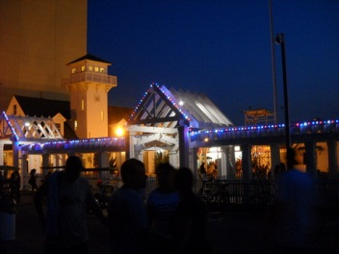
They turn out the lights for a block along the boardwalk from dusk to 11 pm
…behind the 24th Street stage

Slide 16
Scout Groups, students, and families

Slide 17
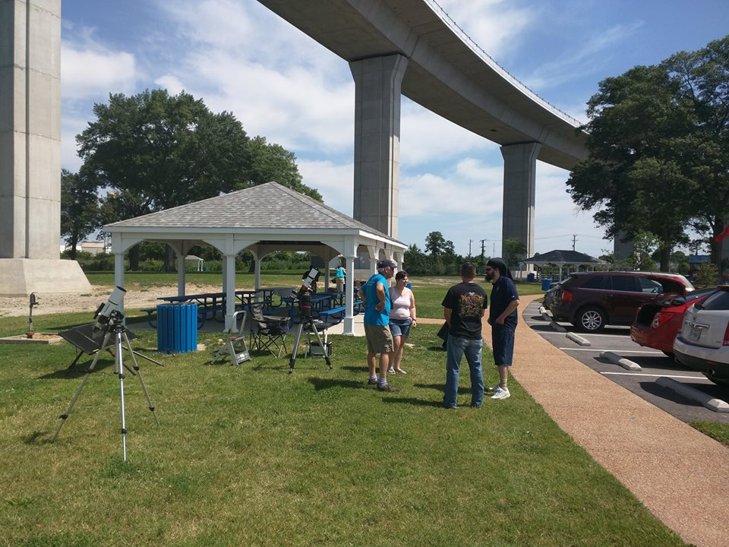
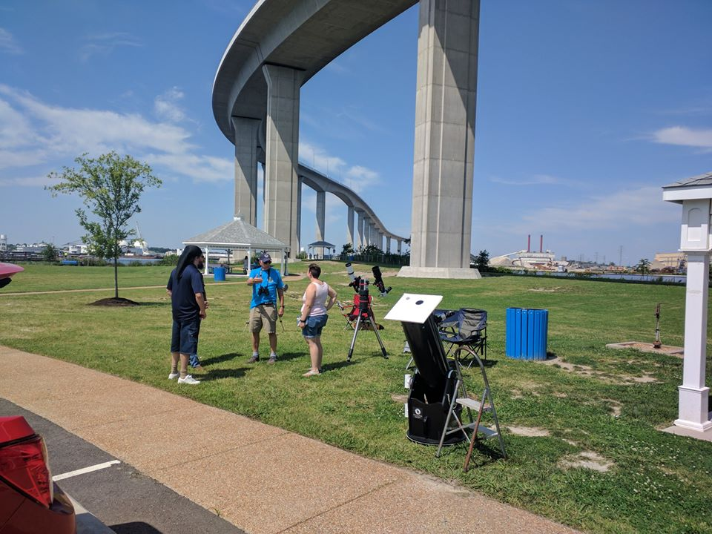
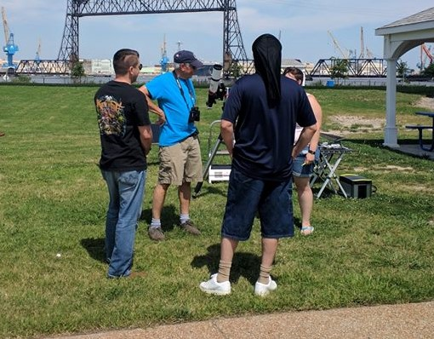
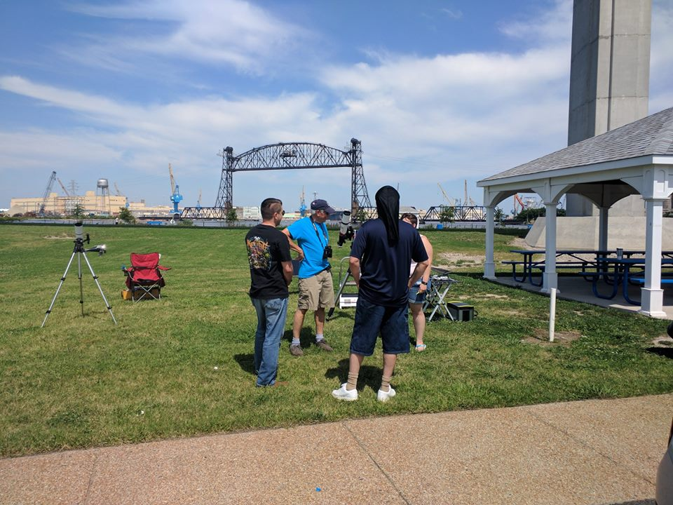
Saturday “Sun” Day
We set up solar-filtered telescopes
at Elizabeth River Park in Chesapeake

Slide 18
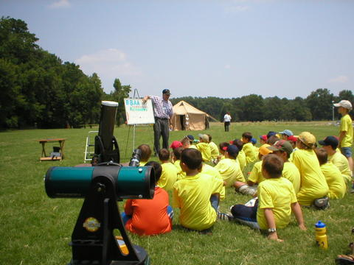
Cub Scouts . . .

Slide 19
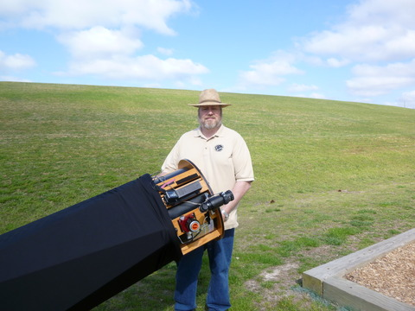
Movie Nights at city parks

Slide 20
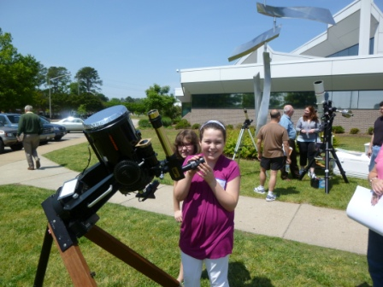
National Astronomy Day
BBAA sets up solar-filtered telescopes and a display table at Central Library in Virginia Beach every spring for National Astronomy Day
Special filters block most of the sun’s rays, making it safe to look at the sun and see sunspots and solar prominences and flares

Slide 21
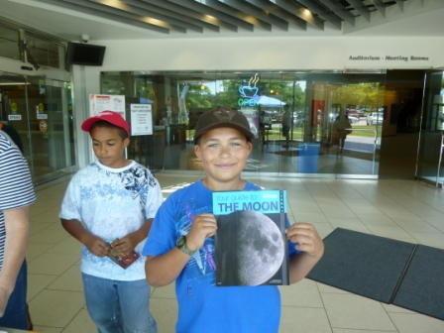
National Astronomy Day
The librarians set up a display of astronomy and space-related books inside, encouraging readers to check them out.

Slide 22
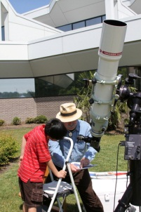
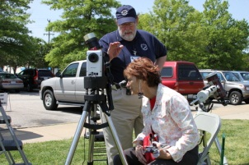
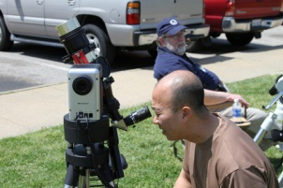
National Astronomy Day

Slide 23
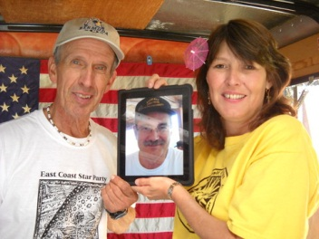
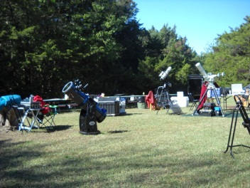
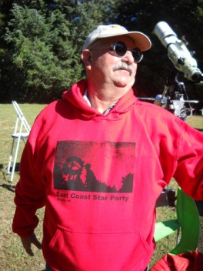
East Coast Star Party
Hosted in Spring and Fall by Kent Blackwell at Coinjock, North Carolina

Slide 24
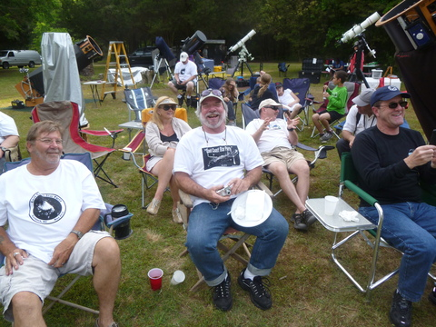
East Coast Star Party
We stay up all night, stargazing, and relax all day…then have a picnic on Saturday…
…and we eat well!

Slide 25
Annual BBAA Scholarship
Every spring, BBAA awards a scholarship to a deserving High School graduating senior.
Emily Wiggans, a recent scholarship winner
Emily with Scholarship committee:
Bill McLean, former Pres. Courtney Flonta, Emily, and Scholarship Chairman Ben Loyola

Slide 26
Ted Forte, “Master Observer”, retired and moved to Arizona.

Slide 27
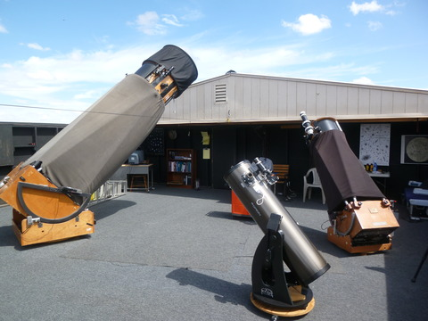
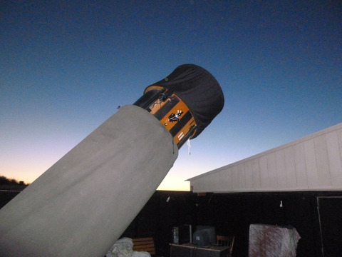
We all envy Ted the dark skies…
And his observatory and collection of large telescopes!

Slide 28
Some of our BBAA members are astrophotographers
They take pretty pictures of the celestial objects we like to look at.
This is Chuck Jagow’s picture of the Pleiades, also known as the “Seven sisters”, an open star cluster in the constellation Taurus the Bull.
Do you know what the Japanese call this star cluster?
Subaru
The Japanese name for this star cluster is . . .

Slide 29
“Astrophotography” is now called “Astroimaging”. Instead of film, they use electronic CCD memory chips
Above: Kevin Rasso’s setup. Telescope, guide scope, and digital CCD camera, all hooked up to a PC.
Right: Kevin’s wide-angle image of the “North American Nebula” in monochrome.

Slide 30
Two views of the North American Nebula
Black and White image
Color image with Hydrogen alpha filter
Both images by Kevin Rasso

Slide 31
The California Nebula (by Kevin Rasso)

Slide 32
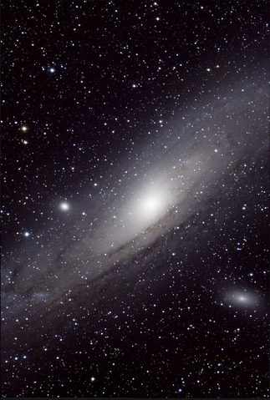
The Andromeda Galaxy
Image by Mark Ost
Image by Kevin Rasso

Slide 33
More astroimaging by Kevin Rasso
⬅ Left: The Eastern Veil Nebula
Right: Can you tell why this is called the “Christmas Tree” Cluster? ➔➔ ➔
(Cone Nebula at top of the tree.)

Slide 34
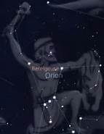
… of the familiar constellation Orion…
which is up in Winter.
(and which rises at 10 pm tonight, Oct. 21. 2017)
Here are some images copied off the Web; constellation, stick figure, and drawing….

Slide 35
Two images of the Flame Nebula and the Horsehead Nebula (b&w and color) in Orion.
This is Sigma Orionis, a multiple star
This is Alnitak, the leftmost “belt” star.

Slide 36
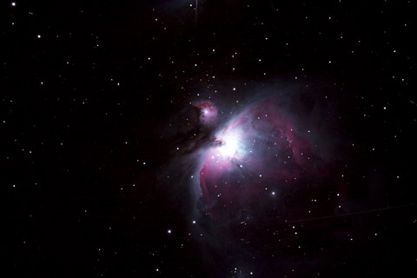
more astroimages . . .
The Great Orion Nebula
Image by Chuck Jagow

Slide 37
more astroimages . . .
The Triangulum Galaxy
Jupiter
Images by Chuck Jagow

Slide 38
Image by Chuck Jagow

Slide 39
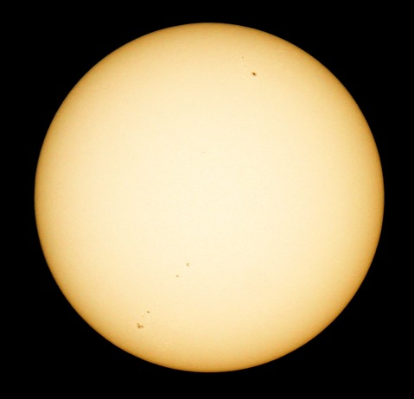
The Sun. . . with some Sunspots
Image by Chuck Jagow

Slide 40
Lunar Eclipse 27 Sep 2015

Slide 41
Solar Eclipse 21 Aug 2017
Image by Kent Blackwell

Slide 42
Who are the Back Bay Amateur Astronomers?
NOW YOU KNOW WHO WE ARE AND WHAT WE DO!
AND WE LOVE
WHAT WE DO!
www.backbayastro.org

