Slide 1
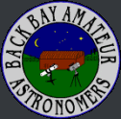
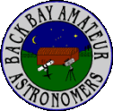
GardenStars – August 13th, 2005
Welcome to GardenStars
An Evening Under the Stars
Presented by
The Norfolk Botanical Garden
And
Back Bay Amateur Astronomers

Slide 2
Tonight’s Agenda
Introduction
Astronomy Overview
Types of Telescopes
Our Solar System
Deep Space
  Galaxies
  Nebulae
    Planetary
    Reflection
    Emission
Current Space Events
Questions
Viewing Outside

Slide 3
Introductions
Back Bay Amateur Astronomers
  Steve Hamilton
  Kevin and Barb Weiner

Slide 4
Introductions
Please refrain from the use of flashlights and other white light sources

Slide 5

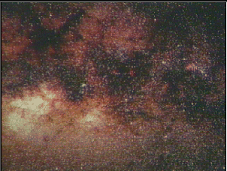
Astronomy Overview
Definition
Astronomy, which etymologically means "law of the stars," is a science involving the observation and explanation of events occurring outside Earth and its atmosphere. It studies the origins, evolution, physical and chemical properties of objects that can be observed in the sky (and are outside the earth), as well as the processes involving them
Norfolk Botanical Garden / Back Bay Amateur Astronomers

Slide 6
Astronomy Overview
Definition
Amateur
Astronomy
Ordinary People with a love of the heavens
Viewing Planets and Deep Space Objects
Taking images of Astronomical objects
Contributing to Science thru discovery and study
Sharing their experiences with others
Norfolk Botanical Garden / Back Bay Amateur Astronomers

Slide 7
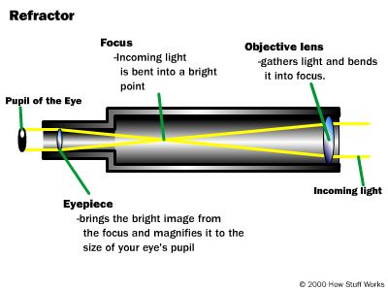
Telescopes – Types
Refractors
Simplest type of Telescope
Most Commonly thought of when you think of a telescope
Light is Refracted – No Mirrors, Glass only
Norfolk Botanical Garden / Back Bay Amateur Astronomers

Slide 8
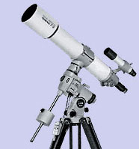
Telescopes – Types
Refractors
Simplest type of Telescope
Most Commonly thought of when you think of a telescope
Light is Refracted – No Mirrors, Glass only
Norfolk Botanical Garden / Back Bay Amateur Astronomers

Slide 9
Telescopes – Types
Light is bent with Mirrors – Primary and Secondary
Most “Bang for the Buck” generally
Largest Telescopes in the world are Reflectors
Refractors
Reflectors
Norfolk Botanical Garden / Back Bay Amateur Astronomers

Slide 10
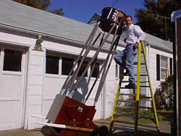
Telescopes – Types
Light is bent with Mirrors – Primary and Secondary
Most “Bang for the Buck” generally
Largest Telescopes in the world are Reflectors
Refractors
Reflectors
Norfolk Botanical Garden / Back Bay Amateur Astronomers

Slide 11
Telescopes – Types
Refractors
Multiple Mirrors
Long Focal Length in a compact design
Most Versatile of the three major types
Reflectors
Catadioptric
(Compound)
Norfolk Botanical Garden / Back Bay Amateur Astronomers

Slide 12
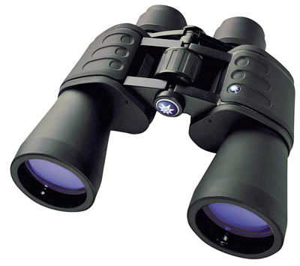
Telescopes – Types
Light weight, easy to carry
Wide Views of large objects
Helpful for locating dimmer objects
Excellent Entry into Astronomy
Refractors
Reflectors
Catadioptric
(Compound)
Binoculars
Norfolk Botanical Garden / Back Bay Amateur Astronomers

Slide 13
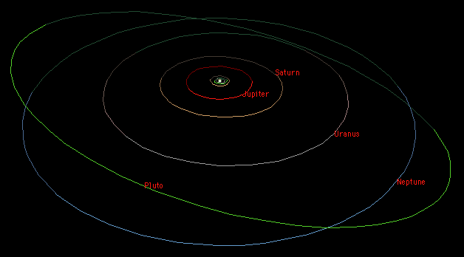
Our Solar System
Overview
The Sun
9 (almost 10) Planets
Comets
Asteroids
Norfolk Botanical Garden / Back Bay Amateur Astronomers

Slide 14
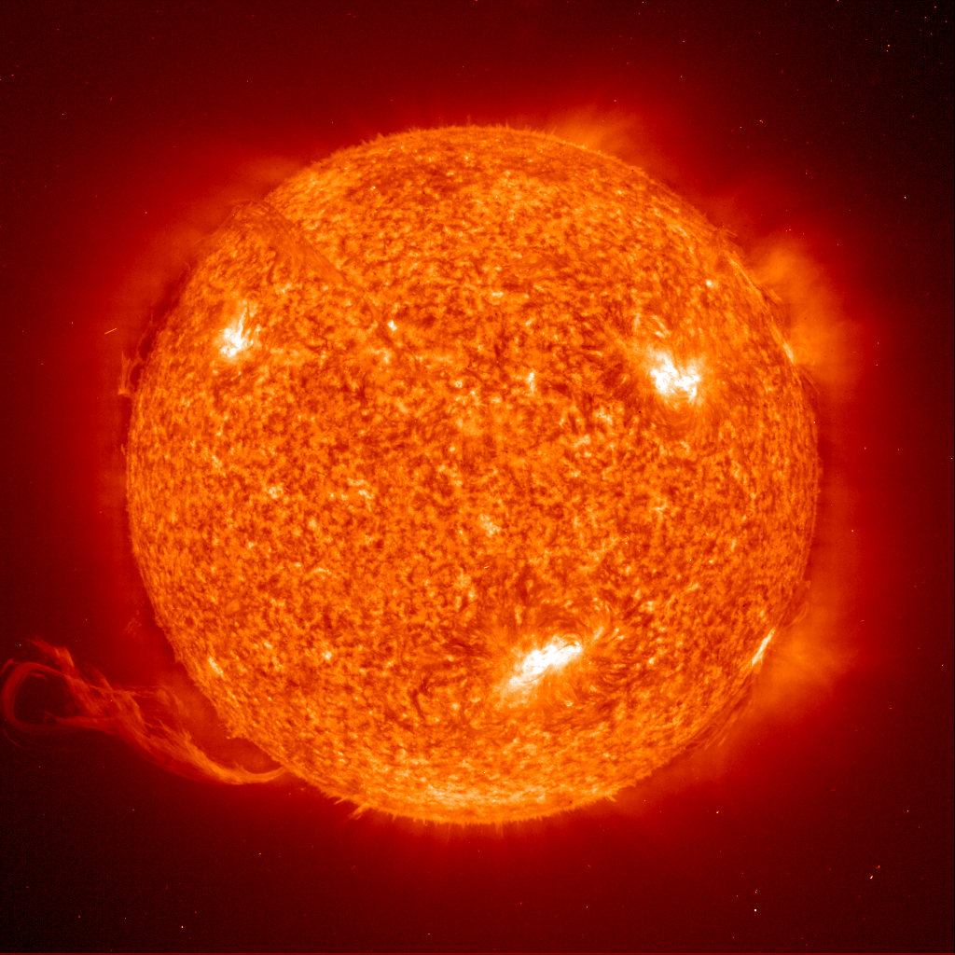
Our Solar System
Overview
1,390,000 Km diameter
Apx 70% Hydrogen
Medium Size Star
The Sun (Our
Local Star)
Norfolk Botanical Garden / Back Bay Amateur Astronomers

Slide 15
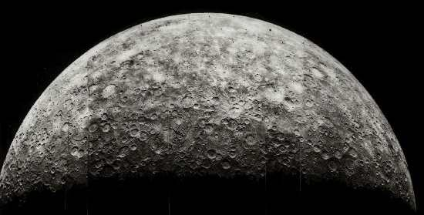
Our Solar System
Overview
4,480 Km diameter
Average Temperature 167 C
Almost no Atmosphere
The Sun (Our
Local Star)
Mercury
Norfolk Botanical Garden / Back Bay Amateur Astronomers

Slide 16
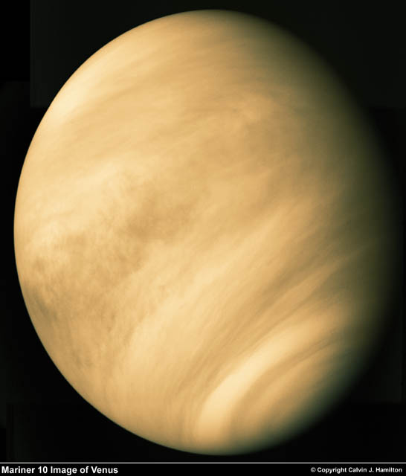
Our Solar System
Overview
12,103 Km diameter
Our nearest neighbor
Sulphuric Atmosphere
The Sun (Our
Local Star)
Mercury
Venus
Norfolk Botanical Garden / Back Bay Amateur Astronomers

Slide 17
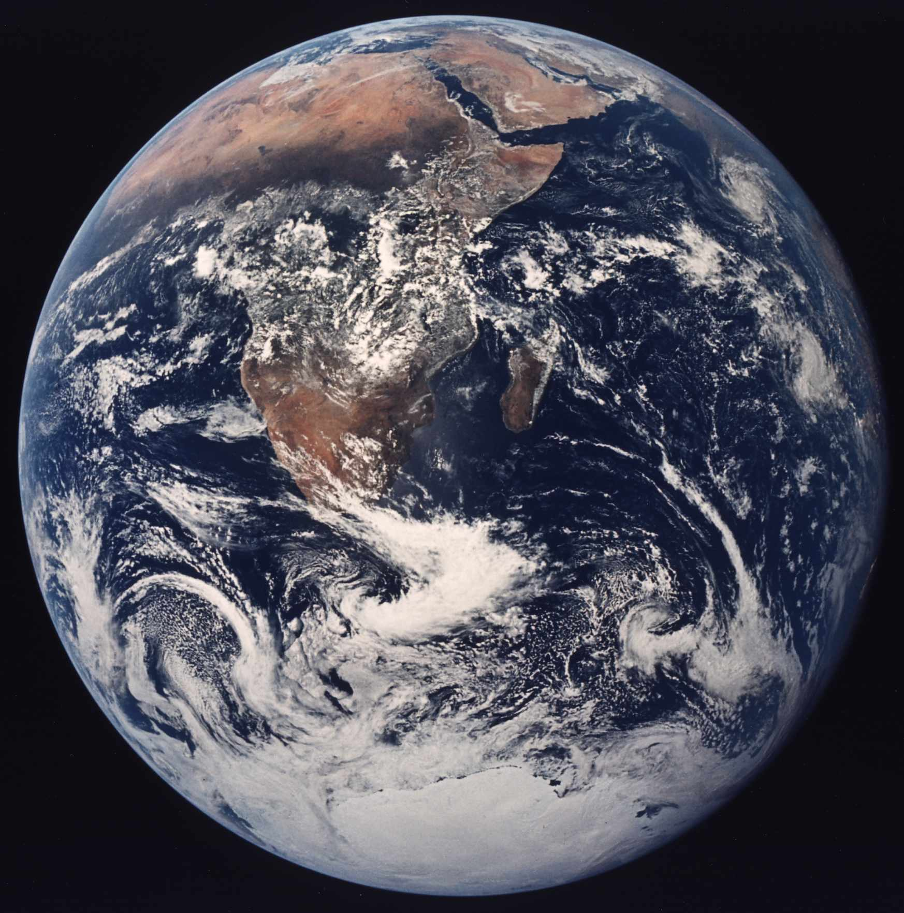
Our Solar System
Overview
12,756 Km diameter
Our Home
Only Planet with life that we know of
The Sun (Our
Local Star)
Mercury
Venus
Earth
Norfolk Botanical Garden / Back Bay Amateur Astronomers

Slide 18
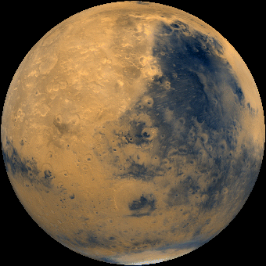
Our Solar System
Overview
6,794 Km diameter
-133C – 80C Temperature
Possible water (frozen or beneath the surface)
The Sun (Our
Local Star)
Mercury
Venus
Earth
Mars
Norfolk Botanical Garden / Back Bay Amateur Astronomers

Slide 19
Our Solar System
Overview
142,984 Km diameter
Gas Giant
63 + Moons
Great Red Spot
The Sun (Our
Local Star)
Mercury
Venus
Earth
Mars
Jupiter
Norfolk Botanical Garden / Back Bay Amateur Astronomers

Slide 20
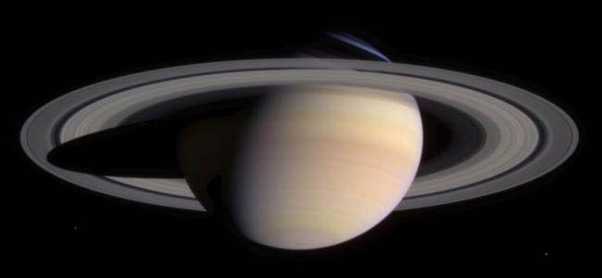
Our Solar System
Overview
120,536 Km diameter
Gas Planet
Only planet with rings that can be easily seen from earth
The Sun (Our
Local Star)
Mercury
Venus
Earth
Mars
Jupiter
Saturn
Norfolk Botanical Garden / Back Bay Amateur Astronomers

Slide 21
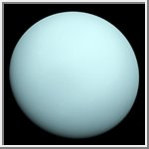
Our Solar System
Overview
51,118 Km diameter
Gas Planet
Axis is sideways
The Sun (Our
Local Star)
Mercury
Venus
Earth
Mars
Jupiter
Saturn
Uranus
Norfolk Botanical Garden / Back Bay Amateur Astronomers

Slide 22
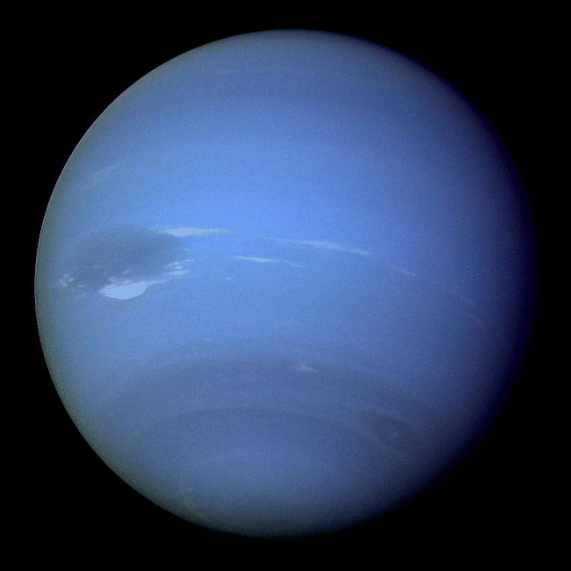
Our Solar System
Overview
49,532 Km diameter
Gas Planet – Possible Core
Also has a “Blue Spot”
The Sun (Our
Local Star)
Mercury
Venus
Earth
Mars
Jupiter
Saturn
Uranus
Neptune
Norfolk Botanical Garden / Back Bay Amateur Astronomers

Slide 23
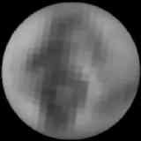
Our Solar System
Overview
2,274 Km diameter
Smallest Planet
Planet to Moon ratio similar to Earth
The Sun (Our
Local Star)
Mercury
Venus
Earth
Mars
Jupiter
Saturn
Uranus
Neptune
Pluto
Norfolk Botanical Garden / Back Bay Amateur Astronomers

Slide 24
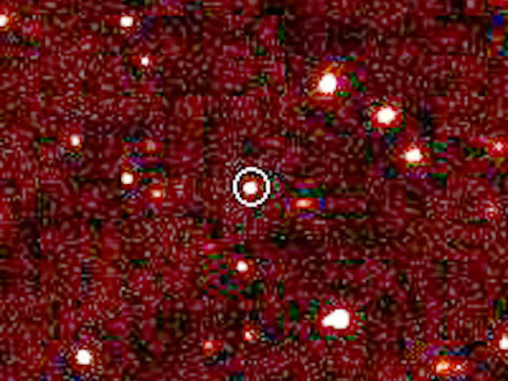
Our Solar System
Overview
Unknown - diameter
Larger than Pluto
nearly 100 times the Earth-Sun distance -- over twice the average Pluto-Sun distance
The Sun (Our
Local Star)
Mercury
Venus
Earth
Mars
Jupiter
Saturn
Uranus
Neptune
Pluto
#10
Norfolk Botanical Garden / Back Bay Amateur Astronomers

Slide 25
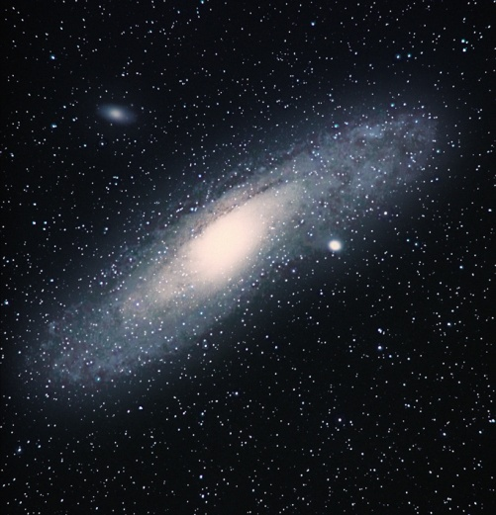
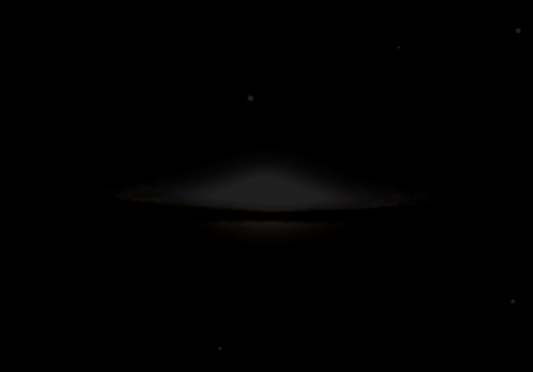
Deep Space
“Island Universes”
Billions of stars and possible Planets
Billions of Galaxies
Milky Way is Our Galaxy
Galaxies
Norfolk Botanical Garden / Back Bay Amateur Astronomers

Slide 26
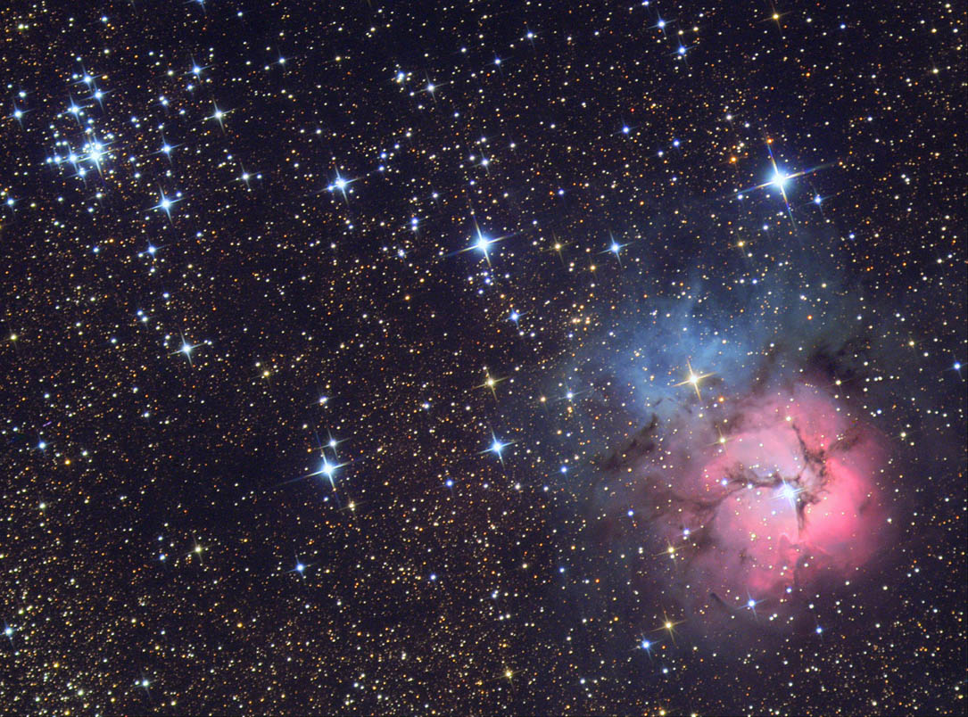
Deep Space
Galaxies
Gas Clouds
Emission, Reflection, Planetary
All we can see are within our Galaxy
Nebulae
Norfolk Botanical Garden / Back Bay Amateur Astronomers

Slide 27
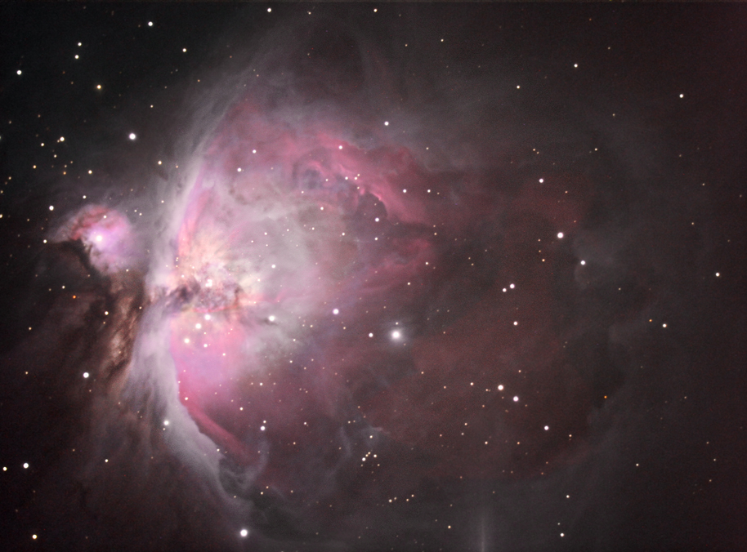
Deep Space
Galaxies
Gas Clouds
Star Nurseries
Light is emitted from within the cloud by new stars
Nebulae
  Emission
Norfolk Botanical Garden / Back Bay Amateur Astronomers

Slide 28
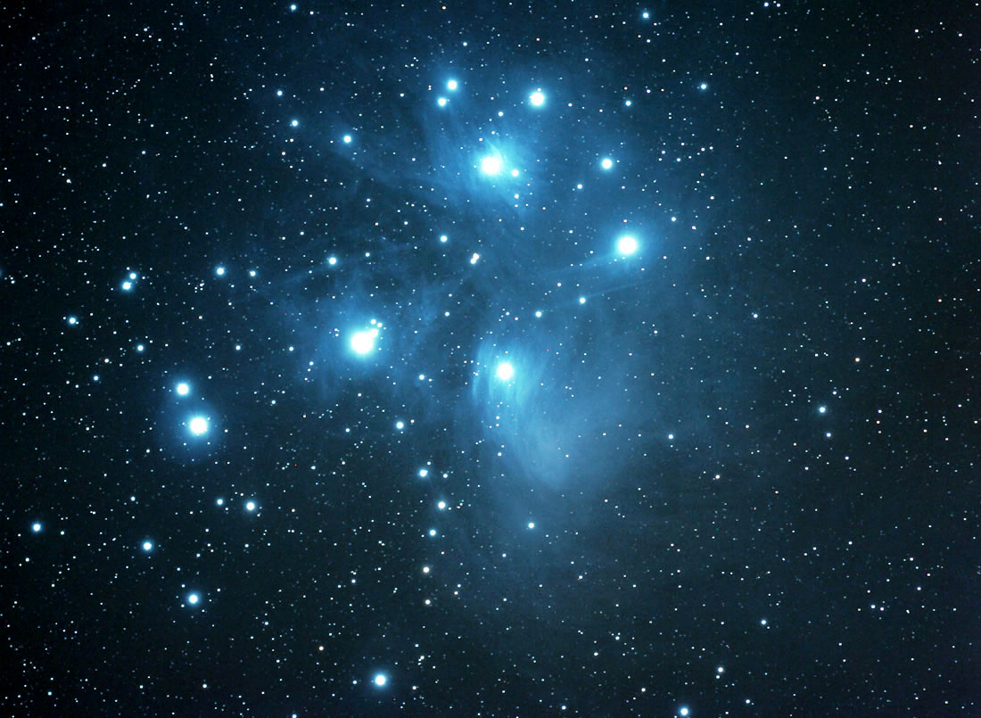
Deep Space
Galaxies
Light reflects from Nearby Stars
Gas is probably left over from previously formed stars or exploded stars
Nebulae
  Emission
  Reflection
Norfolk Botanical Garden / Back Bay Amateur Astronomers

Slide 29
Deep Space
Exploded Stars - Nova’s
Gas forms a ring around the original Star
Not a planet, early astronomers though the center was a planet
Galaxies
Nebulae
  Emission
  Reflection
  Planetary
Norfolk Botanical Garden / Back Bay Amateur Astronomers

Slide 30
Current Events in Astronomy
Jupiter Venus are low in the Sky at Sunset
Moon Phase – Just approaching first Quarter
Mars rises just before midnight and will be high in the evening sky in the fall.

Slide 31
Questions
Questions
Thank You
Please Join us at the scopes
http://www.BackBayAstro.org

