Slide 1


GardenStars – April 29, 2006
Welcome to GardenStars
An Evening Under the Stars
Presented by
The Norfolk Botanical Garden
And
Back Bay Amateur Astronomers

Slide 2


The Back Bay Amateur Astronomers
Bringing Astronomy to the People of Hampton Roads
The Back Bay Amateur Astronomers
PO Box 9877
Virginia Beach, VA 23450

Slide 3
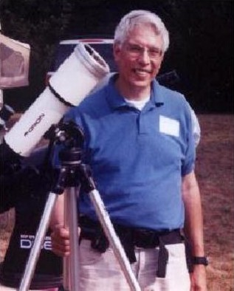

Your “Solar System Ambassador”
George Reynolds

Slide 4

Introductions
Back Bay Amateur Astronomers
  George Reynolds
  Kevin and Barb Weiner
  Matt McLaughlin
  Chuck Rippel
  Chuck Jagow

Slide 5
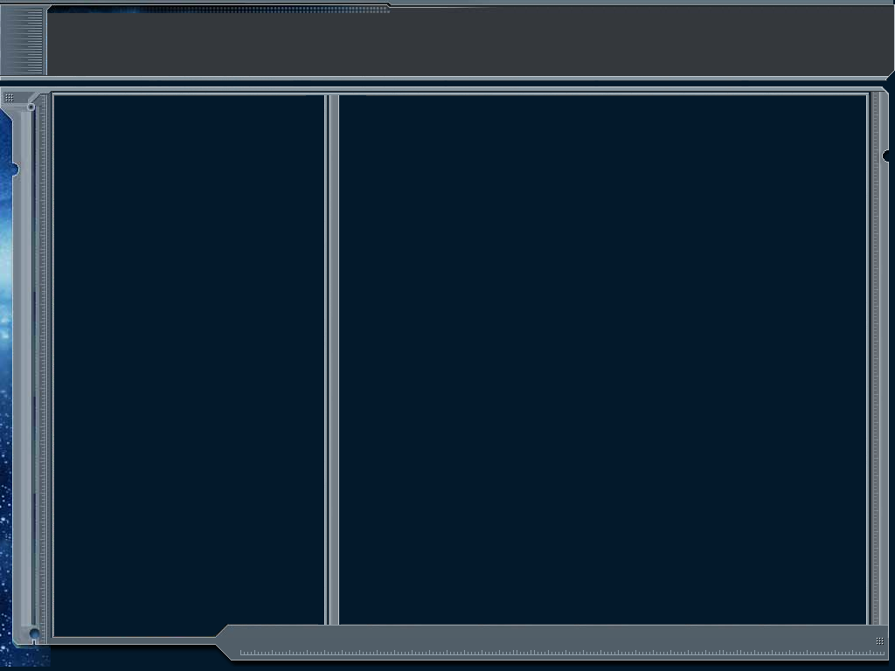
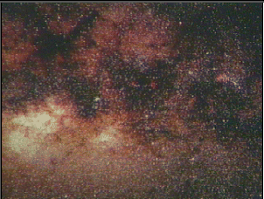
Amateur Astronomers...
We are ordinary people with a love of the heavens. We contribute to science thru discovery, study and by sharing information with others.
Norfolk Botanical Garden / Back Bay Amateur Astronomers

Slide 6


Science is BORING!

Slide 7
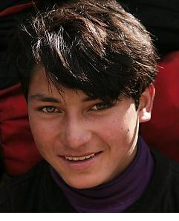
Science is FUN!!

Slide 8
Out of this World Fun for Kids
A kid-friendly (and parent-friendly) Web site by NASA
FUN learning about Space and Exploration!
http://www.nasa.gov/audience/forkids/kidsclub/flash/index.html

Slide 9
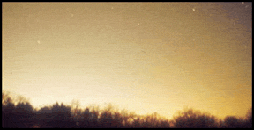
Why can’t I see any stars?
Sky Glow!
Another term for
Light Pollution!

Slide 10
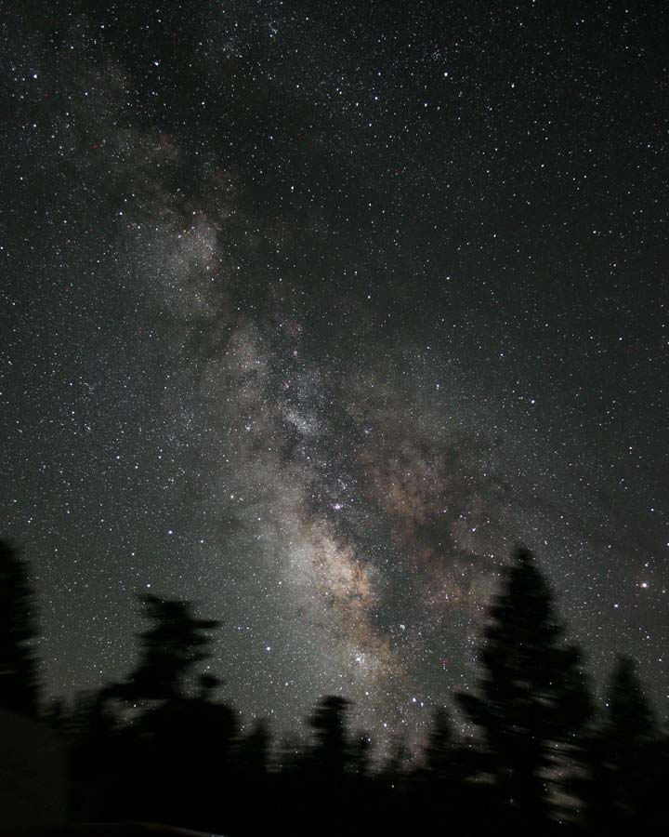
James Jacobson
Here’s what it SHOULD look like!

Slide 11



HOW can I see in a dark sky?
The unaided eye (“Naked eye”)
Binoculars
Telescopes

Slide 12
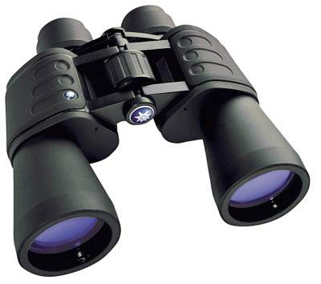
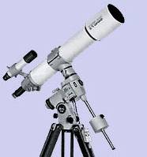
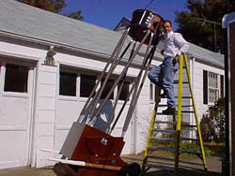
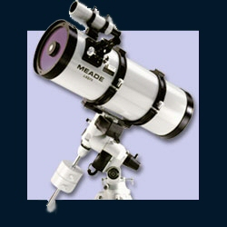
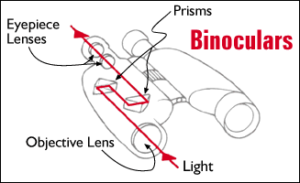
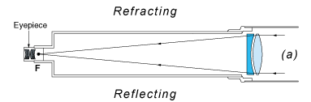
Telescopes – Types
Eyes, Binoculars, Refractors, Reflectors, Catadioptric
Norfolk Botanical Garden / Back Bay Amateur Astronomers

Slide 13
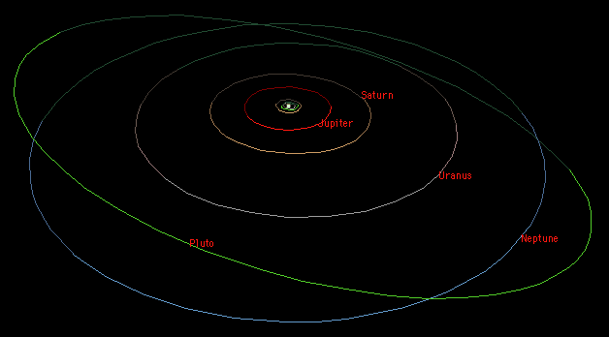
Our Solar System
Overview
The Sun
10 Planets
Comets
Asteroids
Norfolk Botanical Garden / Back Bay Amateur Astronomers

Slide 14
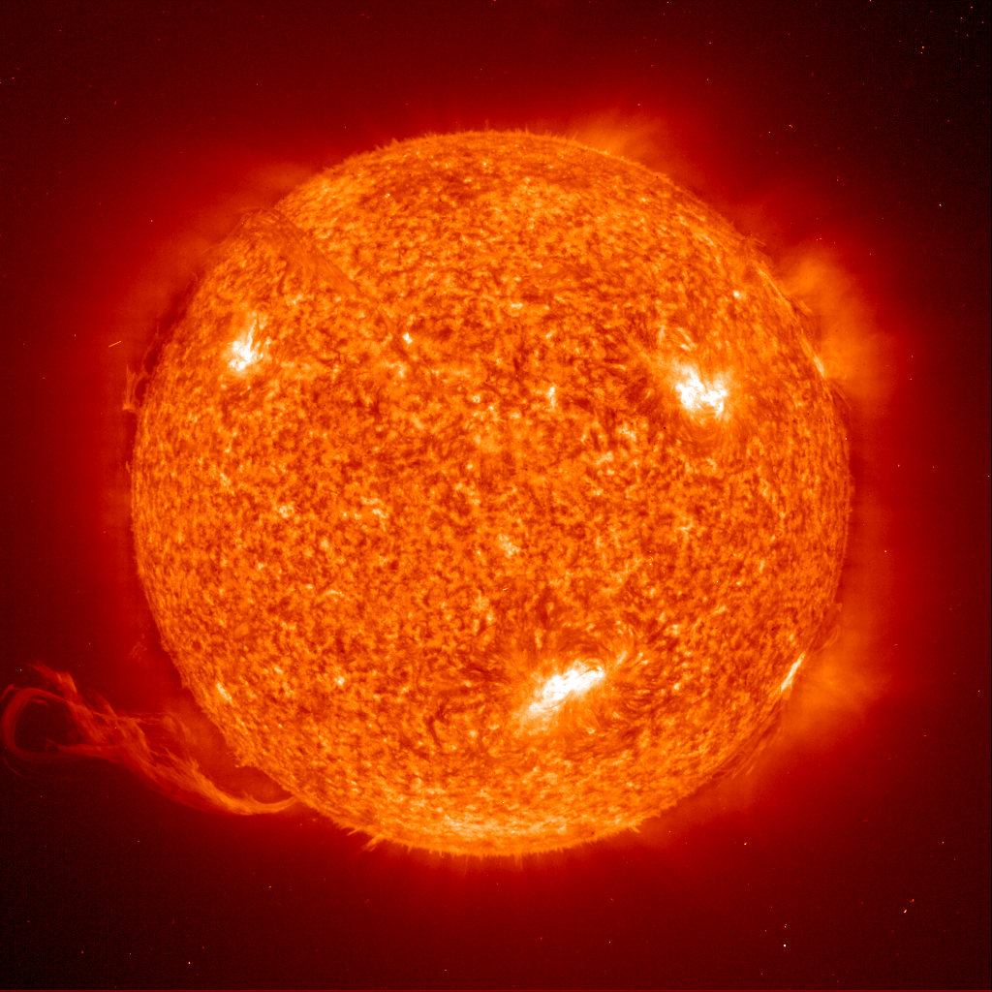
Our Solar System
1,390,000 Km diameter
Apx 70% Hydrogen
Medium Size Star
The Sun
(Our Star)
Norfolk Botanical Garden / Back Bay Amateur Astronomers

Slide 15
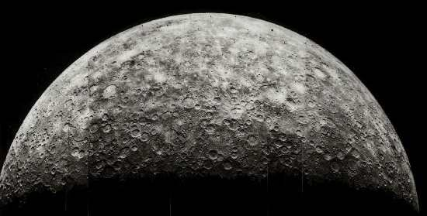
Our Solar System
4,480 Km diameter
Average Temperature 167 C
Almost no Atmosphere
The Sun
(Our Star)
Mercury
Norfolk Botanical Garden / Back Bay Amateur Astronomers

Slide 16
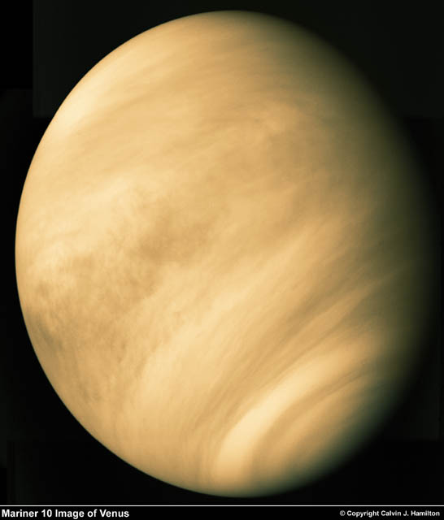
Our Solar System
12,103 Km diameter
Our nearest neighbor
Sulphuric Atmosphere
The Sun
(Our Star)
Mercury
Venus
Norfolk Botanical Garden / Back Bay Amateur Astronomers

Slide 17
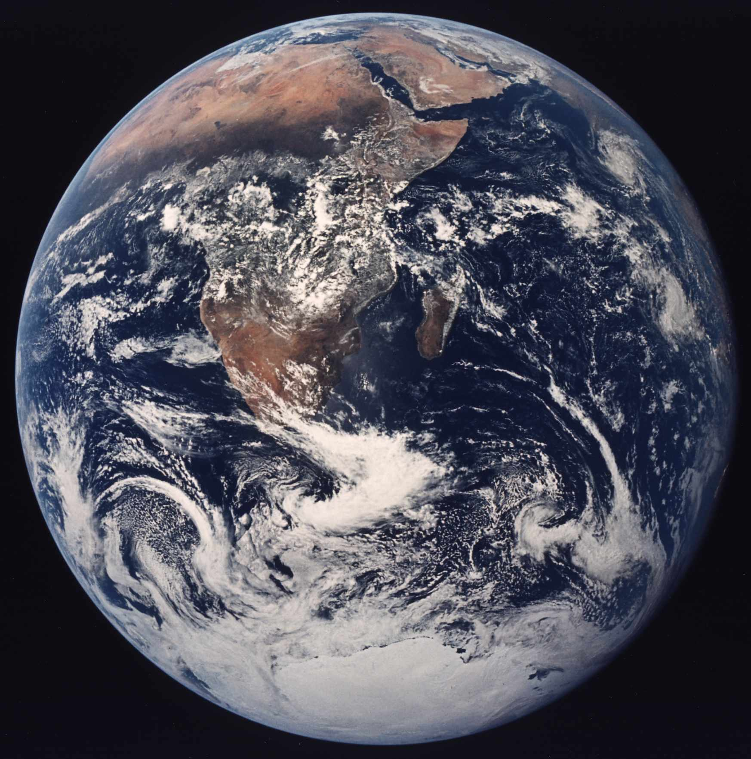
Our Solar System
12,756 Km diameter
Our Home
Only Planet with life that we know of
The Sun
(Our Star)
Mercury
Venus
Earth
Norfolk Botanical Garden / Back Bay Amateur Astronomers

Slide 18
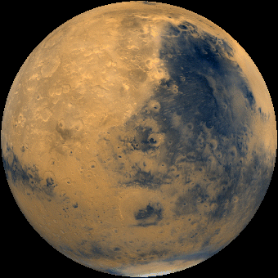
Our Solar System
6,794 Km diameter
-133C – 80C Temperature
Possible water (frozen or beneath the surface)
The Sun
(Our Star)
Mercury
Venus
Earth
Mars
Norfolk Botanical Garden / Back Bay Amateur Astronomers

Slide 19
Our Solar System
142,984 Km diameter
Gas Giant
63 + Moons
Great Red Spot
The Sun
(Our Star)
Mercury
Venus
Earth
Mars
Jupiter
Norfolk Botanical Garden / Back Bay Amateur Astronomers

Slide 20
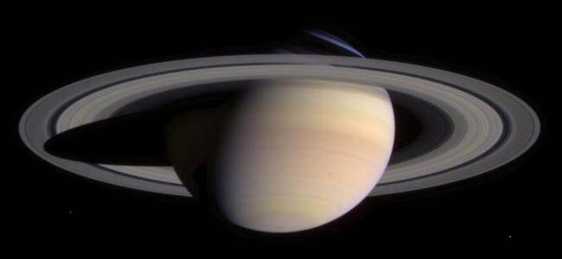
Our Solar System
120,536 Km diameter
Gas Planet
Only planet with rings that can be easily seen from earth
The Sun
(Our Star)
Mercury
Venus
Earth
Mars
Jupiter
Saturn
Norfolk Botanical Garden / Back Bay Amateur Astronomers

Slide 21
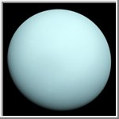
Our Solar System
51,118 Km diameter
Gas Planet
Axis is sideways
The Sun
(Our Star)
Mercury
Venus
Earth
Mars
Jupiter
Saturn
Uranus
Norfolk Botanical Garden / Back Bay Amateur Astronomers

Slide 22
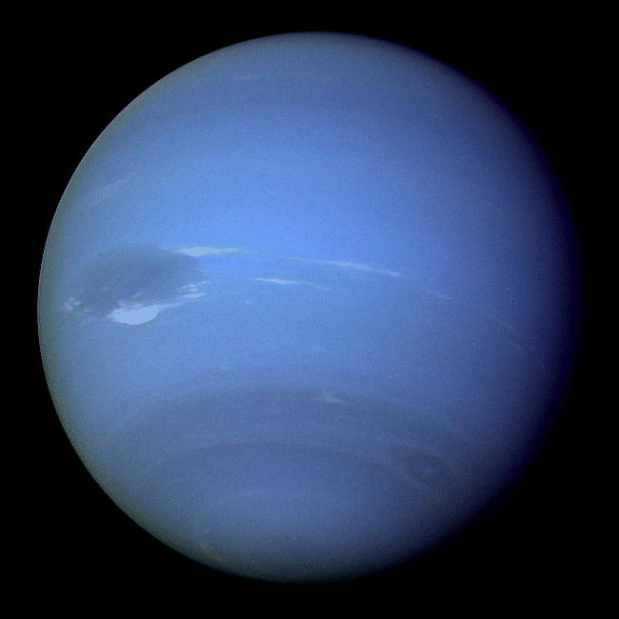
Our Solar System
49,532 Km diameter
Gas Planet – Possible Core
Also has a “Blue Spot”
The Sun
(Our Star)
Mercury
Venus
Earth
Mars
Jupiter
Saturn
Uranus
Neptune
Norfolk Botanical Garden / Back Bay Amateur Astronomers

Slide 23
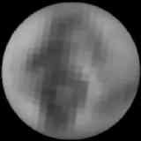
Our Solar System
2,274 Km diameter
Smallest Planet
Planet to Moon ratio similar to Earth
The Sun
(Our Star)
Mercury
Venus
Earth
Mars
Jupiter
Saturn
Uranus
Neptune
Pluto
Norfolk Botanical Garden / Back Bay Amateur Astronomers

Slide 24
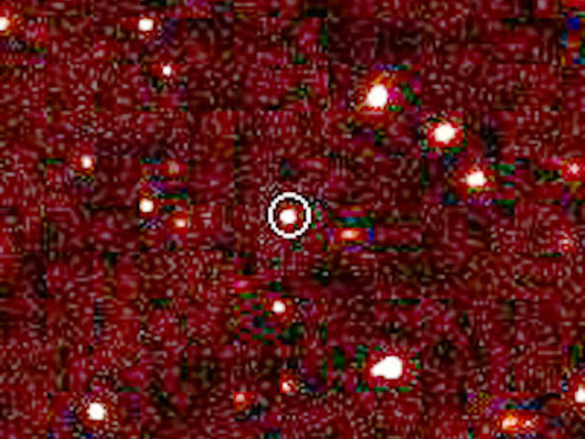
Our Solar System
Unknown - diameter
Larger than Pluto
nearly 100 times the Earth-Sun distance -- over twice the average Pluto-Sun distance
The Sun
(Our Star)
Mercury
Venus
Earth
Mars
Jupiter
Saturn
Uranus
Neptune
Pluto
2003 UB313
Norfolk Botanical Garden / Back Bay Amateur Astronomers

Slide 25
Space Exploration . . .
The Final Frontier

Slide 26
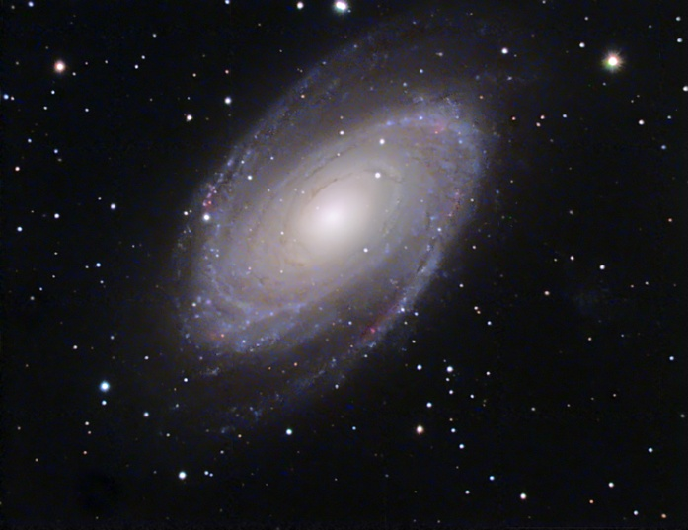
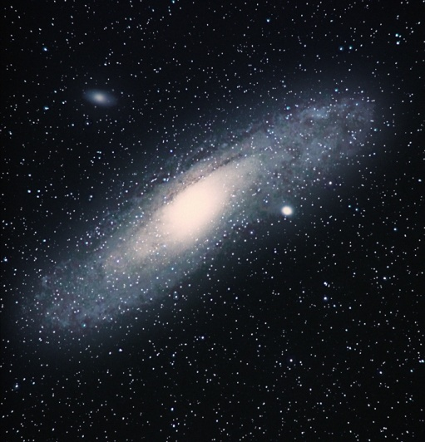
Deep Space
“Island Universes”
Billions of stars and possible Planets
Billions of Galaxies
Milky Way is Our Galaxy
Galaxies
Norfolk Botanical Garden / Back Bay Amateur Astronomers

Slide 27
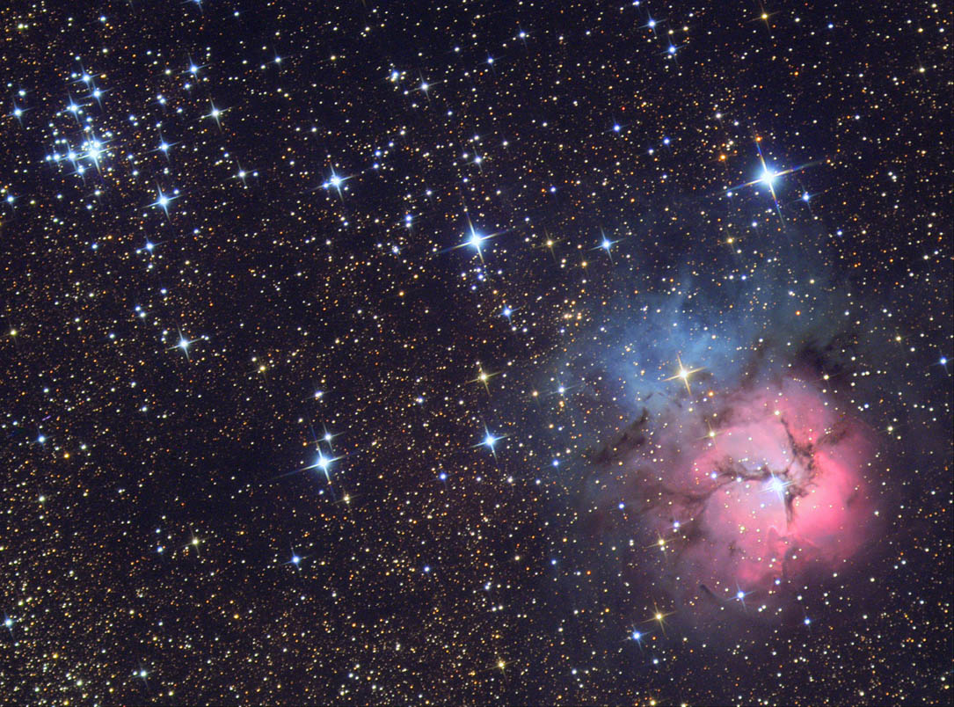
Deep Space
Galaxies
Gas Clouds
Emission, Reflection, Planetary
All we can see are within our Galaxy
Nebulae
Norfolk Botanical Garden / Back Bay Amateur Astronomers

Slide 28
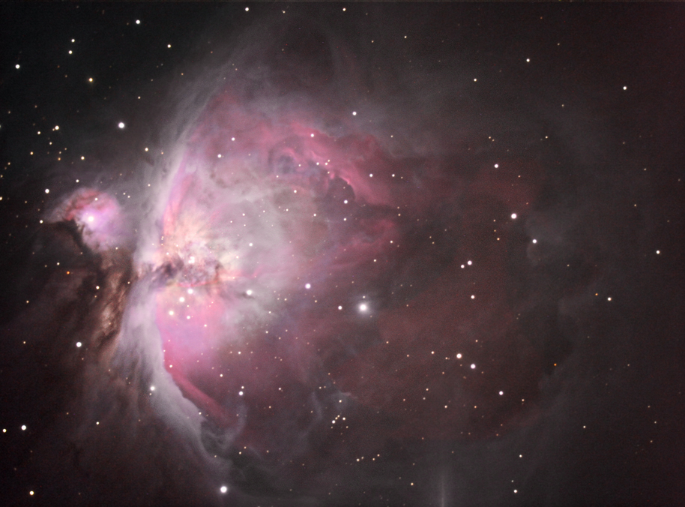
Deep Space
Galaxies
Gas Clouds
Star Nurseries
Light is emitted from within the cloud by new stars
Nebulae
  Emission
Norfolk Botanical Garden / Back Bay Amateur Astronomers

Slide 29
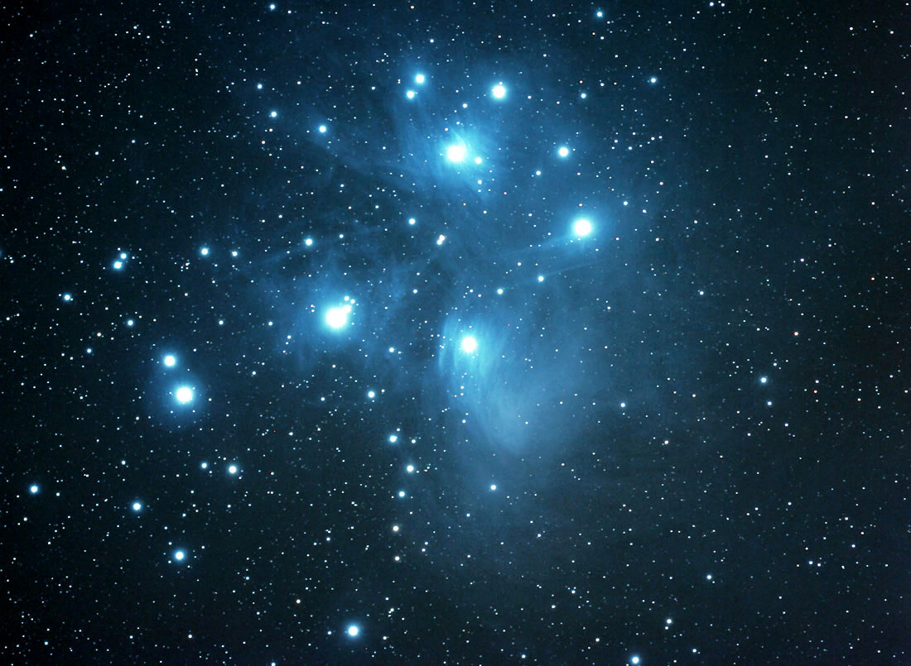
Deep Space
Galaxies
Light reflects from Nearby Stars
Gas is probably left over from previously formed stars or exploded stars
Nebulae
  Emission
  Reflection
Norfolk Botanical Garden / Back Bay Amateur Astronomers

Slide 30
Deep Space
Galaxies
Exploded Stars - Novas (Novae)
Gas forms a ring around the original Star
Not a planet, early astronomers thought the center was a planet
Nebulae
  Emission
  Reflection
  Planetary
Norfolk Botanical Garden / Back Bay Amateur Astronomers

Slide 31
Current Events in Astronomy
TONIGHT . . .
Saturn – In Cancer near M44, high in the WSW
Mars – In Gemini towards the West
Moon – In Taurus low in the WNW, a Waxing Crescent it sets at 10:27 p.m.
Jupiter – Rises at 8:06 p.m., low in the SE
Open Cluster “Coma Berenices” – In the East
Open Cluster M44 “The Beehive” - In Cancer the Crab
Double Cluster in Perseus – In the NW
M3 Globular Cluster – In the East
Double stars Mizar & Alcor – In the Big Dipper
Double Star Algieba – In Leo the Lion
IRIDIUM 47 – Low in the North – 9:28:14 p.m.
Comet 73P Schwassmann-Wachmann – Low in the East in the constellation Hercules

Slide 32
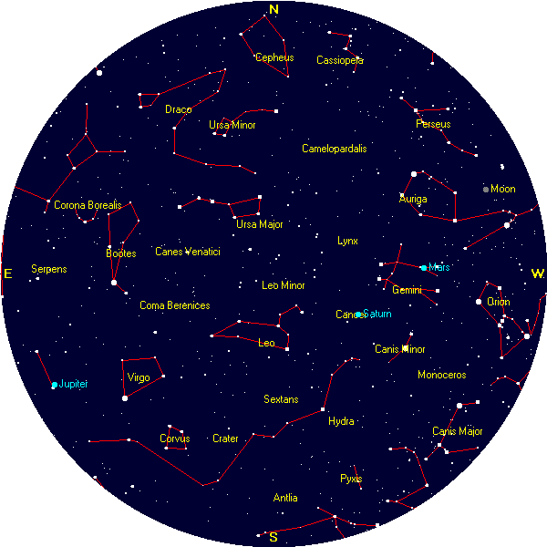
TONIGHT’S SKY
PLANETS:
Mars
Saturn
Jupiter
STAR CLUSTERS:
Coma Berenices
Double Cluster
Beehive Cluster
M3 Globular
DOUBLE STARS:
Mizar & Alcor
Algieba (Gamma Leo)
Comet 73P (S-W)

Slide 33
Questions
Questions
?
http://www.BackBayAstro.org

Slide 34
Safety First!
We will go outside in just a moment.
Please remember, Safety First!
Please do not run or horseplay around the water fountains and telescopes.
Please remember, Safety First!
Please do not run or horseplay around the water fountains and telescopes.

Slide 35
And now, we urge you . . .

Slide 36
Now, please Join us outside for a “tour” of the night sky followed by a look through the telescopes.
Boldly GO!

