Slide 1
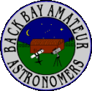
GardenStars – October 20, 2007
Welcome to GardenStars
An Evening Under the Stars
Presented by
The Norfolk Botanical Garden
And
Back Bay Amateur Astronomers

Slide 2
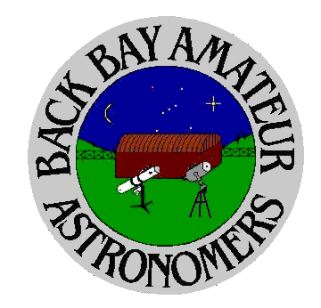
The Back Bay Amateur Astronomers
Bringing Astronomy to the People of Hampton Roads
The Back Bay Amateur Astronomers
PO Box 9877
Virginia Beach, VA 23450

Slide 3
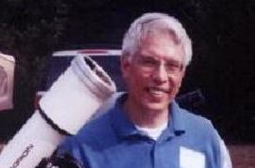

Your “Solar System Ambassadors”
George Reynolds

Slide 4

Introductions
Back Bay Amateur Astronomers
  Bill McLean
  Bruce Bodner
  George Reynolds
  Kevin and Barb Weiner
  Larry Channel
  Rick Bish

Slide 5
Tonight's Agenda...
Pluto
Black holes
How big is the Sun
How to by a telescope
Tonight’s sky
Guided tour of tonight’s sky
Telescope viewing
Norfolk Botanical Garden / Back Bay Amateur Astronomers

Slide 6
Pluto...
What happened to Pluto?
Do you think Pluto is a planet?
Why do you think they said Pluto is not a planet?
Norfolk Botanical Garden / Back Bay Amateur Astronomers
Notes:
Amateur Astronomers – What are they?
Well, some people stereotype astronomers as nerdy individuals with pocket protectors and taped-up glasses.
I will admit to wearing glasses, but I don’t own a pocket protector. ;-)

Slide 7
What is a Planet? – Official Definition
(1) A "planet” is a celestial body that:
  (a) is in orbit around the Sun,
  (b) has sufficient mass for its self-gravity to overcome rigid body forces so that it assumes a hydrostatic equilibrium (nearly round) shape, and
  (c) has cleared the neighborhood around its orbit.
(2) A "dwarf planet" is a celestial body that:
  (a) is in orbit around the Sun,
  (b) has sufficient mass for its self-gravity to overcome rigid body forces so that it assumes a hydrostatic equilibrium (nearly round) shape,
  (c) has not cleared the neighborhood around its orbit, and
  (d) is not a satellite.
(3) All other objects, except satellites, orbiting the Sun shall be referred to collectively as "Small Solar System Bodies".

Slide 8
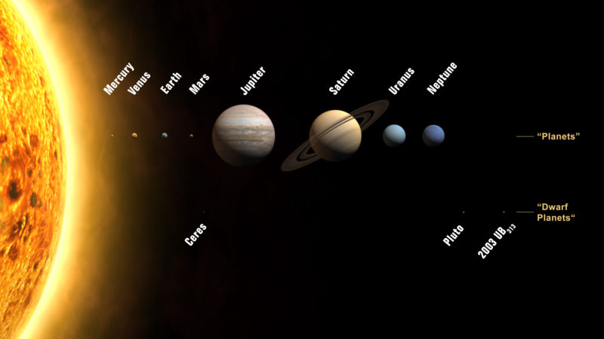
Two types of planets

Slide 9
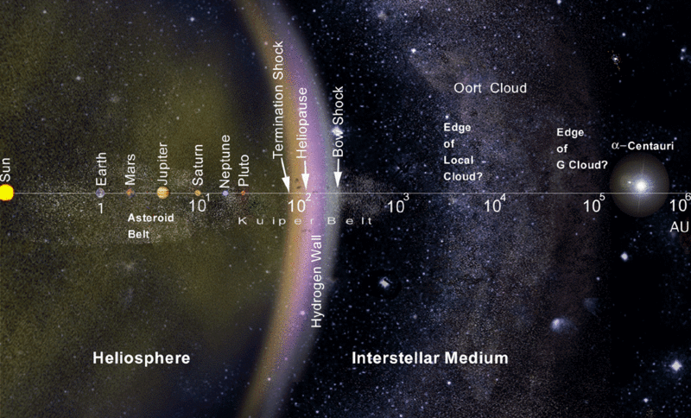
Two types of planets

Slide 10
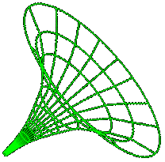
Black holes...
What do you think a Black hole is?
What do you think would happen in the sun turned into a black hole?
What does a Black hole look like?
If you cannot see a Black hole, how do we know they are there?
What do you think would happen if you fell into a Black hole?
Norfolk Botanical Garden / Back Bay Amateur Astronomers
Notes:
Amateur Astronomers – What are they?
Well, some people stereotype astronomers as nerdy individuals with pocket protectors and taped-up glasses.
I will admit to wearing glasses, but I don’t own a pocket protector. ;-)

Slide 11
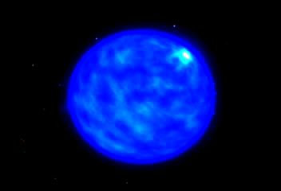
Sun turned into a black hole...
Norfolk Botanical Garden / Back Bay Amateur Astronomers
Notes:
Amateur Astronomers – What are they?
Well, some people stereotype astronomers as nerdy individuals with pocket protectors and taped-up glasses.
I will admit to wearing glasses, but I don’t own a pocket protector. ;-)

Slide 12
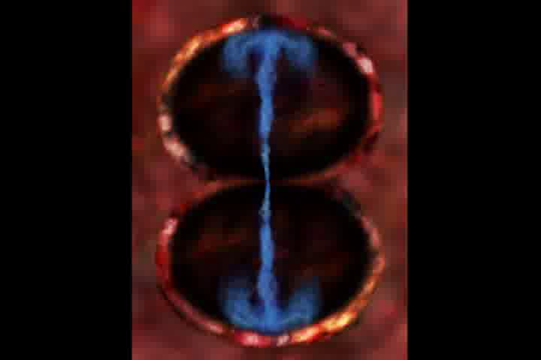
Black hole look like...
Norfolk Botanical Garden / Back Bay Amateur Astronomers
Notes:
Amateur Astronomers – What are they?
Well, some people stereotype astronomers as nerdy individuals with pocket protectors and taped-up glasses.
I will admit to wearing glasses, but I don’t own a pocket protector. ;-)

Slide 13
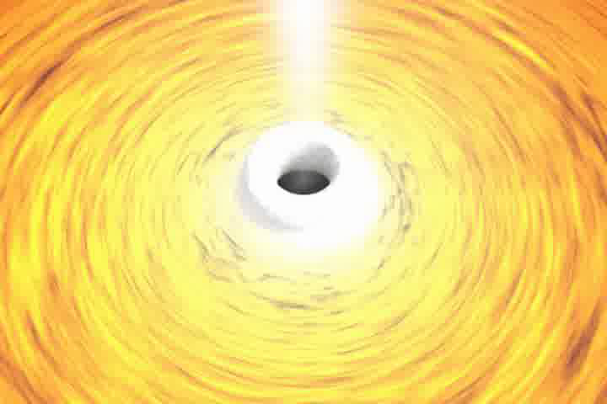
Black hole look like...
Norfolk Botanical Garden / Back Bay Amateur Astronomers
Notes:
Amateur Astronomers – What are they?
Well, some people stereotype astronomers as nerdy individuals with pocket protectors and taped-up glasses.
I will admit to wearing glasses, but I don’t own a pocket protector. ;-)

Slide 14
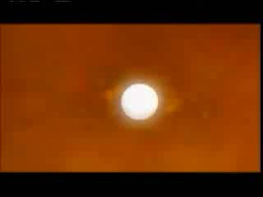
Black hole, how do we know...
Norfolk Botanical Garden / Back Bay Amateur Astronomers
Notes:
Amateur Astronomers – What are they?
Well, some people stereotype astronomers as nerdy individuals with pocket protectors and taped-up glasses.
I will admit to wearing glasses, but I don’t own a pocket protector. ;-)

Slide 15
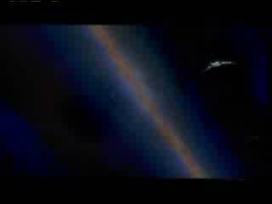
Fall in to a Black hole...
Norfolk Botanical Garden / Back Bay Amateur Astronomers
Notes:
Amateur Astronomers – What are they?
Well, some people stereotype astronomers as nerdy individuals with pocket protectors and taped-up glasses.
I will admit to wearing glasses, but I don’t own a pocket protector. ;-)

Slide 16
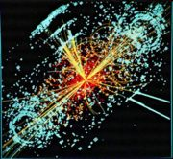

Black holes...
We will soon be able to make our own Black holes!
Norfolk Botanical Garden / Back Bay Amateur Astronomers
Notes:
Amateur Astronomers – What are they?
Well, some people stereotype astronomers as nerdy individuals with pocket protectors and taped-up glasses.
I will admit to wearing glasses, but I don’t own a pocket protector. ;-)

Slide 17
How Big...
How big do you think the Sun is?
Norfolk Botanical Garden / Back Bay Amateur Astronomers
Notes:
Amateur Astronomers – What are they?
Well, some people stereotype astronomers as nerdy individuals with pocket protectors and taped-up glasses.
I will admit to wearing glasses, but I don’t own a pocket protector. ;-)

Slide 18
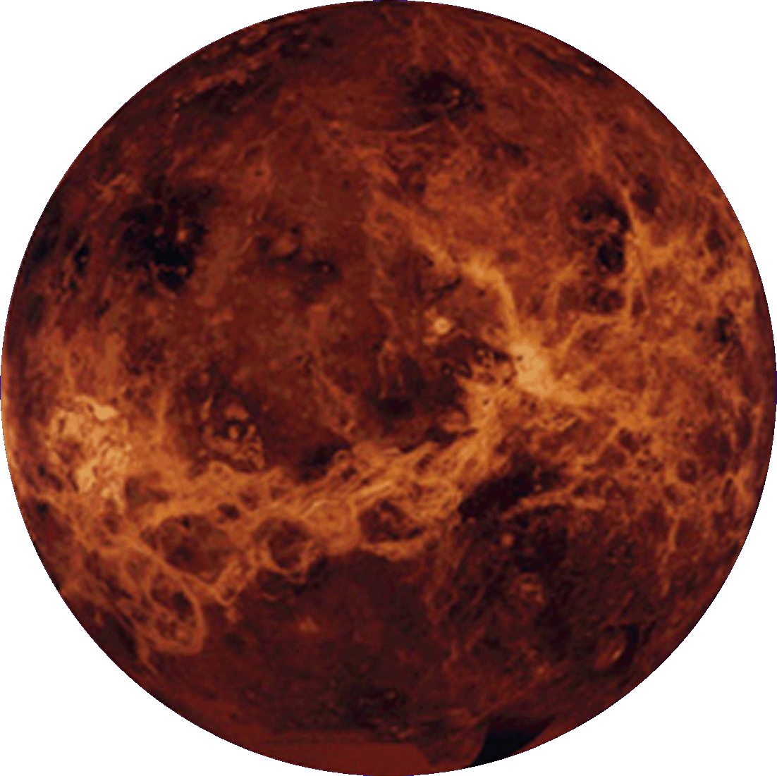
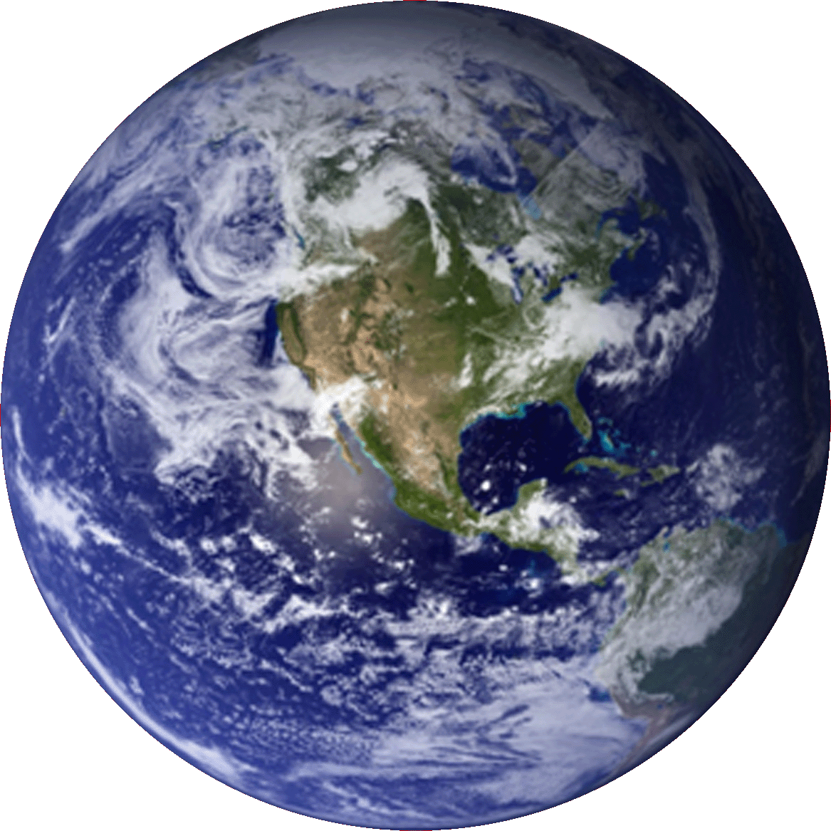
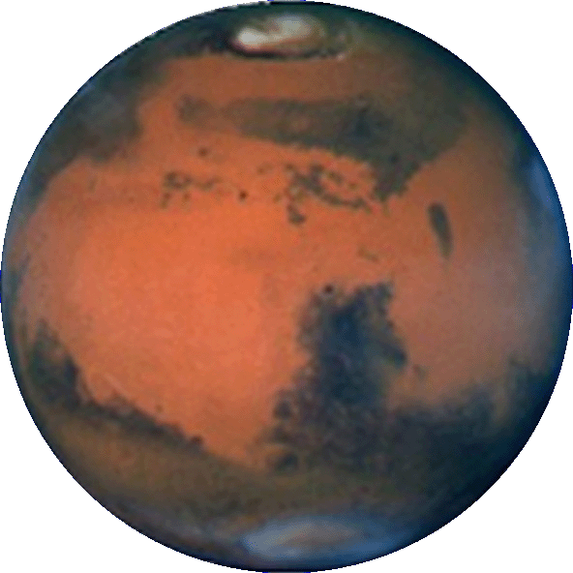
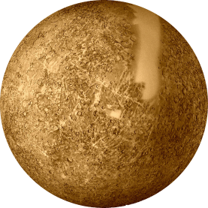
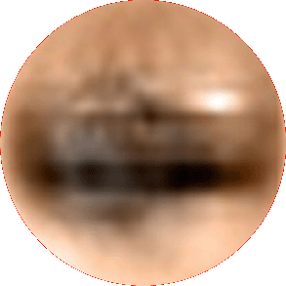
Pluto
Mercury
Mars
Venus
Earth

Slide 19
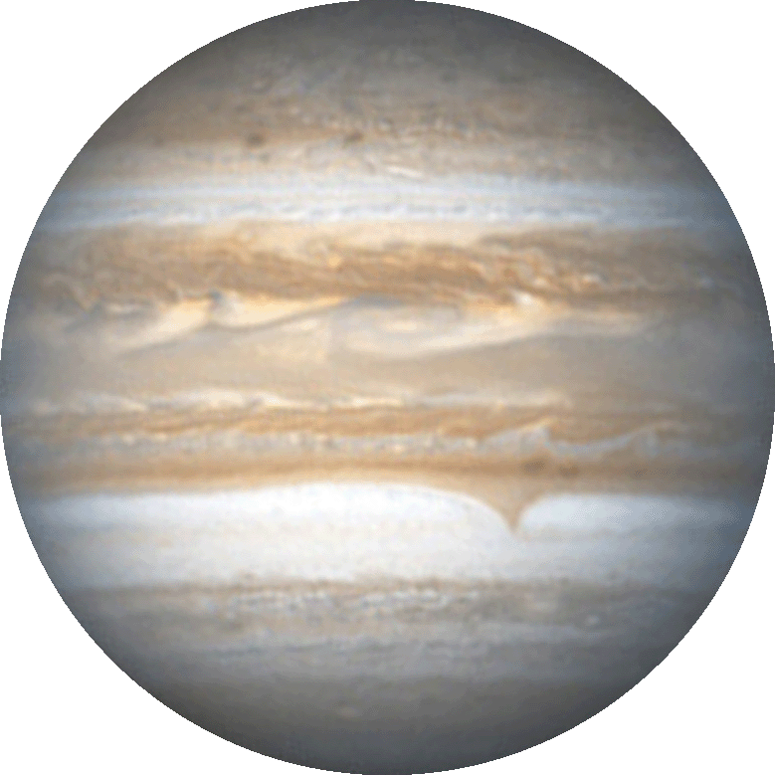
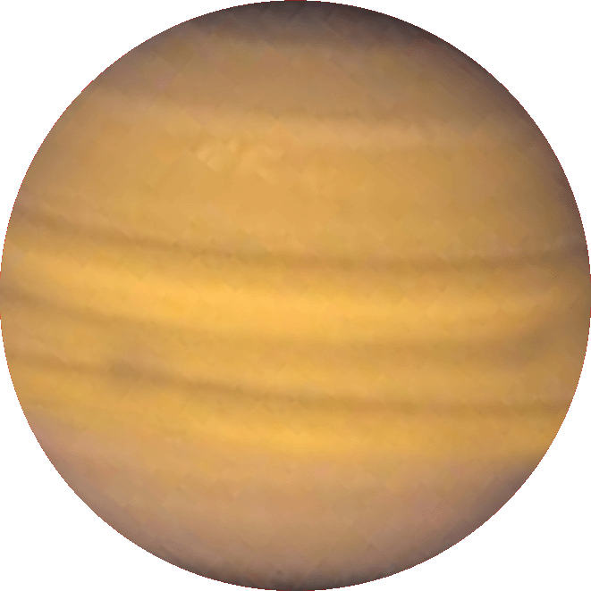



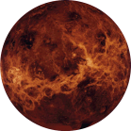
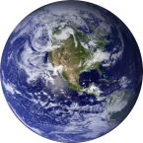

Neptune
Uranus
Saturn
Jupiter

Slide 20
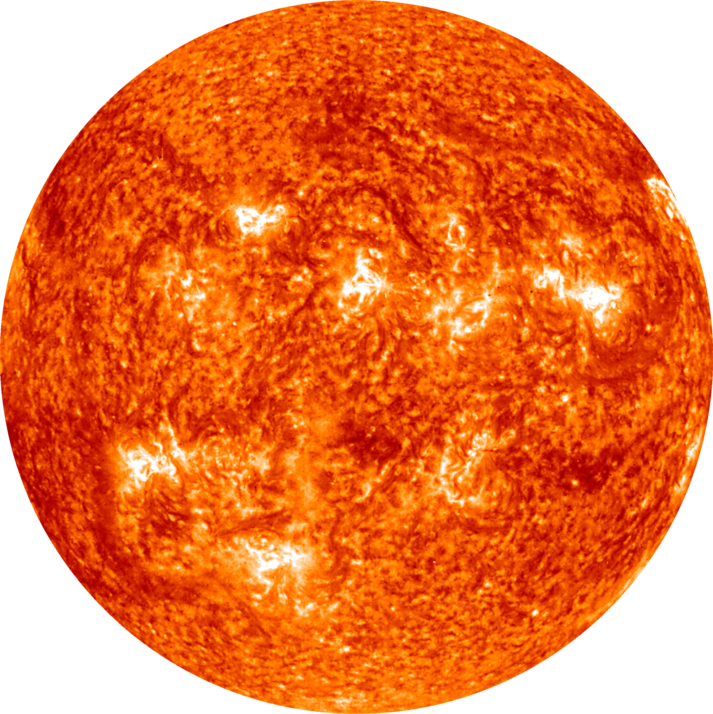
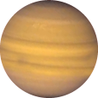
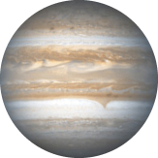


Earth
Sun

Slide 21
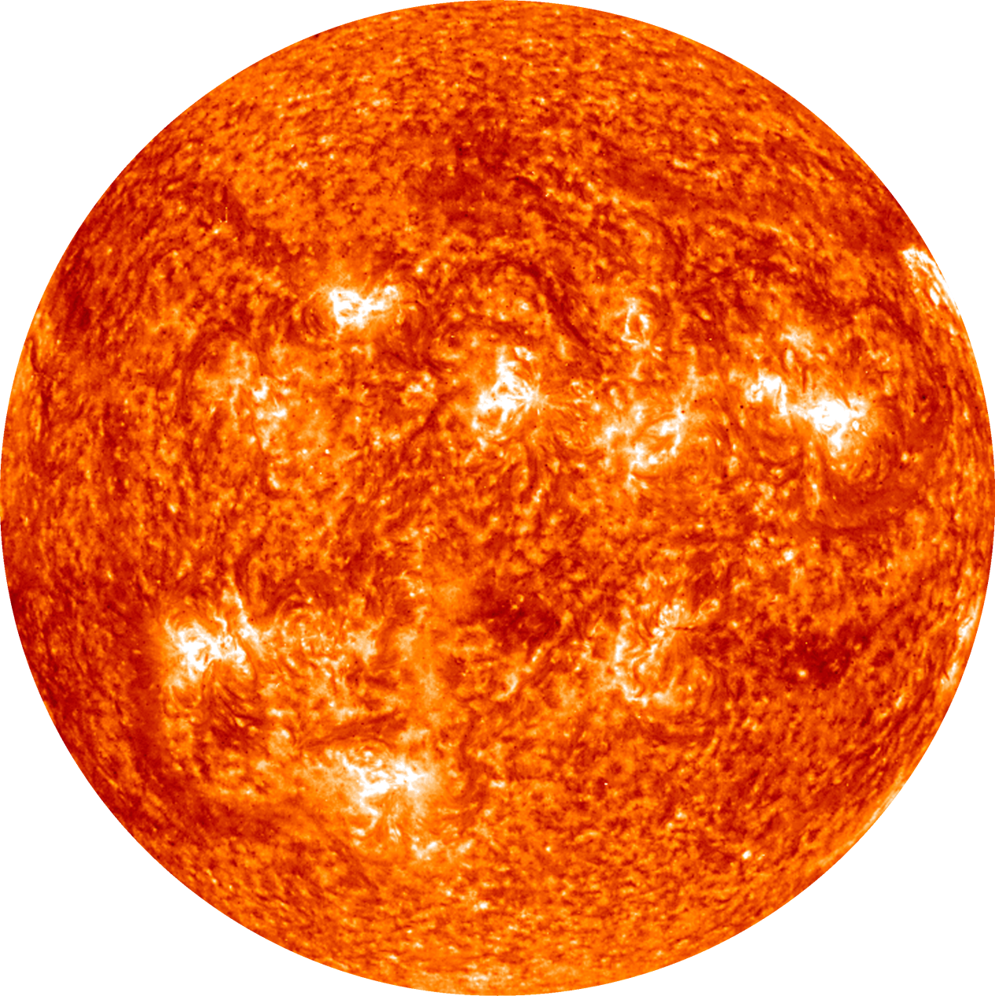
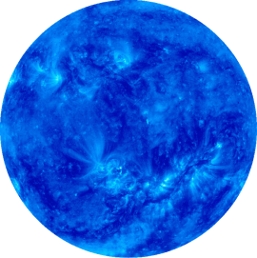
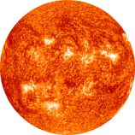
Jupiter
Sun
Sirius
Pollux

Slide 22
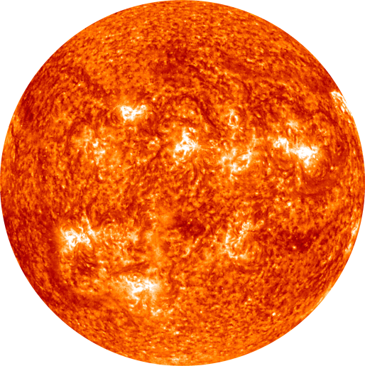
Sun (At this scale, the sun is much smaller than a single pixel)
VY Canis Majoris
Betelgeuse
Pollux

Slide 23
Telescopes...
Buying your first scope?
We recommend, you don’t!
Come use ours!
Buy binoculars!
Norfolk Botanical Garden / Back Bay Amateur Astronomers
Notes:
Amateur Astronomers – What are they?
Well, some people stereotype astronomers as nerdy individuals with pocket protectors and taped-up glasses.
I will admit to wearing glasses, but I don’t own a pocket protector. ;-)

Slide 24

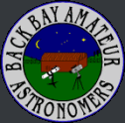
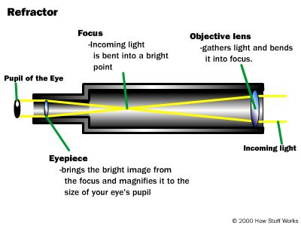
Telescopes – Types
Refractors
Simplest type of Telescope
Most Commonly thought of when you think of a telescope
Light is Refracted – No Mirrors, Glass only
Norfolk Botanical Garden / Back Bay Amateur Astronomers

Slide 25
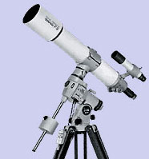
Telescopes – Types
Refractors
Simplest type of Telescope
Most Commonly thought of when you think of a telescope
Light is Refracted – No Mirrors, Glass only
Norfolk Botanical Garden / Back Bay Amateur Astronomers

Slide 26
Telescopes – Types
Light is bent with Mirrors
Most “Bang for the Buck”
Largest Telescopes in the world are Reflectors
Refractors
Reflectors
Norfolk Botanical Garden / Back Bay Amateur Astronomers

Slide 27
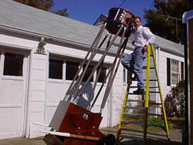
Telescopes – Types
Light is bent with Mirrors – Primary and Secondary
Most “Bang for the Buck” generally
Largest Telescopes in the world are Reflectors
Refractors
Reflectors
Norfolk Botanical Garden / Back Bay Amateur Astronomers

Slide 28
Telescopes – Types
Refractors
Multiple Mirrors
Long Focal Length, compact design
Most Versatile of the three major types
Reflectors
Catadioptric
(Compound)
Norfolk Botanical Garden / Back Bay Amateur Astronomers

Slide 29
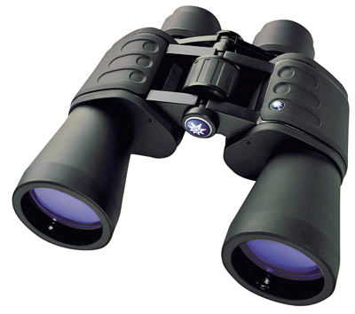
Telescopes – Types
Light weight, easy to carry
Wide Views of large objects
Helpful for locating dimmer objects
Excellent Entry into Astronomy
Refractors
Reflectors
Catadioptric
(Compound)
Binoculars
Norfolk Botanical Garden / Back Bay Amateur Astronomers

Slide 30
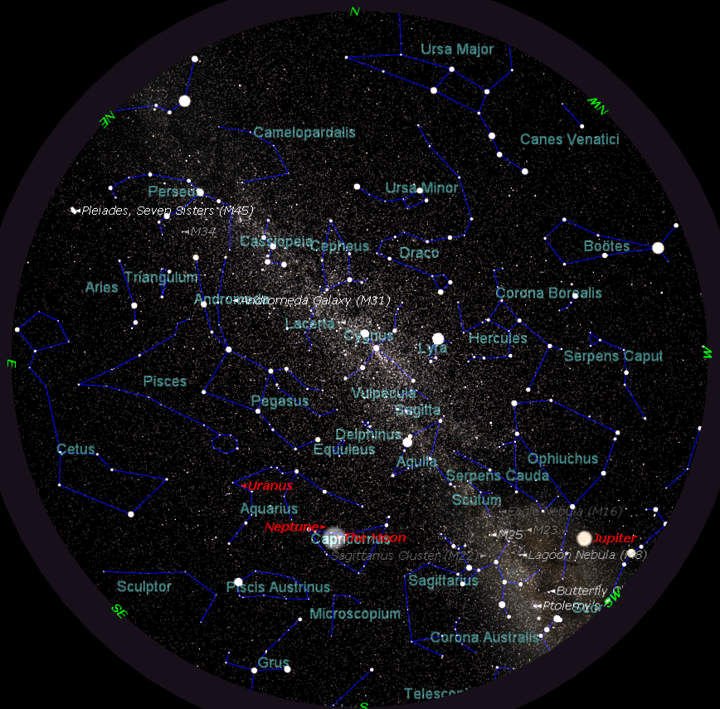
TONIGHT’S SKY
October 20th
at 8:00 p.m.
Notes:
If we had low horizons all around, like out on the ocean, here is what you could see tonight. This sky chart shows the major constellations, groupings of stars that men have named over the centuries, to help us be more familiar with our starry tapestry above.
If conditions outside permit, we will point out some of these constellations to you.

Slide 31
Questions
Questions
?
http://www.BackBayAstro.org

Slide 32
Safety First!
We will go outside in just a moment.
Please remember, Safety First!
Please do not run or horseplay around the water fountains and telescopes.
Please remember, Safety First!
Please do not run or horseplay around the water fountains and telescopes.

