Slide 1

Please take your seat

Slide 2
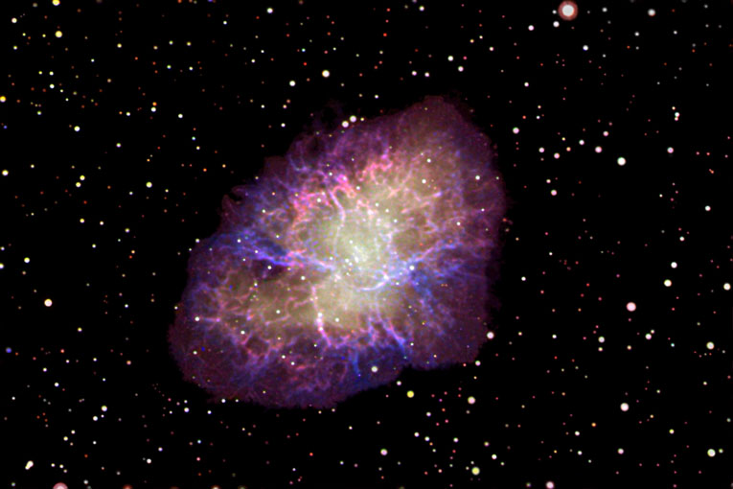

SPACE!
Gimme Some
Presented to
Greenbrier Middle School 6th Grade
November 19, 2004

Slide 3

The Back Bay Amateur Astronomers
Bringing Astronomy to the People of Hampton Roads
The Back Bay Amateur Astronomers
PO Box 9877
Virginia Beach, VA 23450

Slide 4
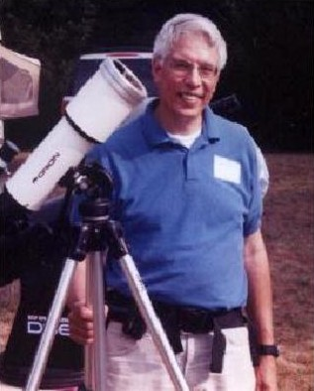
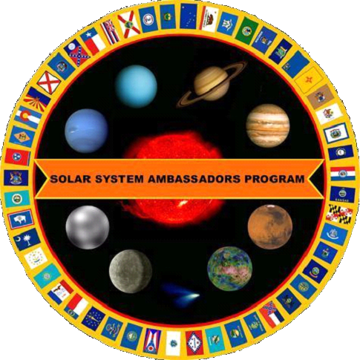
Your “Solar System Ambassador”
George Reynolds

Slide 5
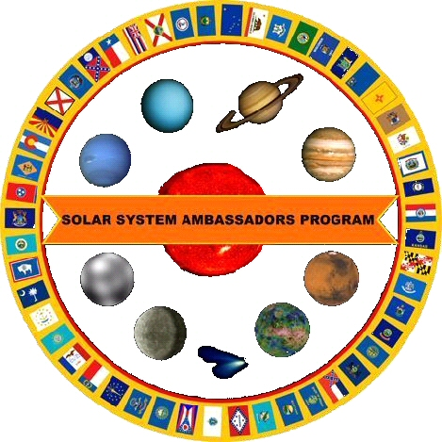
“Solar System Ambassador”
George Reynolds
Assisted by BBAA members…
Matt McLaughlin
Kevin Weiner
Mat Snellings

Slide 6

Science is BORING!

Slide 7
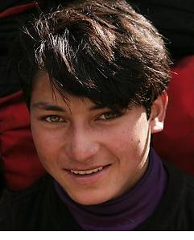
Science is FUN!!

Slide 8
Astronomy...
"Stars in your eyes!"

Slide 9
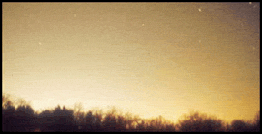
Why can’t I see any stars?
Sky Glow!
Another term for
Light Pollution!

Slide 10
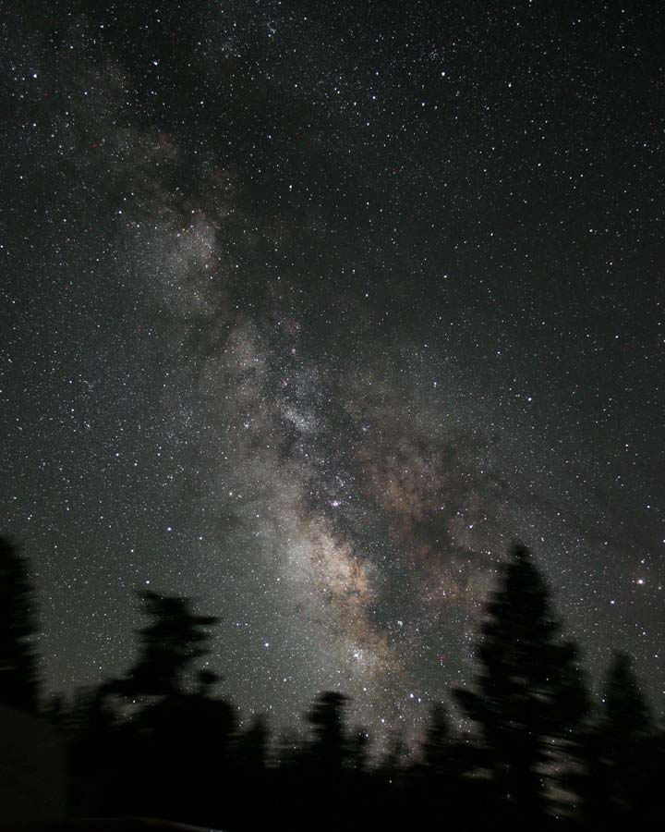
James Jacobson
Here’s what it SHOULD look like!

Slide 11
What can I see in a dark sky?
Stars
Constellations
Planets
Comets
Star Clusters
Nebulas (Nebulae) & Galaxies
Satellites (and Space Junk!)

Slide 12
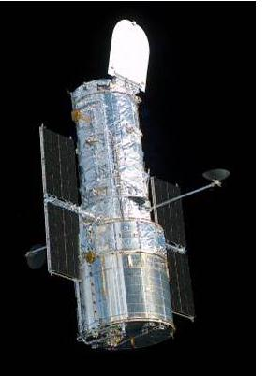
HOW can I see in a dark sky?
The unaided eye (“Naked-eye”)
Binoculars
Telescopes
Hubble Space Telescope
  Always in a dark sky -- in Space, in orbit around Earth
  Above the atmosphere and its pollution
  No humidity, clouds, or rain
Here are some HST photographs . . .

Slide 13
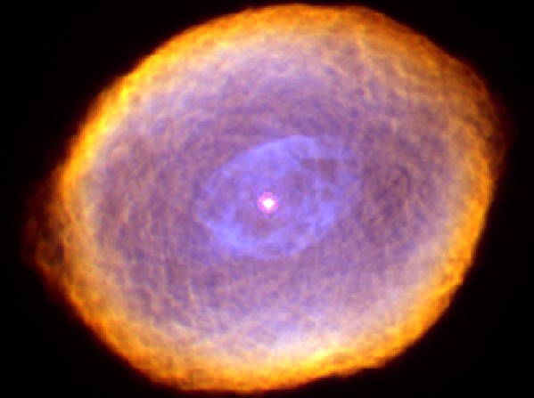
The Spirograph Nebula
Hubble Space Telescope image, Space Telescope Science Institute

Slide 14
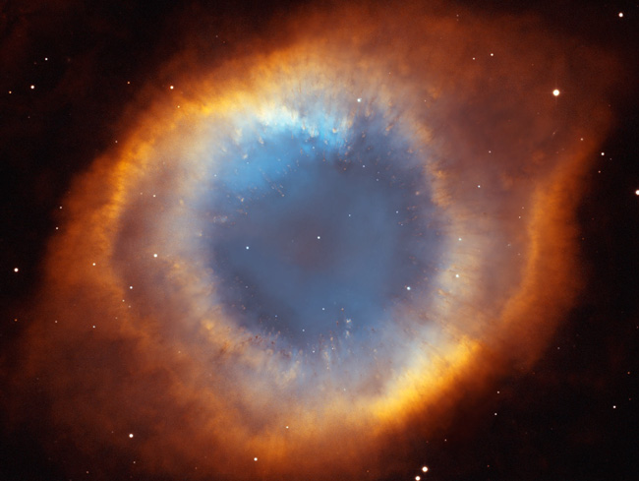
The Helix Nebula (“The Eye of God”)
Hubble Space Telescope image, Space Telescope Science Institute

Slide 15
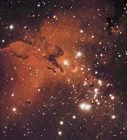
The
Eag
le
Nebula
and
Star
Cluster

Slide 16
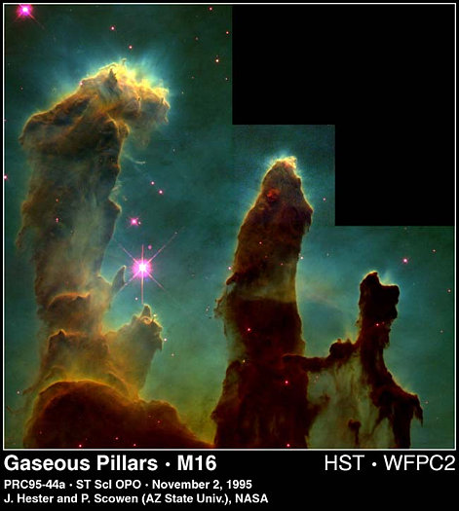
The
Pi
l
lars
of
Creation

Slide 17
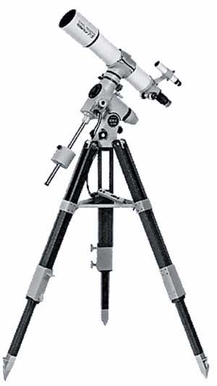
HOW can I see in a dark sky?
The unaided eye (“Naked eye”)
Binoculars
Telescopes
Hubble Space Telescope
  Always in a dark sky -- in Space, in orbit around Earth
  Above the atmosphere and its pollution
  No humidity, clouds, or rain
Telescopes
Here are some photos taken by amateur astronomers . . .

Slide 18
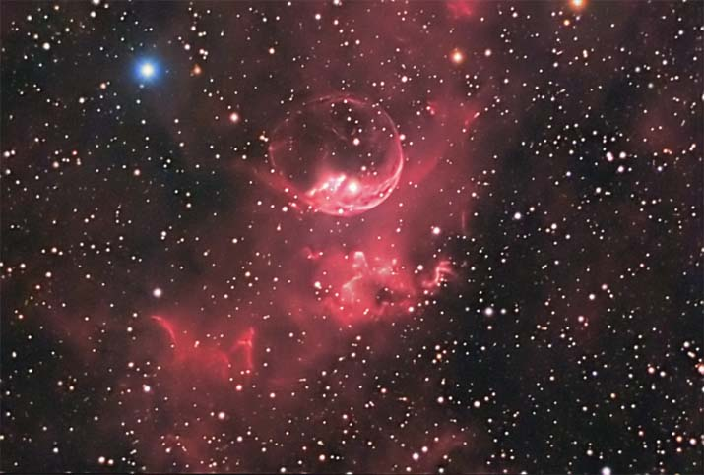
The Bubble Nebula (NGC 7635)
Image courtesy Don Waid, Waid Observatory

Slide 19
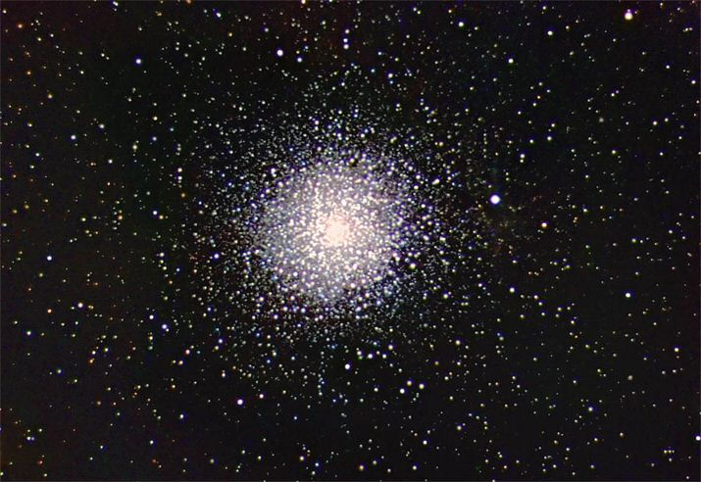
A Globular Star Cluster – a massive ball of hundreds of thousands of stars. This is “M15”.
Image courtesy Don Waid, Waid Observatory

Slide 20
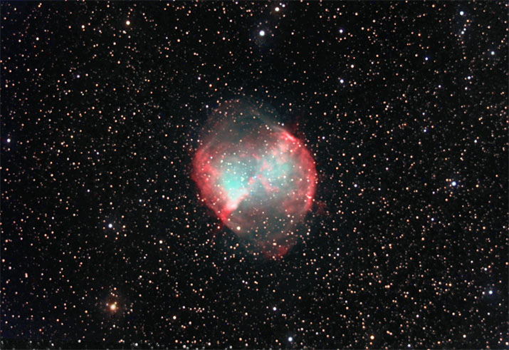
The “Dumbbell Nebula” -- what’s left of a star that exploded thousands of years ago.
Image courtesy Don Waid, Waid Observatory

Slide 21
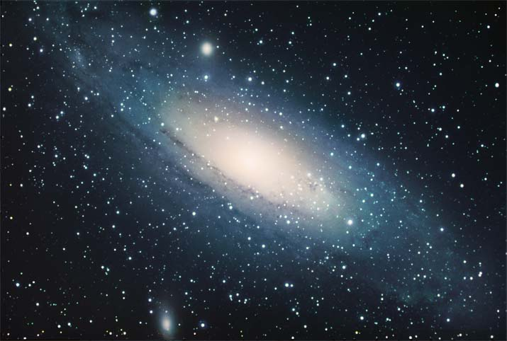

The Andromeda Galaxy – our “neighbor” in space, 2.3 million light years away.
Image courtesy Don Waid, Waid Observatory
Notes:
M31, a galaxy similar in size and shape to opur own Milky Way Galaxy, but even larger, with more stars.
The stars and star clusters we see in the night sky are in our own Milky Way Galaxy. When we look beyond our galaxy, we see thousands of other galaxies, farther and farther away.
Andromeda is in the “Local Group” of nearby galaxies, within a few million light-years distance.

Slide 22
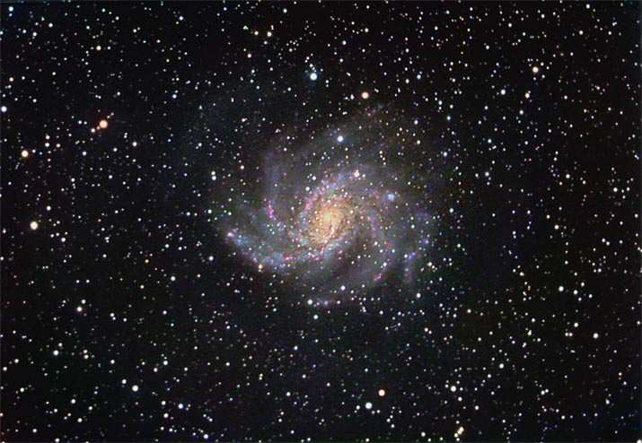

A Spiral Galaxy -- on a vast background of stars
10 million Light-Years distant
Image courtesy Don Waid, Waid Observatory
Notes:
NGC 6946, Approx. 10 million LY away, in the direction of the constellation Cepheus, the King. This is a galaxy out beyond our own Milky Way Galaxy, 4 times as far as the Andromeda Galaxy, on the previous slide.

Slide 23



HOW can I see in a dark sky?
The unaided eye (“Naked eye”)
Binoculars
Telescopes
Hubble Space Telescope
  Always in a dark sky -- in Space, in orbit around Earth
  Above the atmosphere and its pollution
  No humidity, clouds, or rain

Slide 24
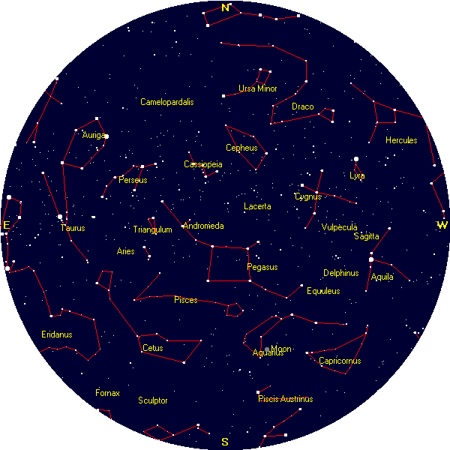
Tonight’s Sky
at 8:00 p.m.
The unaided eye
Courtesy, Heavens-Above (www.heavens-above.com)

Slide 25
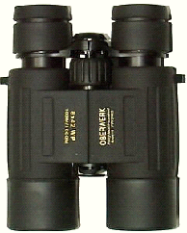
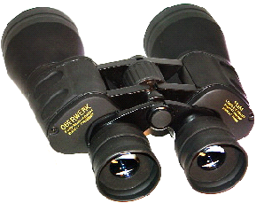
Binoculars
A great way to see the stars . . .
And learn the constellations
“A cheap pair of binoculars is better than a cheap telescope any day!”

Slide 26
Telescope
Telescope ads and department store scopes hype
“magnification”
But the most important feature of a telescope is its
“aperture”,
Or its “light-gathering” power.
A 4.5-inch (114mm) scope gathers 250% MORE light than a 2.4-inch (60mm) scope.

Slide 27
Different Types of Telescopes?
There are three basic types of telescopes.
Refractors use lenses to focus light
(when light passes through glass, it refracts).
Reflectors use mirrors to focus light
(light reflects off of mirrors).
Catadioptric (combination) telescopes use some combination of lenses as well as mirrors (to fold the light path).

Slide 28
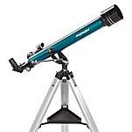
Refractor

Slide 29
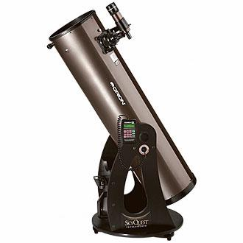
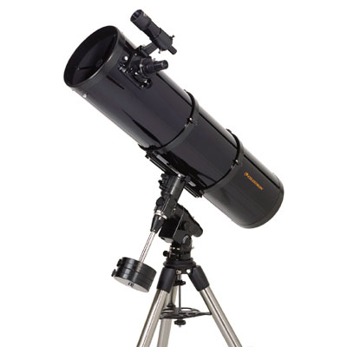
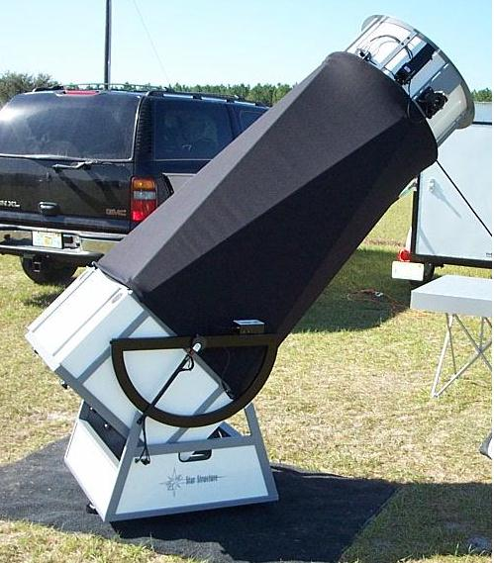
Reflector

Slide 30
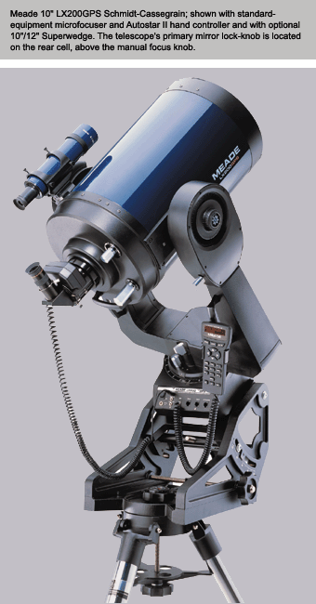
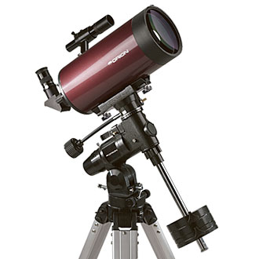
Catadioptric

Slide 31
What can I see in a dark sky?
Stars
Constellations
Planets
Comets
Star Clusters
Nebulas (Nebulae) & Galaxies
Satellites (and Space Junk!)

Slide 32
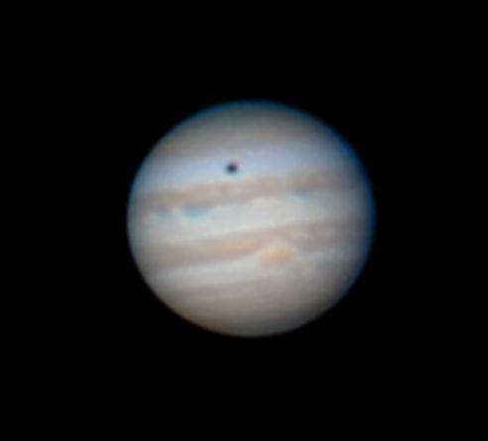
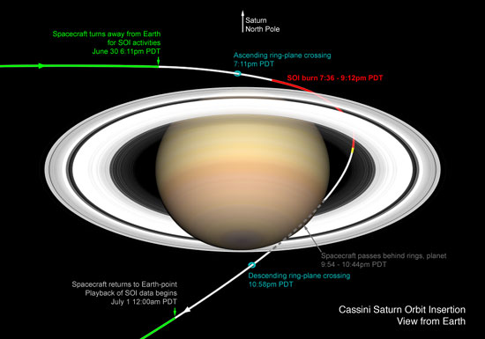
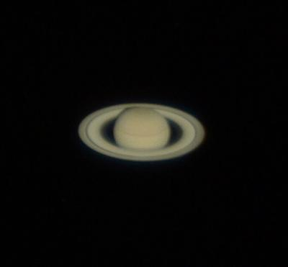
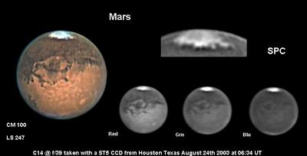
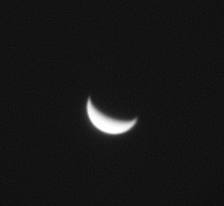
Planets
Saturn
Jupiter
Mars
Venus
All these photos were taken through amateur astronomers’ telescopes.

Slide 33
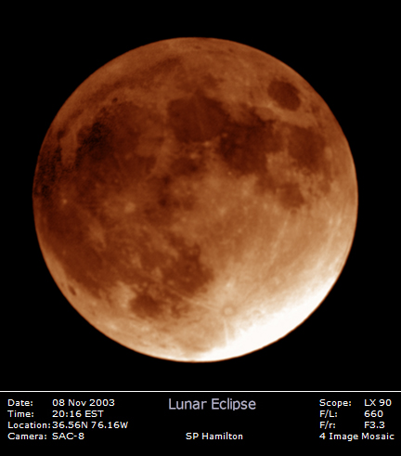
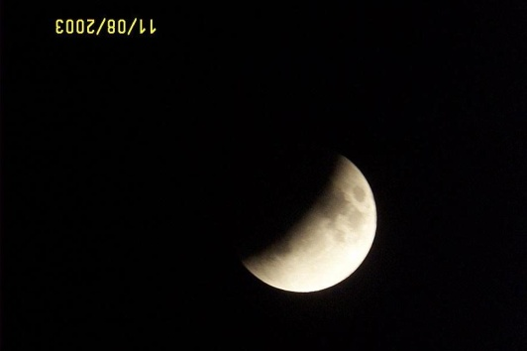
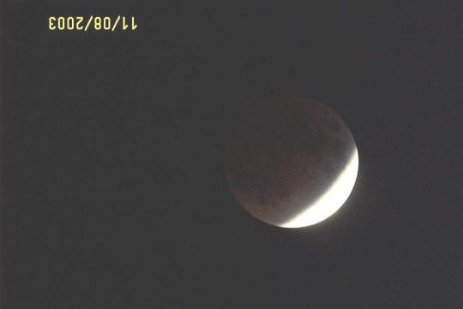
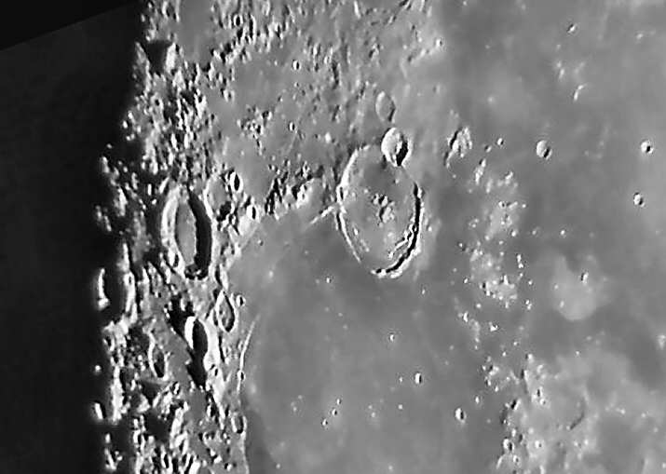
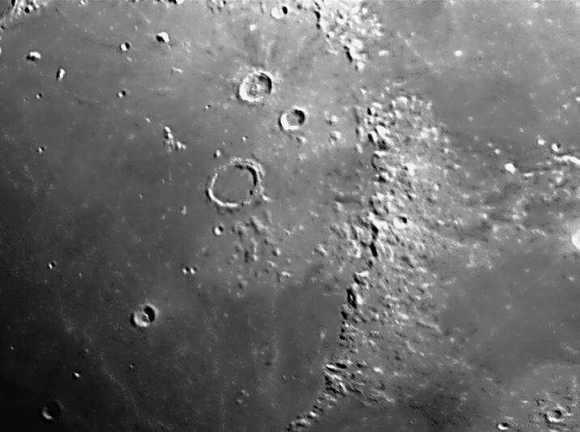
The Moon
Phases
Lunar Eclipse
Craters
Mountains
Photos by Dan Rodgers and Steve Hamilton

Slide 34
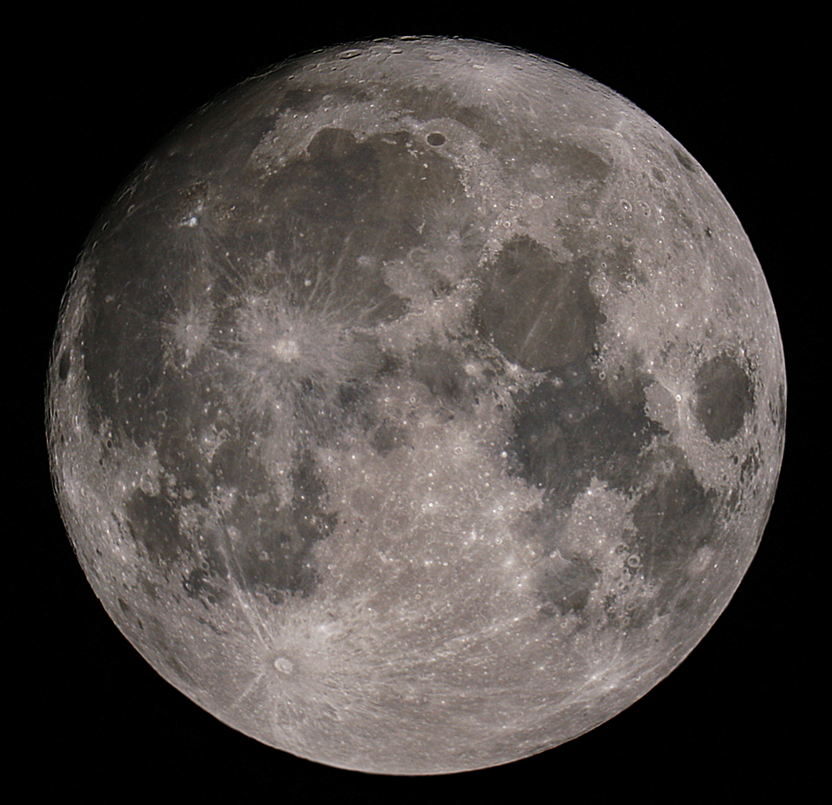
The Moon – The Whole Thing!
Steven P. Hamilton

Slide 35
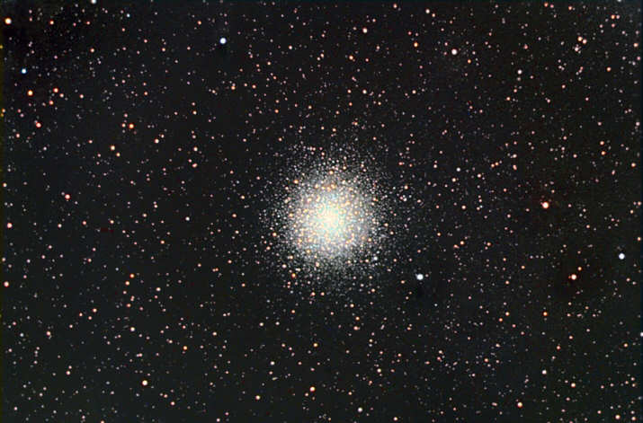
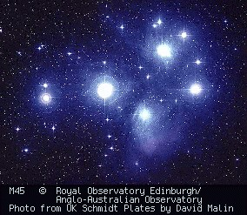
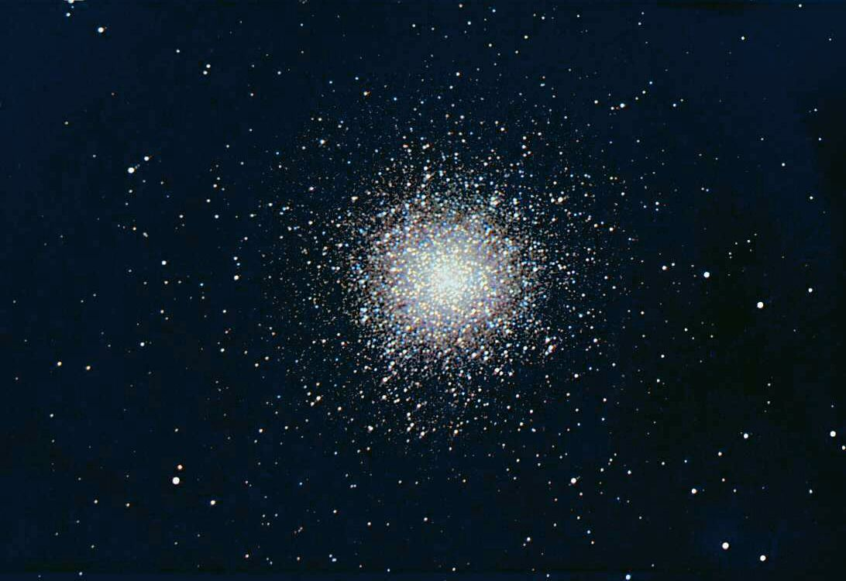
Star Clusters
M80 Globular in Scorpius
Open Cluster –
The Pleiades
Don Waid
M13 Globular in Hercules
Don Waid

Slide 36
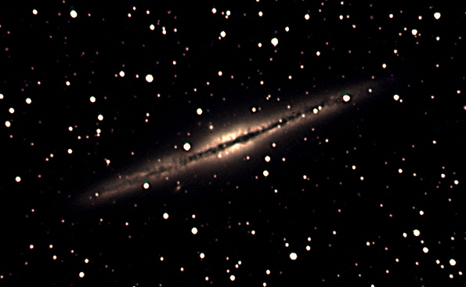
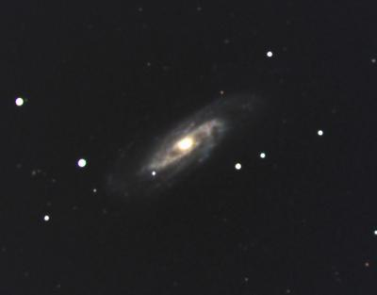
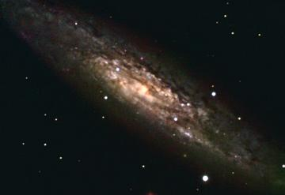
Galaxies
NGC891 Michelle Stone
NGC6946 Don Waid
NGC3192 Michelle Stone
NGC253 Don Waid

Slide 37
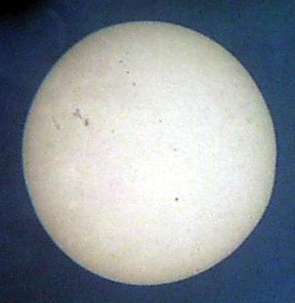
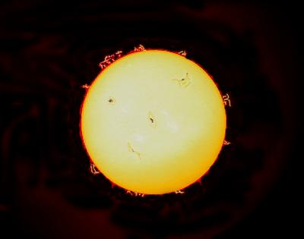
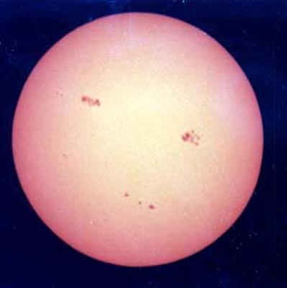
The Sun
CAUTION! NEVER look at the Sun directly without a proper filter!
Sunspots
Solar Flares
More Sunspots

Slide 38
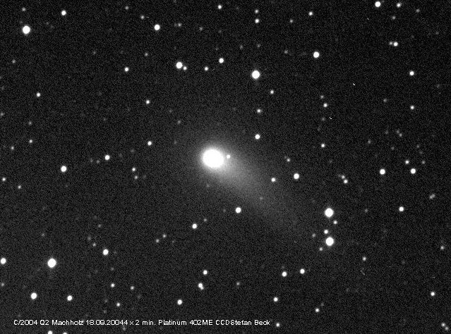
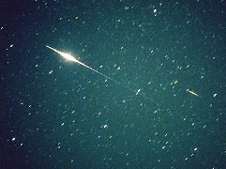
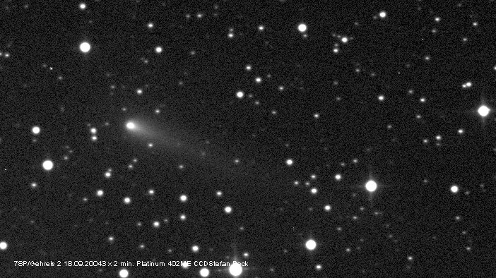
Comets, Meteors, & Satellites
Iridium Satellite
Comet Machholz 10/04/2004
Comet Gehrels 09/18/2004
Meteor + Sound
(67MHz radar echo)

Slide 39


Auroras and other Events
Aurora Borealis
Transit of Venus
Bill Dickinson
Dick Moncure

Slide 40

Photo image by Stephen P. Hamilton
Moon – Jupiter – Venus conjunction 11/9/04

Slide 41

STARS!
STARS!
Photo image by Stephen P. Hamilton

Slide 42

The Great Orion Nebula
Photo image by Richard Dickson
Notes:
The Great Orion Nebula, the “fuzzy star” in the “sword” of Orion the Hunter

Slide 43
Space Exploration . . .
The Final Frontier

Slide 44
Exciting Events for 2004 … and BEYOND!!
Dec 25 - Huygens probe release
        From the CASSINI spacecraft at Saturn

Slide 45


Cassini Mission to Saturn

Slide 46
Exciting Events for 2004 … and BEYOND!!
Dec 25 - Huygens probe release
        From the CASSINI spacecraft at Saturn
Dec 30 - Deep Impact Launch

Slide 47


Slide 48
Exciting Events for 2004 … and BEYOND!!
Dec 25 - Huygens probe release
        From the CASSINI spacecraft at Saturn
Dec 30 - Deep Impact Launch
Jan 14, 2005 - Huygens descent to Titan

Slide 49


Slide 50
Exciting Events for 2004 … and BEYOND!!
Dec 25 - Huygens probe release
        From the CASSINI spacecraft at Saturn
Dec 30 - Deep Impact Launch
Jan 14, 2005 - Huygens descent to Titan
Mar 1, 2005 - Cosmos 1 Solar Sail launch

Slide 51


Slide 52
Exciting Events for 2004 … and BEYOND!!
Dec 25 - Huygens probe release
        From the CASSINI spacecraft at Saturn
Dec 30 - Deep Impact Launch
Jan 14, 2005 - Huygens descent to Titan
Mar 1, 2005 - Cosmos 1 Solar Sail launch
July 2005 - Deep Impact meets Comet

Slide 53


Slide 54
Exciting Events for 2004 … and BEYOND!!
Dec 25 - Huygens probe release
        From the CASSINI spacecraft at Saturn
Dec 30 - Deep Impact Launch
Jan 14, 2005 - Huygens descent to Titan
Mar 1, 2005 - Cosmos 1 Solar Sail launch
July 2005 - Deep Impact meets Comet
Jan 15, 2006 - Stardust Sample Return

Slide 55

STARDUST
STARDUST Flyby of Comet Wild-2 January 2, 2004

Slide 56
The STARDUST Mission
First-ever Comet Sample Return
Launched 1999
Rendezvous Comet WILD-2 Jan. 2, 2004
Return Sample to Earth July 15, 2006
421 days to go!
Counting Down!

Slide 57



Mars Missions
Mars Global Surveyor
Mars Odyssey
Mars Exploration Rovers
“Spirit”
and “Opportunity”

Slide 58

The Mars Exploration Rovers
Opportunity
Spirit

Slide 59
In Conclusion . . .

Slide 60

The BBAA has been “bringing astronomy to the people” for more than 25 years.

Slide 61
BBAA
Back Bay Amateur Astronomers invite you to come out to a free public sky watch.
Check our web site for the schedule
http://groups.hamptonroads.com/BBAA/
Northwest River Park, Chesapeake
Use our scopes…
Beware of department store telescopes. Don’t buy one!

Slide 62

Your “Solar System Ambassador”
Thank You! . . . from
George Reynolds
and Matt, Kevin, and Mat
We urge you . . .

Slide 63
Boldly GO!

