Slide 1
10:00

Slide 2
09:59

Slide 3
09:58

Slide 4
09:57

Slide 5
09:56

Slide 6
09:55

Slide 7
09:54

Slide 8
09:53

Slide 9
09:52

Slide 10
09:51

Slide 11
09:50

Slide 12
09:49

Slide 13
09:48

Slide 14
09:47

Slide 15
09:46

Slide 16
09:45

Slide 17
09:44

Slide 18
09:43

Slide 19
09:42

Slide 20
09:41

Slide 21
09:40

Slide 22
09:39

Slide 23
09:38

Slide 24
09:37

Slide 25
09:36

Slide 26
09:35

Slide 27
09:34

Slide 28
09:33

Slide 29
09:32

Slide 30
09:31

Slide 31
09:30

Slide 32
09:29

Slide 33
09:28

Slide 34
09:27

Slide 35
09:26

Slide 36
09:25

Slide 37
09:24

Slide 38
09:23

Slide 39
09:22

Slide 40
09:21

Slide 41
09:20

Slide 42
09:19

Slide 43
09:18

Slide 44
09:17

Slide 45
09:16

Slide 46
09:15

Slide 47
09:14

Slide 48
09:13

Slide 49
09:12

Slide 50
09:11

Slide 51
09:10

Slide 52
09:09

Slide 53
09:08

Slide 54
09:07

Slide 55
09:06

Slide 56
09:05

Slide 57
09:04

Slide 58
09:03

Slide 59
09:02

Slide 60
09:01

Slide 61
09:00

Slide 62
08:59

Slide 63
08:58

Slide 64
08:57

Slide 65
08:56

Slide 66
08:55

Slide 67
08:54

Slide 68
08:53

Slide 69
08:52

Slide 70
08:51

Slide 71
08:50

Slide 72
08:49

Slide 73
08:48

Slide 74
08:47

Slide 75
08:46

Slide 76
08:45

Slide 77
08:44

Slide 78
08:43

Slide 79
08:42

Slide 80
08:41

Slide 81
08:40

Slide 82
08:39

Slide 83
08:38

Slide 84
08:37

Slide 85
08:36

Slide 86
08:35

Slide 87
08:34

Slide 88
08:33

Slide 89
08:32

Slide 90
08:31

Slide 91
08:30

Slide 92
08:29

Slide 93
08:28

Slide 94
08:27

Slide 95
08:26

Slide 96
08:25

Slide 97
08:24

Slide 98
08:23

Slide 99
08:22

Slide 100
08:21

Slide 101
08:20

Slide 102
08:19

Slide 103
08:18

Slide 104
08:17

Slide 105
08:16

Slide 106
08:15

Slide 107
08:14

Slide 108
08:13

Slide 109
08:12

Slide 110
08:11

Slide 111
08:10

Slide 112
08:09

Slide 113
08:08

Slide 114
08:07

Slide 115
08:06

Slide 116
08:05

Slide 117
08:04

Slide 118
08:03

Slide 119
08:02

Slide 120
08:01

Slide 121
08:00

Slide 122
07:59

Slide 123
07:58

Slide 124
07:57

Slide 125
07:56

Slide 126
07:55

Slide 127
07:54

Slide 128
07:53

Slide 129
07:52

Slide 130
07:51

Slide 131
07:50

Slide 132
07:49

Slide 133
07:48

Slide 134
07:47

Slide 135
07:46

Slide 136
07:45

Slide 137
07:44

Slide 138
07:43

Slide 139
07:42

Slide 140
07:41

Slide 141
07:40

Slide 142
07:39

Slide 143
07:38

Slide 144
07:37

Slide 145
07:36

Slide 146
07:35

Slide 147
07:34

Slide 148
07:33

Slide 149
07:32

Slide 150
07:31

Slide 151
07:30

Slide 152
07:29

Slide 153
07:28

Slide 154
07:27

Slide 155
07:26

Slide 156
07:25

Slide 157
07:24

Slide 158
07:23

Slide 159
07:22

Slide 160
07:21

Slide 161
07:20

Slide 162
07:19

Slide 163
07:18

Slide 164
07:17

Slide 165
07:16

Slide 166
07:15

Slide 167
07:14

Slide 168
07:13

Slide 169
07:12

Slide 170
07:11

Slide 171
07:10

Slide 172
07:09

Slide 173
07:08

Slide 174
07:07

Slide 175
07:06

Slide 176
07:05

Slide 177
07:04

Slide 178
07:03

Slide 179
07:02

Slide 180
07:01

Slide 181
07:00

Slide 182
06:59

Slide 183
06:58

Slide 184
06:57

Slide 185
06:56

Slide 186
06:55

Slide 187
06:54

Slide 188
06:53

Slide 189
06:52

Slide 190
06:51

Slide 191
06:50

Slide 192
06:49

Slide 193
06:48

Slide 194
06:47

Slide 195
06:46

Slide 196
06:45

Slide 197
06:44

Slide 198
06:43

Slide 199
06:42

Slide 200
06:41

Slide 201
06:40

Slide 202
06:39

Slide 203
06:38

Slide 204
06:37

Slide 205
06:36

Slide 206
06:35

Slide 207
06:34

Slide 208
06:33

Slide 209
06:32

Slide 210
06:31

Slide 211
06:30

Slide 212
06:29

Slide 213
06:28

Slide 214
06:27

Slide 215
06:26

Slide 216
06:25

Slide 217
06:24

Slide 218
06:23

Slide 219
06:22

Slide 220
06:21

Slide 221
06:20

Slide 222
06:19

Slide 223
06:18

Slide 224
06:17

Slide 225
06:16

Slide 226
06:15

Slide 227
06:14

Slide 228
06:13

Slide 229
06:12

Slide 230
06:11

Slide 231
06:10

Slide 232
06:09

Slide 233
06:08

Slide 234
06:07

Slide 235
06:06

Slide 236
06:05

Slide 237
06:04

Slide 238
06:03

Slide 239
06:02

Slide 240
06:01

Slide 241
06:00

Slide 242
05:59

Slide 243
05:58

Slide 244
05:57

Slide 245
05:56

Slide 246
05:55

Slide 247
05:54

Slide 248
05:53

Slide 249
05:52

Slide 250
05:51

Slide 251
05:50

Slide 252
05:49

Slide 253
05:48

Slide 254
05:47

Slide 255
05:46

Slide 256
05:45

Slide 257
05:44

Slide 258
05:43

Slide 259
05:42

Slide 260
05:41

Slide 261
05:40

Slide 262
05:39

Slide 263
05:38

Slide 264
05:37

Slide 265
05:36

Slide 266
05:35

Slide 267
05:34

Slide 268
05:33

Slide 269
05:32

Slide 270
05:31

Slide 271
05:30

Slide 272
05:29

Slide 273
05:28

Slide 274
05:27

Slide 275
05:26

Slide 276
05:25

Slide 277
05:24

Slide 278
05:23

Slide 279
05:22

Slide 280
05:21

Slide 281
05:20

Slide 282
05:19

Slide 283
05:18

Slide 284
05:17

Slide 285
05:16

Slide 286
05:15

Slide 287
05:14

Slide 288
05:13

Slide 289
05:12

Slide 290
05:11

Slide 291
05:10

Slide 292
05:09

Slide 293
05:08

Slide 294
05:07

Slide 295
05:06

Slide 296
05:05

Slide 297
05:04

Slide 298
05:03

Slide 299
05:02

Slide 300
05:01

Slide 301
05:00

Slide 302
04:59

Slide 303
04:58

Slide 304
04:57

Slide 305
04:56

Slide 306
04:55

Slide 307
04:54

Slide 308
04:53

Slide 309
04:52

Slide 310
04:51

Slide 311
04:50

Slide 312
04:49

Slide 313
04:48

Slide 314
04:47

Slide 315
04:46

Slide 316
04:45

Slide 317
04:44

Slide 318
04:43

Slide 319
04:42

Slide 320
04:41

Slide 321
04:40

Slide 322
04:39

Slide 323
04:38

Slide 324
04:37

Slide 325
04:36

Slide 326
04:35

Slide 327
04:34

Slide 328
04:33

Slide 329
04:32

Slide 330
04:31

Slide 331
04:30

Slide 332
04:29

Slide 333
04:28

Slide 334
04:27

Slide 335
04:26

Slide 336
04:25

Slide 337
04:24

Slide 338
04:23

Slide 339
04:22

Slide 340
04:21

Slide 341
04:20

Slide 342
04:19

Slide 343
04:18

Slide 344
04:17

Slide 345
04:16

Slide 346
04:15

Slide 347
04:14

Slide 348
04:13

Slide 349
04:12

Slide 350
04:11

Slide 351
04:10

Slide 352
04:09

Slide 353
04:08

Slide 354
04:07

Slide 355
04:06

Slide 356
04:05

Slide 357
04:04

Slide 358
04:03

Slide 359
04:02

Slide 360
04:01

Slide 361
04:00

Slide 362
03:59

Slide 363
03:58

Slide 364
03:57

Slide 365
03:56

Slide 366
03:55

Slide 367
03:54

Slide 368
03:53

Slide 369
03:52

Slide 370
03:51

Slide 371
03:50

Slide 372
03:49

Slide 373
03:48

Slide 374
03:47

Slide 375
03:46

Slide 376
03:45

Slide 377
03:44

Slide 378
03:43

Slide 379
03:42

Slide 380
03:41

Slide 381
03:40

Slide 382
03:39

Slide 383
03:38

Slide 384
03:37

Slide 385
03:36

Slide 386
03:35

Slide 387
03:34

Slide 388
03:33

Slide 389
03:32

Slide 390
03:31

Slide 391
03:30

Slide 392
03:29

Slide 393
03:28

Slide 394
03:27

Slide 395
03:26

Slide 396
03:25

Slide 397
03:24

Slide 398
03:23

Slide 399
03:22

Slide 400
03:21

Slide 401
03:20

Slide 402
03:19

Slide 403
03:18

Slide 404
03:17

Slide 405
03:16

Slide 406
03:15

Slide 407
03:14

Slide 408
03:13

Slide 409
03:12

Slide 410
03:11

Slide 411
03:10

Slide 412
03:09

Slide 413
03:08

Slide 414
03:07

Slide 415
03:06

Slide 416
03:05

Slide 417
03:04

Slide 418
03:03

Slide 419
03:02

Slide 420
03:01

Slide 421
03:00

Slide 422
02:59

Slide 423
02:58

Slide 424
02:57

Slide 425
02:56

Slide 426
02:55

Slide 427
02:54

Slide 428
02:53

Slide 429
02:52

Slide 430
02:51

Slide 431
02:50

Slide 432
02:49

Slide 433
02:48

Slide 434
02:47

Slide 435
02:46

Slide 436
02:45

Slide 437
02:44

Slide 438
02:43

Slide 439
02:42

Slide 440
02:41

Slide 441
02:40

Slide 442
02:39

Slide 443
02:38

Slide 444
02:37

Slide 445
02:36

Slide 446
02:35

Slide 447
02:34

Slide 448
02:33

Slide 449
02:32

Slide 450
02:31

Slide 451
02:30

Slide 452
02:29

Slide 453
02:28

Slide 454
02:27

Slide 455
02:26

Slide 456
02:25

Slide 457
02:24

Slide 458
02:23

Slide 459
02:22

Slide 460
02:21

Slide 461
02:20

Slide 462
02:19

Slide 463
02:18

Slide 464
02:17

Slide 465
02:16

Slide 466
02:15

Slide 467
02:14

Slide 468
02:13

Slide 469
02:12

Slide 470
02:11

Slide 471
02:10

Slide 472
02:09

Slide 473
02:08

Slide 474
02:07

Slide 475
02:06

Slide 476
02:05

Slide 477
02:04

Slide 478
02:03

Slide 479
02:02

Slide 480
02:01

Slide 481
02:00

Slide 482
01:59

Slide 483
01:58

Slide 484
01:57

Slide 485
01:56

Slide 486
01:55

Slide 487
01:54

Slide 488
01:53

Slide 489
01:52

Slide 490
01:51

Slide 491
01:50

Slide 492
01:49

Slide 493
01:48

Slide 494
01:47

Slide 495
01:46

Slide 496
01:45

Slide 497
01:44

Slide 498
01:43

Slide 499
01:42

Slide 500
01:41

Slide 501
01:40

Slide 502
01:39

Slide 503
01:38

Slide 504
01:37

Slide 505
01:36

Slide 506
01:35

Slide 507
01:34

Slide 508
01:33

Slide 509
01:32

Slide 510
01:31

Slide 511
01:30

Slide 512
01:29

Slide 513
01:28

Slide 514
01:27

Slide 515
01:26

Slide 516
01:25

Slide 517
01:24

Slide 518
01:23

Slide 519
01:22

Slide 520
01:21

Slide 521
01:20

Slide 522
01:19

Slide 523
01:18

Slide 524
01:17

Slide 525
01:16

Slide 526
01:15

Slide 527
01:14

Slide 528
01:13

Slide 529
01:12

Slide 530
01:11

Slide 531
01:10

Slide 532
01:09

Slide 533
01:08

Slide 534
01:07

Slide 535
01:06

Slide 536
01:05

Slide 537
01:04

Slide 538
01:03

Slide 539
01:02

Slide 540
01:01

Slide 541
01:00

Slide 542
00:59

Slide 543
00:58

Slide 544
00:57

Slide 545
00:56

Slide 546
00:55

Slide 547
00:54

Slide 548
00:53

Slide 549
00:52

Slide 550
00:51

Slide 551
00:50

Slide 552
00:49

Slide 553
00:48

Slide 554
00:47

Slide 555
00:46

Slide 556
00:45

Slide 557
00:44

Slide 558
00:43

Slide 559
00:42

Slide 560
00:41

Slide 561
00:40

Slide 562
00:39

Slide 563
00:38

Slide 564
00:37

Slide 565
00:36

Slide 566
00:35

Slide 567
00:34

Slide 568
00:33

Slide 569
00:32

Slide 570
00:31

Slide 571
00:30

Slide 572
00:29

Slide 573
00:28

Slide 574
00:27

Slide 575
00:26

Slide 576
00:25

Slide 577
00:24

Slide 578
00:23

Slide 579
00:22

Slide 580
00:21

Slide 581
00:20

Slide 582
00:19

Slide 583
00:18

Slide 584
00:17

Slide 585
00:16

Slide 586
00:15

Slide 587
00:14

Slide 588
00:13

Slide 589
00:12

Slide 590
00:11

Slide 591
00:10

Slide 592
00:09

Slide 593
00:08

Slide 594
00:07

Slide 595
00:06

Slide 596
00:05

Slide 597
00:04

Slide 598
00:03

Slide 599
00:02

Slide 600
00:01

Slide 601
00:00

Slide 602
Junior Girl Scouts
“Sky Search” Merit Badge,
Brownies Space Explorer, and Girl Scout Space Exploration Interest Project Patch
Presented by the
Back Bay Amateur Astronomers
(BBAA)

Slide 603
Sky Search Badge Requirements
Mapping the Skies
Constellations
Directions, Please
Planets
Connect the Dots
Tools of the Trade
Time for the Moon
The Sky is Falling
Star Stamps
Mission: Space

Slide 604
Sky Search Badge Requirements
Mapping the Skies
  Obtain or make a planisphere (“star wheel”)
  Supplies: Planisphere sheet, scissors, brass pin, tape
  Learn how to use it
  http://www.washjeff.edu/physics/plan.html
  http://www.lhs.berkeley.edu/starclock/skywheel.html

Slide 605
Sky Search Badge Requirements
Constellations
  Identify at least five constellations
    Cassiopeia
    Perseus
    Orion
    Canis Major
    Gemini
    Leo
    Show how constellation stars look close together, but may be millions of miles apart.
    http://www.dibonsmith.com/constel.htm

Slide 606
Sky Search Badge Requirements
Directions, Please
  Learn about the North Star (Polaris)
  Use the North Star to find two constellations
  (Or, use a constellation to find the North Star)
  Ursa Major and Ursa Minor (if visible)

Slide 607
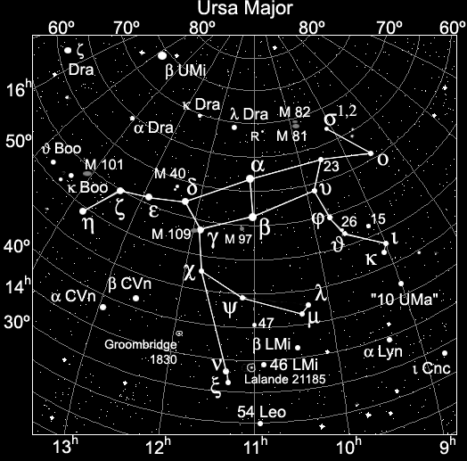
Ursa Major (The Great Bear)
The “Big Dipper”
The “pointer stars”
They point at the North Star
…to help you find it.

Slide 608
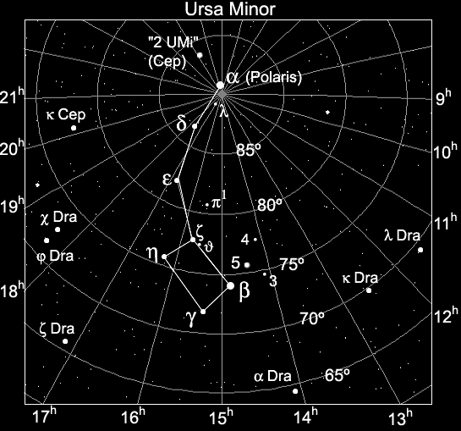
Ursa Minor (The Small Bear)
The “Little Dipper”
The North Star
(NOT the brightest star in the sky)
The Big Dipper
(off the screen)
Big Dipper‘s pointer stars

Slide 609
Sky Search Badge Requirements
Planets
  Which of the nine
  eight planets are visible to the naked eye?
    Mercury – very elusive, close to Sun
    Venus – evening or morning “star”
    Earth – the planet we live on
    Mars – comes closer every two years
    Jupiter – has four large moons and colored bands
    Saturn – rings and many moons

Slide 610
Sky Search Badge Requirements
Planets (cont.)
  Try to locate one of these while stargazing
    Venus – brightest object in the sky (after Sun & Moon), appears in evening or morning.
    Saturn – the ringed planet, now in constellation Leo.
    Jupiter – Rises about 1:30 am in Scorpius, easily visible by 3:30 – 4:00 am.
    Pluto – was downgraded to “dwarf planet” status; NOT visible to the naked eye, but may be seen through a telescope; east of Jupiter now.

Slide 611


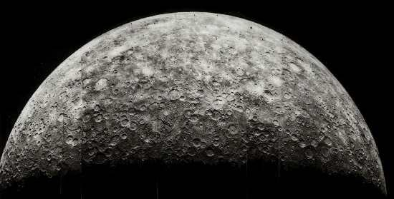
Our Solar System
4,480 km diameter
Average Temperature 167 C
Almost no Atmosphere
The Sun
(Our Star)
Mercury
Norfolk Botanical Garden / Back Bay Amateur Astronomers

Slide 612
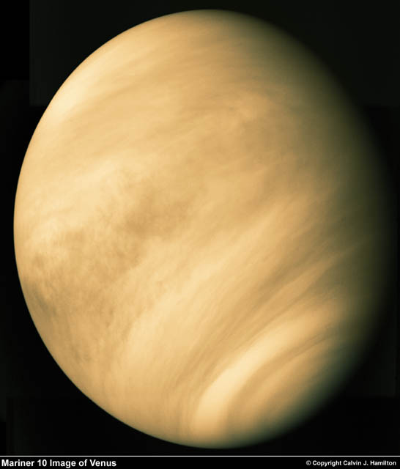
Our Solar System
12,103 km diameter
Our nearest neighbor
Sulphuric Atmosphere
The Sun
(Our Star)
Mercury
Venus
Norfolk Botanical Garden / Back Bay Amateur Astronomers

Slide 613
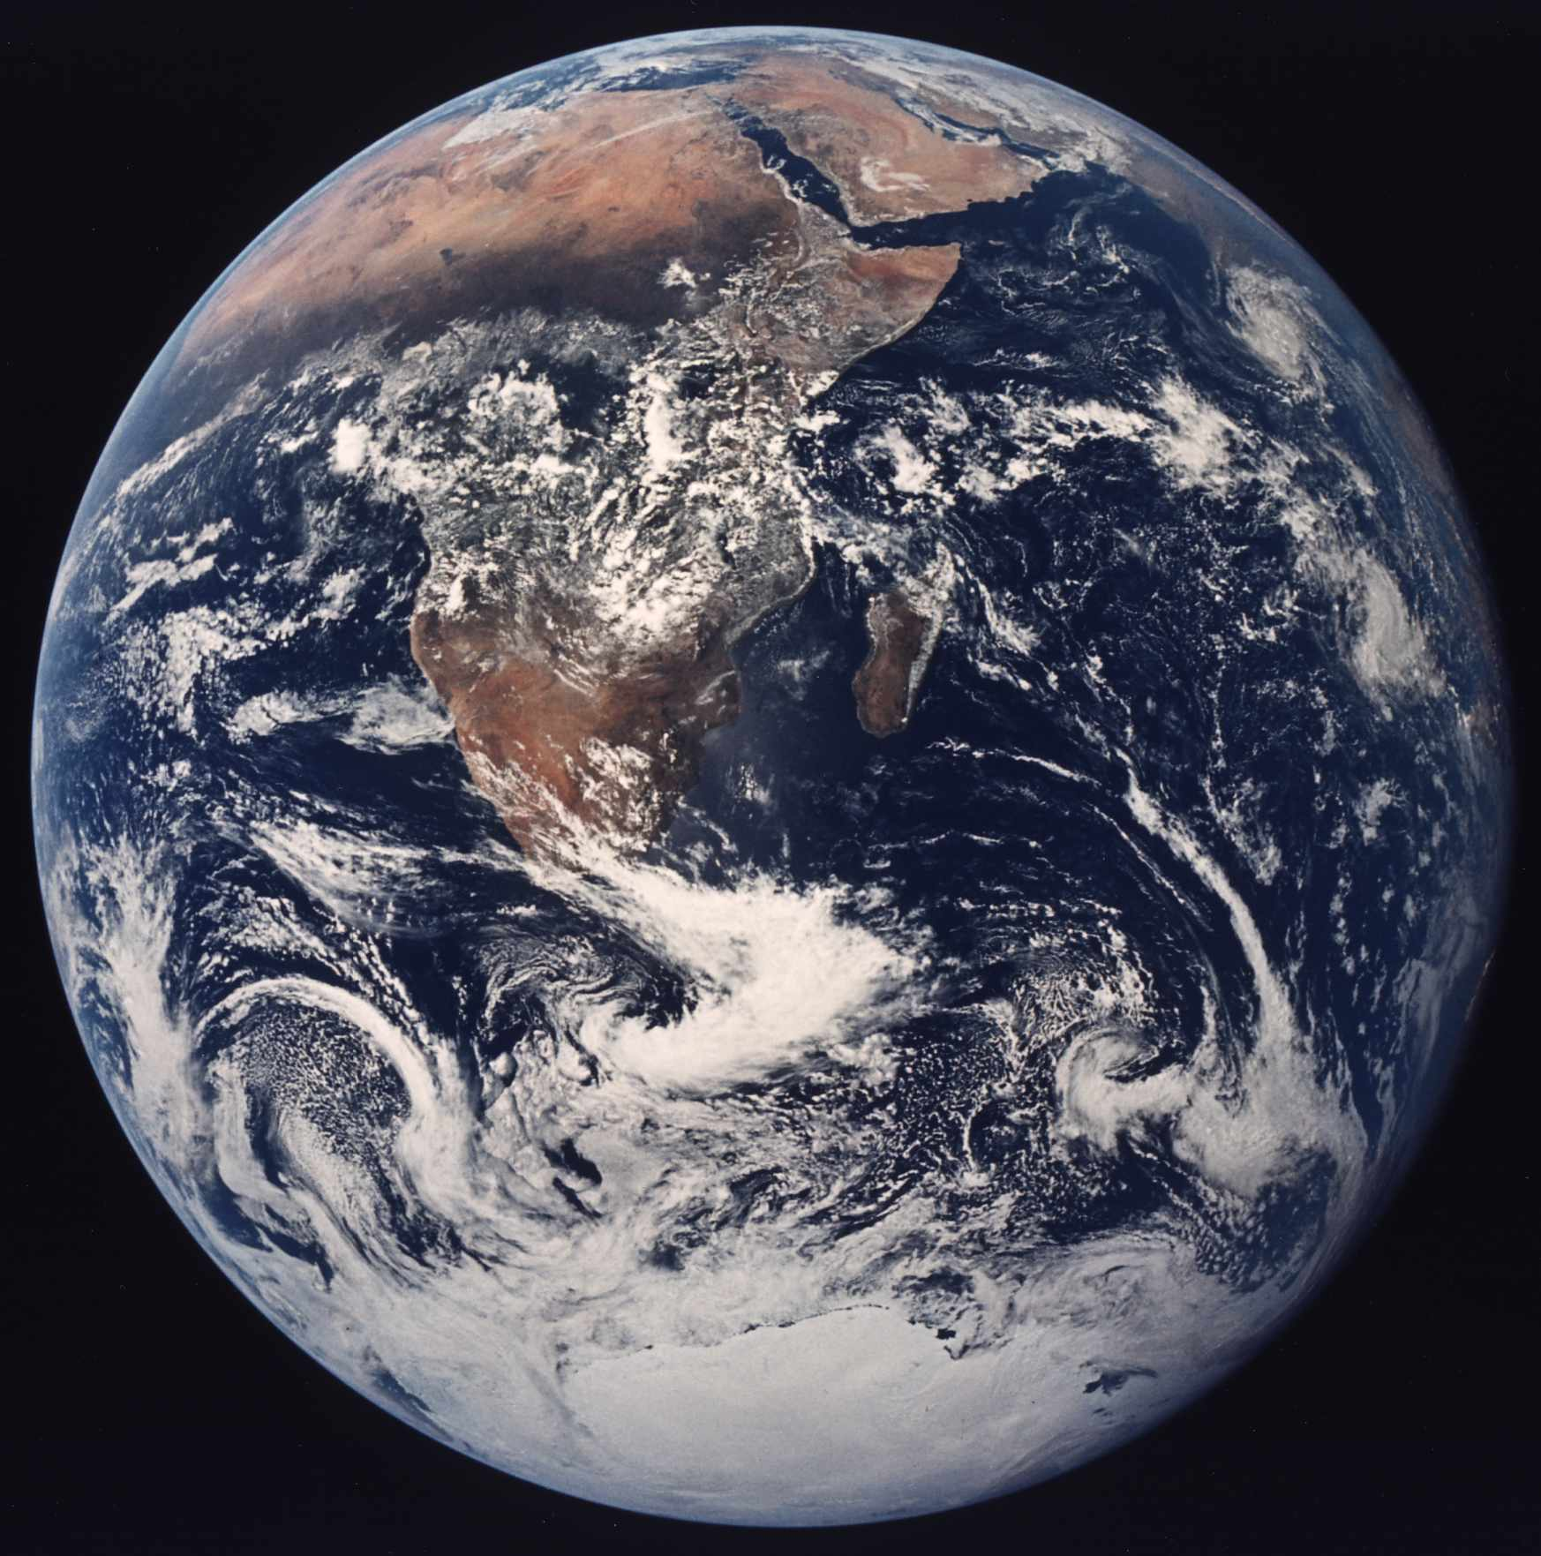
Our Solar System
12,756 km diameter
Our Home
Only Planet with life that we know of
The Sun
(Our Star)
Mercury
Venus
Earth
Norfolk Botanical Garden / Back Bay Amateur Astronomers

Slide 614
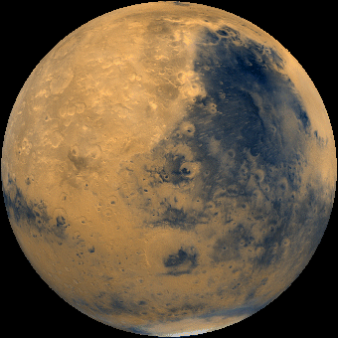
Our Solar System
6,794 km diameter
-133C – 80C Temperature
Possible water (frozen or beneath the surface)
The Sun
(Our Star)
Mercury
Venus
Earth
Mars
Norfolk Botanical Garden / Back Bay Amateur Astronomers

Slide 615
Our Solar System
142,984 km diameter
Gas Giant
63 + Moons
Great Red Spot
The Sun
(Our Star)
Mercury
Venus
Earth
Mars
Jupiter
Norfolk Botanical Garden / Back Bay Amateur Astronomers

Slide 616
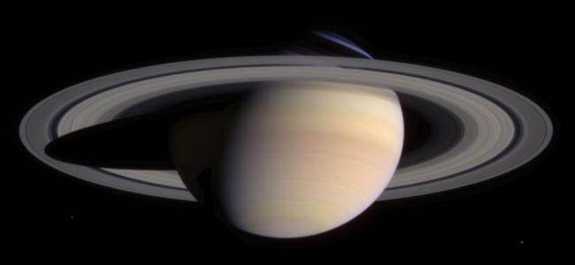
Our Solar System
120,536 km diameter
Gas Planet
Only planet with rings that can be easily seen from earth
The Sun
(Our Star)
Mercury
Venus
Earth
Mars
Jupiter
Saturn
Norfolk Botanical Garden / Back Bay Amateur Astronomers

Slide 617
Sky Search Badge Requirements
Connect the Dots
  Learn some of the stories about the stars and constellations from ancient cultures
  The story of Andromeda, Perseus, & Cassiopeia
  Orion and Scorpius

Slide 618
Sky Search Badge Requirements
Tools of the Trade
  Learn the parts of a telescope
    Lenses and mirrors
    Eyepieces
    Optical tube assembly (OTA)
    Mount
    Finder
    Focuser
  Learn how to use a telescope

Slide 619
Telescope
Telescope ads and department store scopes hype
“magnification”
But the most important feature of a telescope is its
“aperture”,
Or its “light-gathering” power.
A 4.5-inch (114mm) scope gathers 250% MORE light than a 2.4-inch (60mm) scope.

Slide 620
Different Types of Telescopes?
There are three basic types of telescopes.
Refractors use lenses to focus light
(when light passes through glass, it refracts).
Reflectors use mirrors to focus light
(light reflects off of mirrors).
Catadioptric (combination) telescopes use some combination of lenses as well as mirrors (to fold the light path).

Slide 621
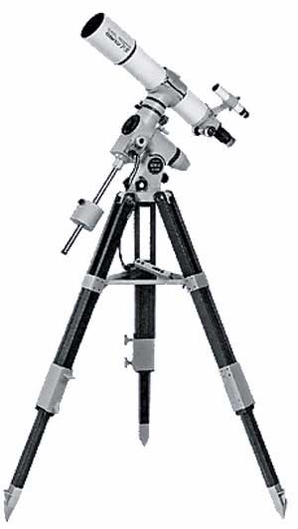
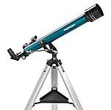
Refractor
    Lenses Eyepieces
    Optical tube assembly (OTA)
    Mount
    Finder
    Focuser

Slide 622
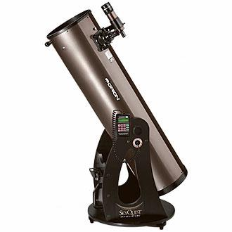
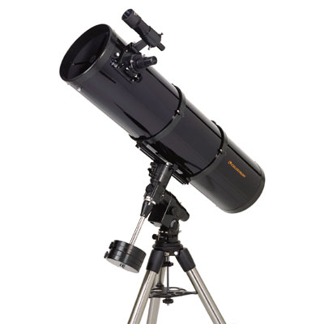
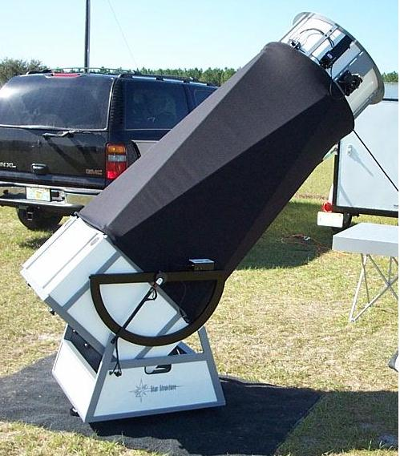
Reflector
    Mirrors Eyepiece
    Optical tube assembly (OTA) Focuser
    Finder Mount

Slide 623
Sky Search Badge Requirements
Time for the Moon
  Learn about the Moon
    Phases
    Age
    Features
  It is almost “New Moon”, so we will not see the Moon tonight.

Slide 624
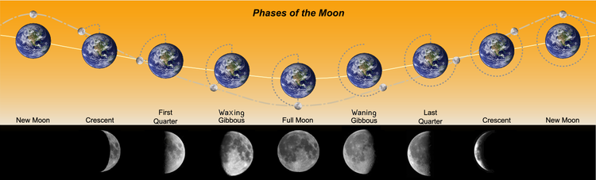
The phases of the Moon have been given the following names, which are listed in sequential order:
Dark Moon - Not visible
New Moon - Not visible, or traditionally, the first visible crescent of the Moon
Waxing Crescent Moon - Right 1-49% visible
First Quarter Moon - Right 50% visible
Waxing gibbous Moon - Right 51-99% visible
Full Moon - Fully visible
Waning gibbous Moon - Left 51-99% visible
Third Quarter Moon - Left 50% visible
Waning Crescent Moon - Left 1-49% visible
New Moon - Not visible

Slide 625
Sky Search Badge Requirements
The Sky is Falling
  Meteors, meteoroids, meteorites
  Meteor showers
  Asteroids
  Comets

Slide 626
Sky Search Badge Requirements
Star Stamps
  Address an envelope including your solar system and galaxy address:
  Example:
    813 Romney Lane
    Virginia Beach, Virginia
    United States of America
    North America
    Terra (Planet Earth)
    Solar System
    Orion Arm
    Milky Way Galaxy

Slide 627
Sky Search Badge Requirements
Mission: Space
  Current space missions
    Mars Rovers “Spirit” and “Opportunity”
    Mars Global Surveyor
    Mars Express (ESA)
    Mars Reconnaissance Orbiter
    Saturn – Cassini/Huygens mission
    Mercury – MESSENGER
    New Horizons mission to Pluto and beyond

Slide 628
Brownies — Space Explorer
1. Night Sky: Go stargazing with someone who knows the planets and the stars, or have someone help you to read a star map. Try to find the North Star, the Big Dipper, the Milky Way, or other constellations. Look for planets and satellites overhead.

Slide 629
Brownies — Space Explorer
2. The Moon: Why does the moon look like it changes shape? The moonlight you see is the sun’s light shining on the part of the moon which is facing us. As the moon orbits the Earth, we see the moon changing its position in the sky. We also observe the hemisphere (side) which faces us go from nighttime, into full daytime, and back again into nighttime. The various shapes which the moon goes through are called its phases.

Slide 630
Girl Scouts Space Exploration Interest Project Patch For Senior and Cadette Girl Scouts, ages 11-17
Requirements
To earn an interest project patch complete at least seven activities as follows:
Two Skill Builders activities
One Technology activity
One Service Project activity
One Career Exploration activity
Two from any category that they choose

Slide 631
Girl Scouts Space Exploration Interest Project Patch
Requirements
Two Skill Builders activities
One Technology activity
One Service Project activity
One Career Exploration activity
Two from any category that they choose

Slide 632
Girl Scouts Space Exploration Interest Project Patch
SKILL BUILDERS
1. Find out about at least four of the following astronomical phenomena: quasars, pulsars, novas, supernovas, black holes, dwarf stars, giant stars, proto-stars, neutron stars, variable stars, cosmic clouds, and globular clusters. Can you observe any of these with the naked eye?
2. Visit a museum, planetarium, observatory, or space center to learn about the history of space exploration, or visit the National Aeronautics and Space Administration (NASA) site on the Internet to find out about projects currently in progress. Make a file of your findings and develop a list of Web sites for others to explore.

Slide 633
Girl Scouts Space Exploration Interest Project Patch
SKILL BUILDERS (cont.)
3. Learn more about the sun and the moon and their relationship to earth. Do two of the following.
  Mark your calendar with the phases of the moon for a month.
  Learn to read an ocean tide chart.
  Make a poster illustrating why and how seasons change.
  Demonstrate what happens during a solar or lunar eclipse.
  Identify a tale or superstition about the sun or the moon. Discuss whether or not this is a valid or even measurable belief.

Slide 634
Girl Scouts Space Exploration Interest Project Patch
SKILL BUILDERS (cont.)
4. With a group discuss "the case for space," addressing issues such as: Who owns space? Who owns the moon? Who should fund space travel or research? What are priorities for research in space? What happens if we find other life in space? Come up with charts and posters depicting your questions and answers.
5. Science fiction often predicts future developments. Read science fiction written in the 1960s or earlier, or view an old science fiction film from the sixties or earlier. How do they appear today in light of the new information people have about space? Or try your hand at writing science fiction. Incorporate technological or social changes brought about by space travel.

Slide 635
Girl Scouts Space Exploration Interest Project Patch
SKILL BUILDERS (cont.)
6. Develop your own space exploration activity. Here are some of the things you might do:
  Explore what countries around the world are doing in space exploration.
  Using a telescope, monitor an object in the night sky for a month.
  Vist NASA and, if possible, view the launching of a space vehicle.
  Develop a space exploration resource file. NASA has many educational materials available to the public.
  Keep a scrapbook of news clippings on items related to astronomy and space exploration.

Slide 636
Girl Scouts Space Exploration Interest Project Patch
Requirements
Two Skill Builders activities
One Technology activity
One Service Project activity
One Career Exploration activity
Two from any category that they choose

Slide 637
Girl Scouts Space Exploration Interest Project Patch
TECHNOLOGY
1. Find out about the capabilities of today's telescopes. If possible, visit an observatory or a site on the World Wide Web to learn more about these telescopes.
2. Investigate the role of mathematics and computer simulations in developing theories about the universe. Talk with someone knowledgeable in astronomy or physics, if possible.

Slide 638
Girl Scouts Space Exploration Interest Project Patch
TECHNOLOGY (cont.)
3. Design a human space colony. Decide whether it is a station in space or one that will be set up on a planet in this solar system. Determine what conditions will need to be considered as well as the purpose of the vehicle/structure, living arrangements, special equipment, health and safety needs, and environmental protection or danger. Share and explain your design or model with others.
4. Build an accurate scale model of a space exploration vehicle. Find out about its design, function, and basic operation. Be able to help others learn about your vehicle.
5. Construct a "flying object" - something that is capable of flight. Be able to explain the scientific principles that governed your design. Determine which actual flight vehicles operate on the same principles.

Slide 639
Girl Scouts Space Exploration Interest Project Patch
Requirements
Two Skill Builders activities
One Technology activity
One Service Project activity
One Career Exploration activity
Two from any category that they choose

Slide 640
Girl Scouts Space Exploration Interest Project Patch
SERVICE PROJECTS
1. Help sponsor an event, such as a space exploration activity day or science career day. Incorporate hands-on and creative activities, such as acting in a play about women who have studied or explored space in some way.
2. Develop a booklet or display that highlights women who have played an important role in the history of flight and space exploration.
3. Help Brownie and Junior Girl Scouts learn about space exploration. Do two of the following: Conduct a night-sky exploration, put on a play about life on a space station, tell a story about a woman astronaut, including her training and achievements, or share stories from different cultures about the night sky.

Slide 641
Girl Scouts Space Exploration Interest Project Patch
SERVICE PROJECTS (cont.)
4. Design a library exhibit about space and astronomy for your school, library or town recreation center. Include books, an activity box, and a list of resources in your display.
5. Using glow-in-the-dark paint, stars, or reflector tape, make an accurate constellation map on a ceiling. The map should include a minimum of twelve constellations in any season. Create a guided tour of the ceiling.

Slide 642
Girl Scouts Space Exploration Interest Project Patch
Requirements
Two Skill Builders activities
One Technology activity
One Service Project activity
One Career Exploration activity
Two from any category that they choose

Slide 643
Girl Scouts Space Exploration Interest Project Patch
CAREER EXPLORATION
1. Check out at least two of the following careers and show how they are linked to the space program: biomedical engineering, meteorology, ceramics, chemistry, industrial engineering, materials science, metallurgy, optical engineering, physiology, and photography.
2. Plan to attend a "space camp" or astronomy camp to get more hands-one experiences.

Slide 644
Girl Scouts Space Exploration Interest Project Patch
CAREER EXPLORATION (cont.)
3. Contact two science societies for professional women related to astronomy or space exploration. Find out what careers are related to space exploration. Also, find out what benefits members of the society receive and whether they have any special programs for young people.
4. List five way that you can maintain your interest in space and/or astronomy. Investigate and list space-related places to visit or activities to pursue in your community or on the Internet

Slide 645
Girl Scouts Space Exploration Interest Project Patch
Requirements
Two Skill Builders activities
One Technology activity
One Service Project activity
One Career Exploration activity
Two from any category that they choose

Slide 646
Don’t Forget to . . .
Keep
Looking
UP!

