Slide 1
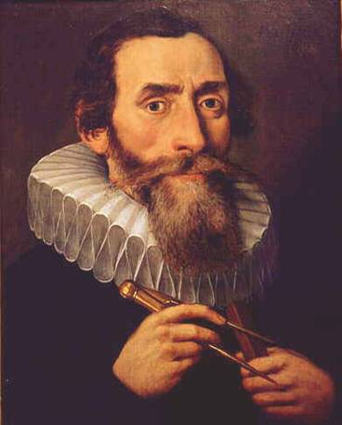
JOHANNES KEPLER
( By permission Sternwarte Kremsmünster)
A guy who’s thought a lot about planets

Slide 2

Kepler Mission
A SEARCH FOR HABITABLE PLANETS
Night Sky Network Presentation
November 16, 2006
David Koch
NASA Ames Research Center

Slide 3
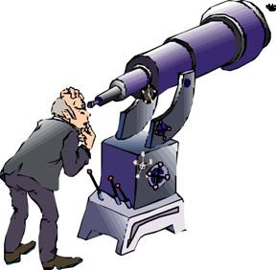
OVERVIEW
What makes for a Habitable Planet
Different Methods for Finding Planets
Planets Discovered to Date
Transit Photometry
Kepler Mission Concept
Expected Results
3

Slide 4

WHAT DOES HABITABLE MEAN TO YOU?
Right temperature
Air
Liquid water
Light to keep you warm and to see
Radiation shield
Asteroid protection
4
Notes:
Before designing an experiment, you need to ask yourself “What am I looking for?”

Slide 5
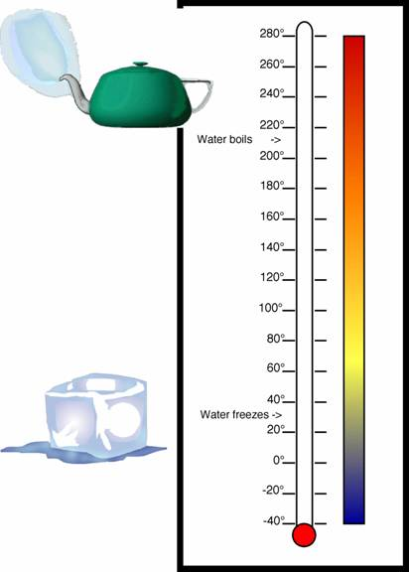
THINGS THAT AFFECT TEMPERATURE
Want temperature so you can have liquid water on the surface of the planet
Temperature of star
Distance from the star
Shape of planet’s orbit: circular or elliptical
Planet’s atmosphere: greenhouse gases
These define the Habitable Zone (HZ) for a star
5

Slide 6
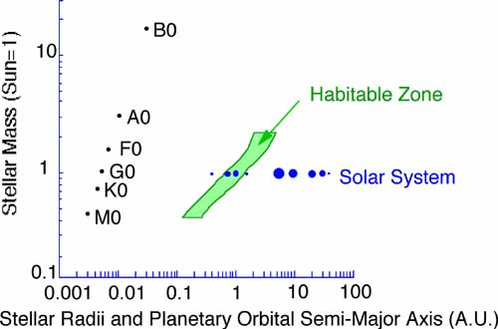
THE HABITABLE ZONE
FOR VARIOUS STELLAR TYPES
The Habitable Zone (HZ) in green is the distance from a star where liquid water is expected to exist on the planets surface. (Kasting, Whitmire and Reynolds, 1993)
6
Notes:
More specifically, the continuously habitable zone

Slide 7
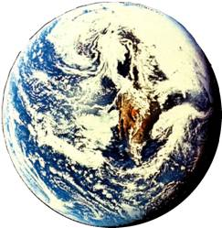
WHAT IS IMPORTANT ABOUT AN ATMOSPHERE?
Composition (Earth)
  free oxygen (about 23%)
  mostly inert (about 75% nitrogen)
  very little toxic gases
Composition affects temperature
  Minimize day-night extremes
  Greenhouse gases (water, CO₂) hold in the heat
Acts as an invisible protective shield
  Cosmic rays (high energy gamma-rays, protons, electrons)
  Solar wind and solar flares (charged particles)
  UV - ultraviolet
  Micrometeoroids (e.g., puts holes in Space Shuttle window)
Transports water
  Rain
7

Slide 8
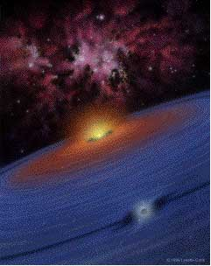
PLANET SIZE AFFECTS HABITABILITY
Planets form by accretion from a disk of gas and dust
Too small (about <0.5 M⊕):
Can’t hold onto a life sustaining atmosphere (Mercury, Mars)
surface gravity g<0.8 G
Too big (about >10 M⊕):
Can hold onto the very abundant light gases (H₂ and He) and turn into a gas giant (Jupiter, Saturn, Uranus, Neptune)
surface gravity g>2.2 G
(Surface gravity proportional to radius)
Copyright Lynnette Cook
8

Slide 9
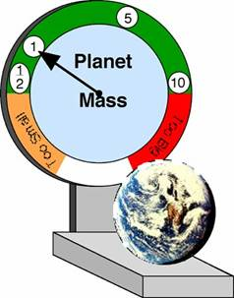
KEY POINTS THAT GUIDE THE SEARCH
Stellar type => Which stars to search
HZ => Orbital periods and how long to look
Planet sizes => Sensitivity or precision needed
More detail: Rare Earth, Ward and Brownlee, Copernicus (Springer-Verlag) ISBN 0-387-98701
9

Slide 10
DETECTING EXTRA-SOLAR PLANETS
That is,
Planets orbiting other stars
10

Slide 11
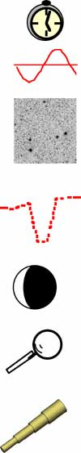
TECHNIQUES FOR FINDING EXTRASOLAR PLANETS
Method Yield Mass Limit Status
Pulsar Timing m/M ; τ Lunar Successful (3)
Radial Velocity m sini ; τ super-Earth Successful (~200)
Astrometry m ; τ ; Ds ; a
Ground: Interferometer sub-Jupiter In development
Space: Interferometer Uranus Being studied
Transit Photometry A ; τ ; sini=1
Ground sub-Jupiter HD209458, OGLE TR-56
Space (2006) sub-Jupiter HST (~16)
Space (2006, 2008) Venus Planned CoRoT, Kepler
Reflection Photometry: albedo*A ; τ
Space Saturn Planned Kepler
Microlensing: f(m,M,r,Ds,DL )
Ground sub-Uranus On-going
Direct Imaging albedo*A ; τ ; Ds ; a ; M
Ground Saturn Being studied
Space Earth Being studied
(Source: J. Lissauer)
11

Slide 12
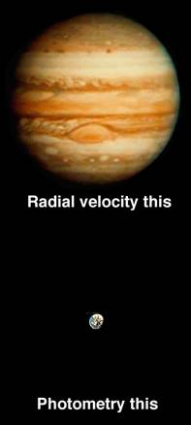
WE NEED A DIFFERENT APPROACH
Radial velocity (Doppler spectroscopy) method unable to detect Earth-size planets
Earth-like planets are about 300 times less massive and about 100 times smaller in area than Jupiter
Need a different approach that can detect smaller planets
No method exists for detecting habitable planets from ground-based observatories
The Kepler Mission uses photometry to detect transits and can detect Earth-size planets from space
The Kepler Mission is optimized to detect habitable planets in the habitable zone of solar-like stars
Exoplanet encyclopedia http://exoplanet.eu
12

Slide 13
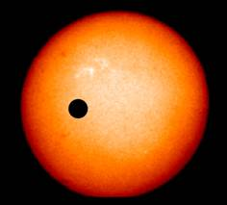
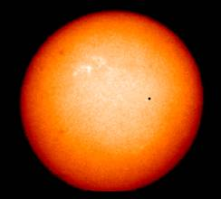
USING PHOTOMETRY TO DETECT EARTH-SIZE PLANETS
The relative change in brightness (ΔL/L) is equal to the relative areas (A_{planet}/A_{star})
To measure 0.01% must get above the Earth’s atmosphere
Method is robust but you must be patience:
Require at least 3 transits preferably 4 with same brightness change, duration and temporal separation
Jupiter:
1% area of the Sun (1/100)
Earth or Venus
0.01% area of the Sun (1/10,000)
13

Slide 14
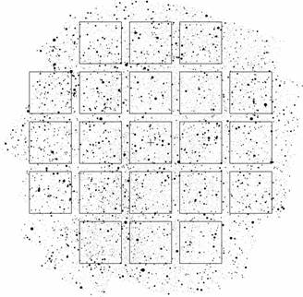
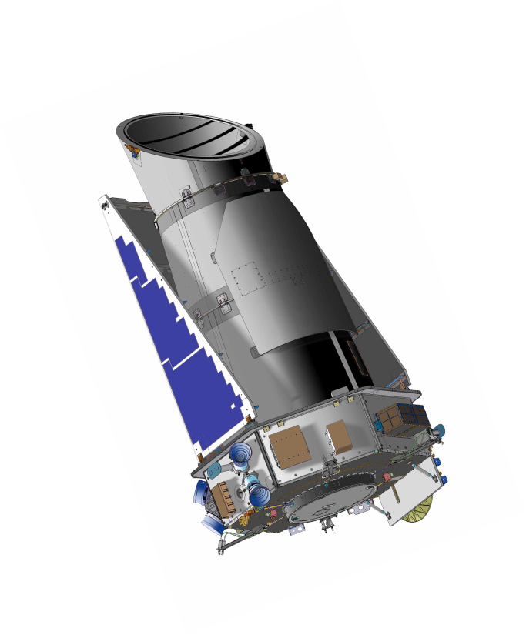

Kepler MISSION CONCEPT
Kepler Mission is optimized for finding
habitable planets ( 0.5 to 10 M⊕ )
in the HZ ( near 1 AU ) of solar-like stars
Continuously and simultaneously
monitor 100,000 main-sequence stars
Use a one-meter Schmidt telescope:
FOV >100 deg² with an array of 42 CCD
Photometric precision:
Noise < 20 ppm in 6.5 hours V = 12 solar-like star
=> 4σ detection for Earth-size transit
Mission:
Heliocentric orbit for continuous viewing
> 4 year duration
14

Slide 15
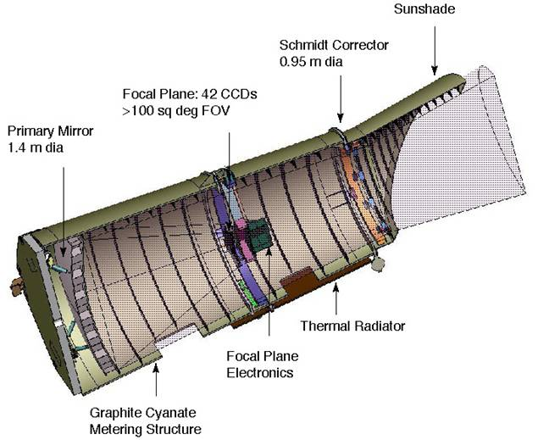
Kepler PHOTOMETER
Photometer = CCDs sensors+ Telescope
Kepler will be 9th largest Schmidt ever built
and the largest telescope launched beyond earth-orbit
15

Slide 16
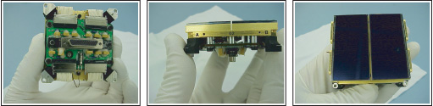
Proto Type CCDs
Views of a prototype module composed of
two CCDs mounted to a common carrier
Each CCD is 2200 columns by 1024 rows, thinned, back-illuminated,
anti-reflection coated, 4-phase devices manufactured by e2v.
Each CCD has two outputs with the serial channel on the long edge.
The pixels are 27 μm square, corresponding to 3.98 arcsec on the sky.
16

Slide 17
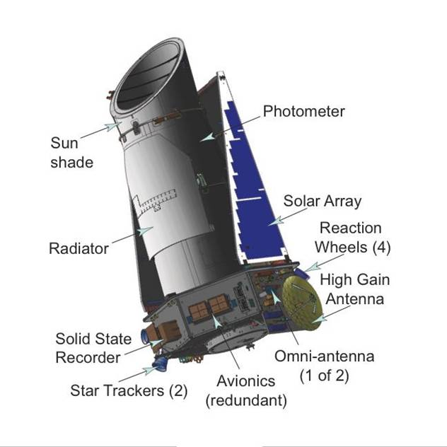
Kepler SPACECRAFT
17

Slide 18
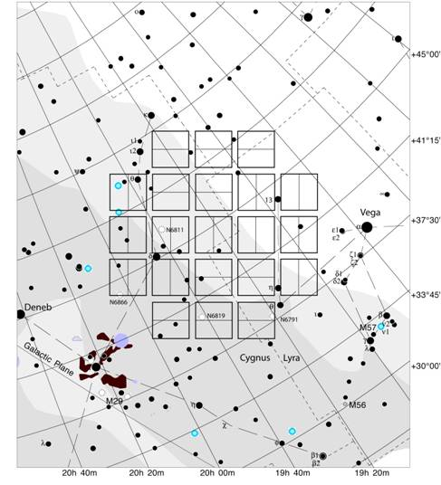
FIELD OF VIEW IN CYGNUS
A region of the extended solar neighborhood in the Cygnus-Lyra regions along the Orion arm of our galaxy has been chosen. Located on one side of the summer triangle (Deneb-Vega-Altair)
18

Slide 19
EXPECTED RESULTS
Hypothesis: all dwarf stars have planets and monitor 100,000 dwarf stars for 4 years
Transits of terrestrial planets:
About 50 planets if most have R~1.0 R⊕ (M~1.0 M⊕ )
About 185 planets if most have R~1.3 R⊕ (M~2.2 M⊕ )
About 640 planets if most have R ~2.2 R⊕ (M~10 M⊕ )
About 70 cases (12%) of 2 or more planets per system
Transits of thousands of terrestrial planets:
If most have orbits much less than 1 AU
Modulation of reflected light of giant inner planets:
About 870 planets with periods ≤1 week, 35 with transits
Albedos for 100 giants planets also seen in transit
Transits of giant planets:
About 135 inner-orbit planet detections
Densities for about 35 giants planets from radial velocity data
About 30 outer-orbit planet detections
Results expected will most likely be a mix of the above
19

Slide 20

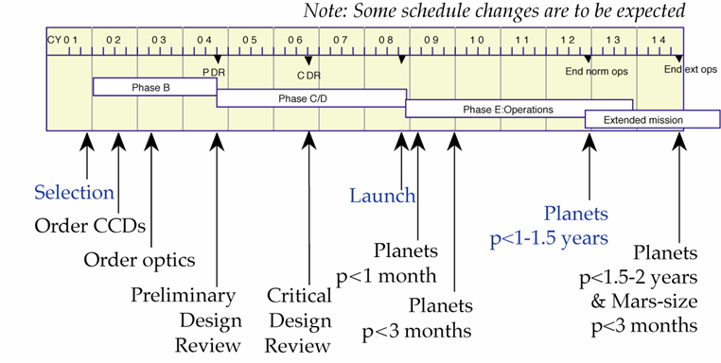
SCHEDULE AND RESULTS
20

Slide 21

SCIENCE TEAM
William Borucki, Principal Investigator, NASA Ames Research Center
David Koch, Deputy Principal Investigator, NASA Ames Research Center
Co-Investigator’s Working Group
G. Basri UC-Berkeley
T. Brown HAO/NCAR
J. Christensen-Dalsgaard
U. Aarhus, Denmark
W. Cochran McDonald Obs./U. Texas
E. DeVore SETI Institute
E. Dunham Lowell Observatory
T. N. Gautier JPL
J. Geary SAO
R. Gilliland STScI
A. Gould Lawrence Hall of Sci/UC-B
J. Jenkins SETI Institute
Y. Kondo NASA/GSFC
D. Latham SAO
J. Lissauer NASA/ARC
Science Working Group
N. Batalha San Jose State University
A. Boss Carnegie Institute of Washington
D. Brownlee University of Washington
D. Caldwell SETI Institute
J. Caldwell York University
A. Dupree SAO
S. Howell Planetary Science Institute
G. Marcy UC-Berkeley
D. Morrison NASA/ARC
T. Owen University of Hawaii
H. Reitsema Ball Aerospace
D. Sasselov SAO
J. Tarter SETI Institute
MANAGEMENT TEAM
Leslie Livesay, Project Manager at Jet Propulsion Lab
Monte Henderson, Program Manager Ball Aerospace, Boulder, CO
www.Kepler.NASA.gov
21

Slide 22
SUMMARY
The Kepler Mission will:
  Observe more than 100,000 dwarf stars
  continuously for 4 to 6+ years
  with a precision capable of detecting Earth’s in the HZ
The Kepler Mission can discover:
  Planet sizes from that of Mars to greater than Jupiter
  Orbital periods from days up to two years
  About 600 terrestrial planetary systems if most have 1 AU orbits
  About 1000 inner-orbit giant planets based on
  already known frequency
  Can expect 100’s to 1000’s of ??? size planets
  depending on frequency ??? and orbit ???
  A NULL result would also be very significant ! ! !
Results expected 3 months after launch (November 2008)
and will continue for 4 to 6+ years
http://kepler.nasa.gov
22

