Slide 1
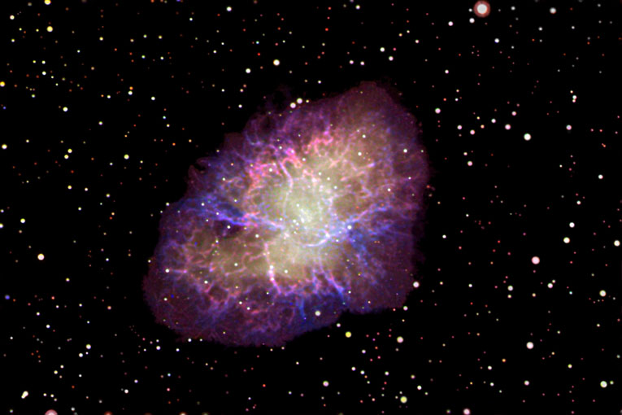

SPACE!
Gimme Some
Presented to
Indian Lakes Elementary School
June 10, 2005

Slide 2


The Back Bay Amateur Astronomers
Bringing Astronomy to the People of Hampton Roads
The Back Bay Amateur Astronomers
PO Box 9877
Virginia Beach, VA 23450

Slide 3
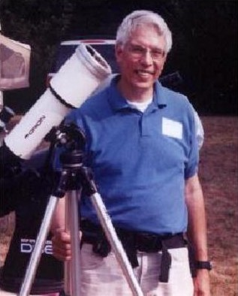
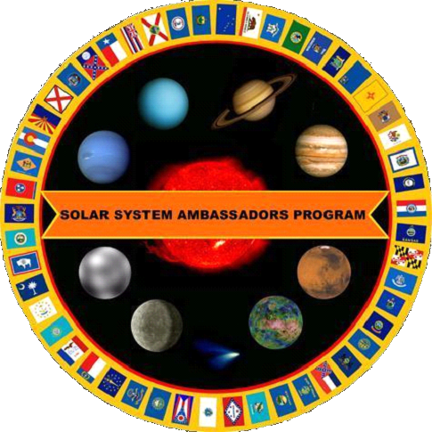
Your “Solar System Ambassador”
George Reynolds

Slide 4
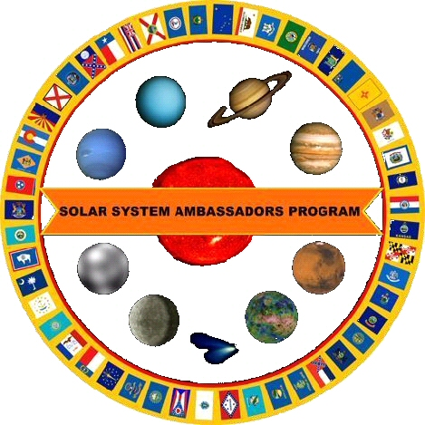
“Solar System Ambassador”
George Reynolds
Assisted by BBAA members…
Matt McLaughlin
Kevin Weiner
Tom Pearson

Slide 5
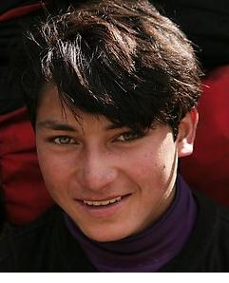
Science is FUN!!

Slide 6
Astronomy...
"Stars in your eyes!"

Slide 7
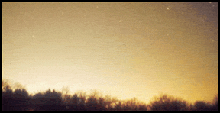
Why can’t I see any stars?
Sky Glow!
Another term for
Light Pollution!

Slide 8
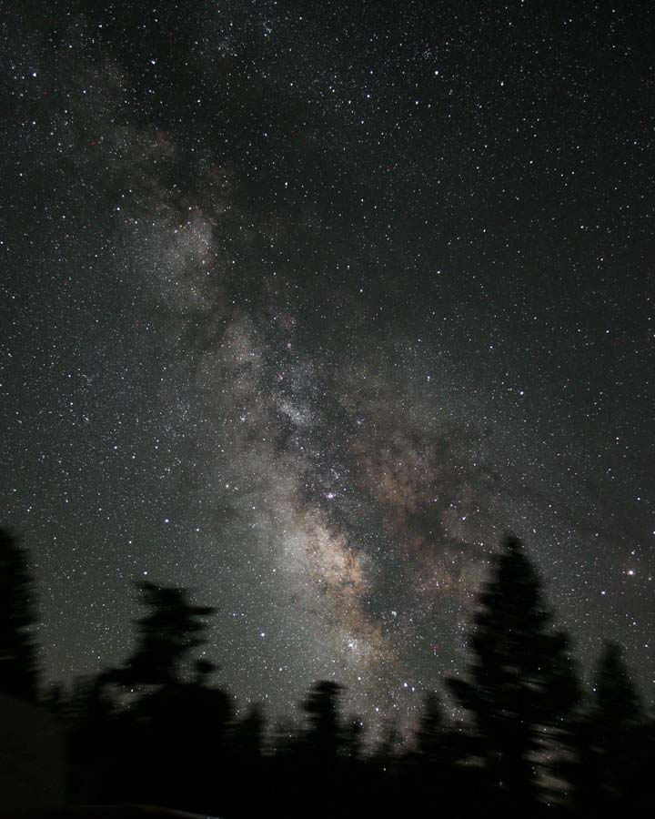
James Jacobson
Here’s what it SHOULD look like!

Slide 9
What can I see in a dark sky?
Stars
Constellations
Planets
Comets
Star Clusters
Nebulas (Nebulae) & Galaxies
Satellites (and Space Junk!)

Slide 10
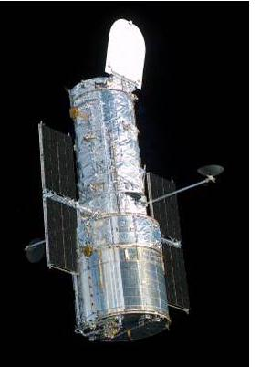
HOW can I see in a dark sky?
The unaided eye (“Naked-eye”)
Binoculars
Telescopes
Hubble Space Telescope
  Always in a dark sky -- in Space, in orbit around Earth
  Above the atmosphere and its pollution
  No humidity, clouds, or rain
Here are some HST photographs . . .

Slide 11
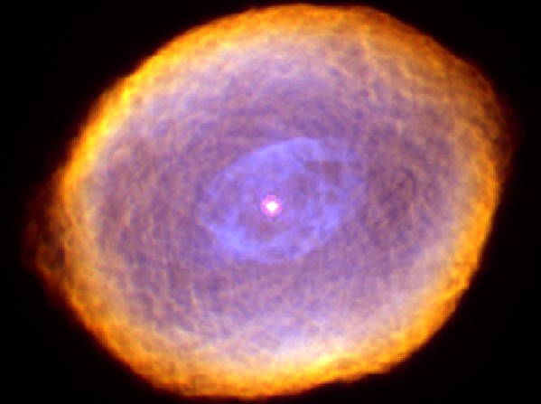
The Spirograph Nebula
Hubble Space Telescope image, Space Telescope Science Institute

Slide 12
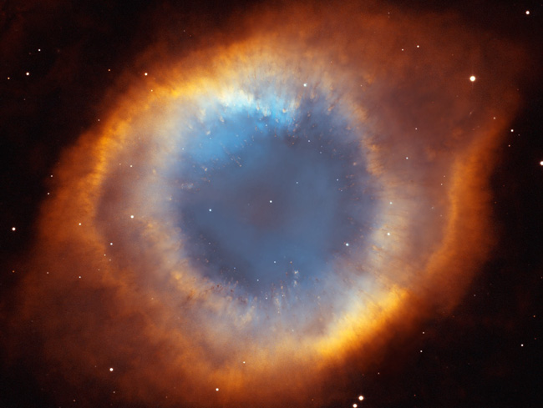
The Helix Nebula (“The Eye of God”)
Hubble Space Telescope image, Space Telescope Science Institute

Slide 13
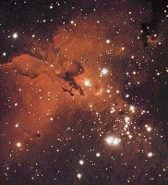
The
Eag
le
Nebula
and
Star
Cluster

Slide 14
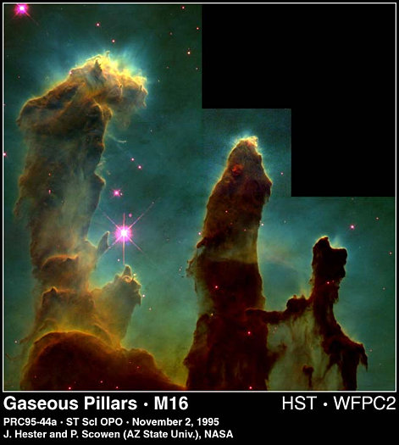
The
Pi
l
lars
of
Creation

Slide 15
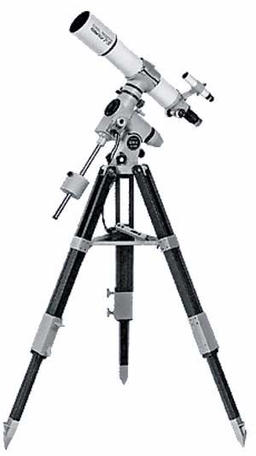
HOW can I see in a dark sky?
The unaided eye (“Naked eye”)
Binoculars
Telescopes
Hubble Space Telescope
  Always in a dark sky -- in Space, in orbit around Earth
  Above the atmosphere and its pollution
  No humidity, clouds, or rain
Telescopes
Here are some photos taken by amateur astronomers . . .

Slide 16
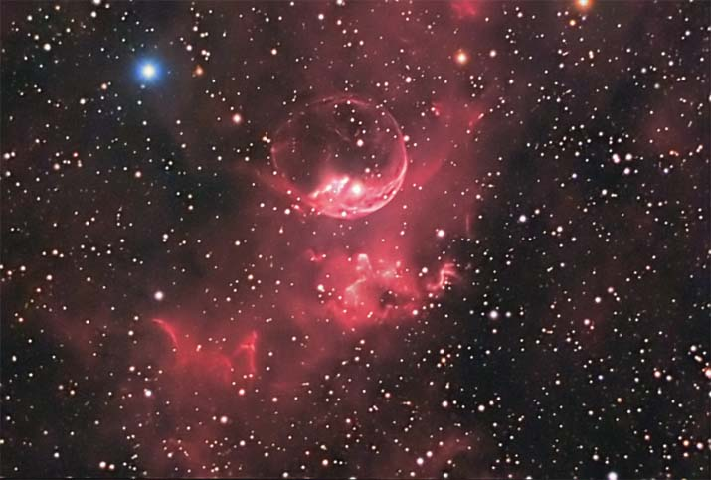
The Bubble Nebula (NGC 7635)
Image courtesy Don Waid, Waid Observatory

Slide 17
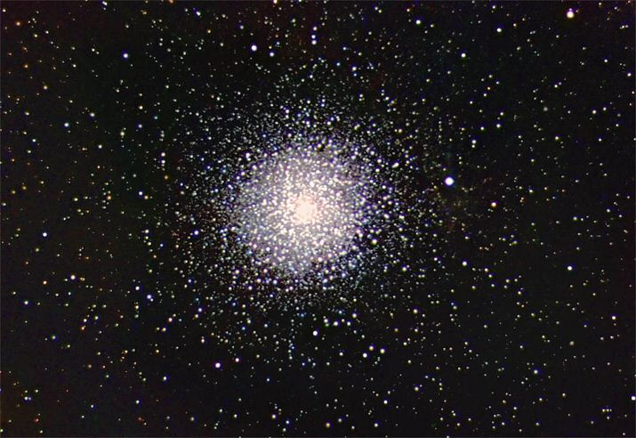
A Globular Star Cluster – a massive ball of hundreds of thousands of stars. This is “M15”.
Image courtesy Don Waid, Waid Observatory

Slide 18
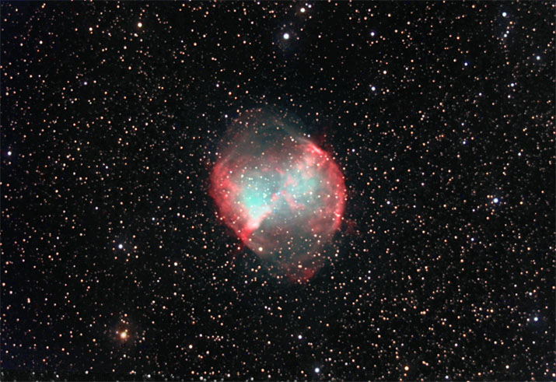
The “Dumbbell Nebula” -- what’s left of a star that exploded thousands of years ago.
Image courtesy Don Waid, Waid Observatory

Slide 19
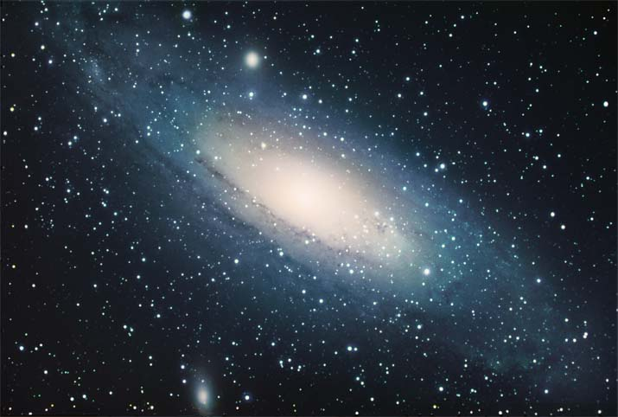

The Andromeda Galaxy – our “neighbor” in space, 2.3 million light years away.
Image courtesy Don Waid, Waid Observatory
Notes:
M31, a galaxy similar in size and shape to opur own Milky Way Galaxy, but even larger, with more stars.
The stars and star clusters we see in the night sky are in our own Milky Way Galaxy. When we look beyond our galaxy, we see thousands of other galaxies, farther and farther away.
Andromeda is in the “Local Group” of nearby galaxies, within a few million light-years distance.

Slide 20
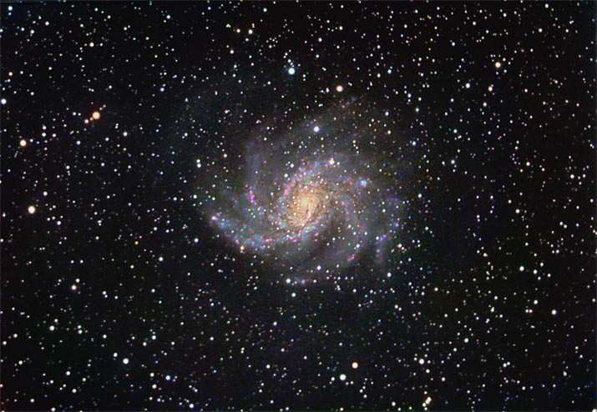

A Spiral Galaxy -- on a vast background of stars
10 million Light-Years distant
Image courtesy Don Waid, Waid Observatory
Notes:
NGC 6946, Approx. 10 million LY away, in the direction of the constellation Cepheus, the King. This is a galaxy out beyond our own Milky Way Galaxy, 4 times as far as the Andromeda Galaxy, on the previous slide.

Slide 21



HOW can I see in a dark sky?
The unaided eye (“Naked eye”)
Binoculars
Telescopes
Hubble Space Telescope
  Always in a dark sky -- in Space, in orbit around Earth
  Above the atmosphere and its pollution
  No humidity, clouds, or rain

Slide 22
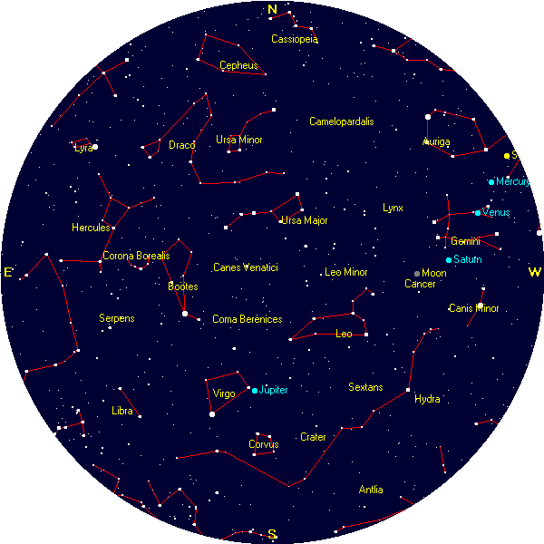
Tonight’s Sky
at 8:00 p.m.
Courtesy, Heavens-Above (www.heavens-above.com)
The unaided eye

Slide 23
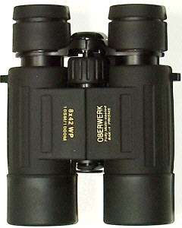
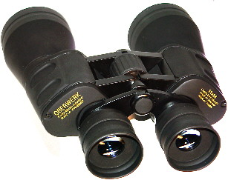
Binoculars
A great way to see the stars . . .
And learn the constellations
“A cheap pair of binoculars is better than a cheap telescope any day!”

Slide 24
Telescope
Telescope ads and department store scopes hype
“magnification”
But the most important feature of a telescope is its
“aperture”,
Or its “light-gathering” power.
A 4.5-inch (114mm) scope gathers 250% MORE light than a 2.4-inch (60mm) scope.

Slide 25
Different Types of Telescopes?
There are three basic types of telescopes.
Refractors use lenses to focus light
(when light passes through glass, it refracts).
Reflectors use mirrors to focus light
(light reflects off of mirrors).
Catadioptric (combination) telescopes use some combination of lenses as well as mirrors (to fold the light path).

Slide 26
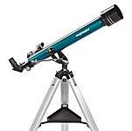
Refractor

Slide 27
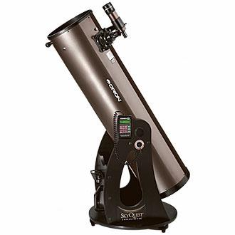
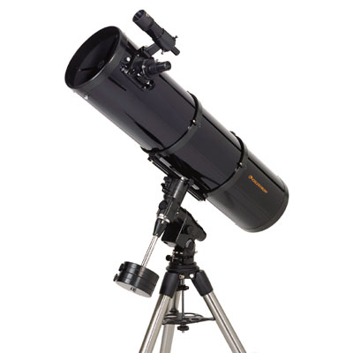
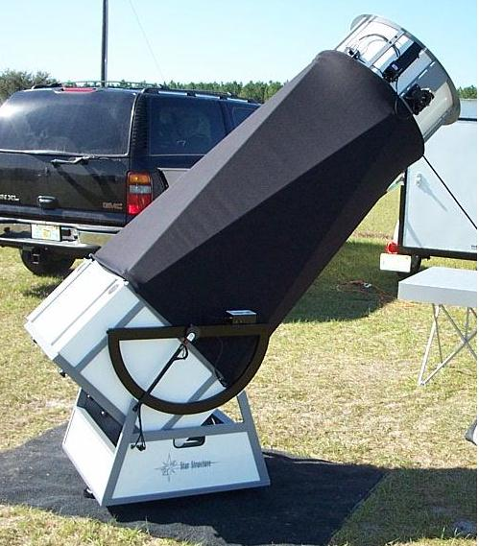
Reflector

Slide 28
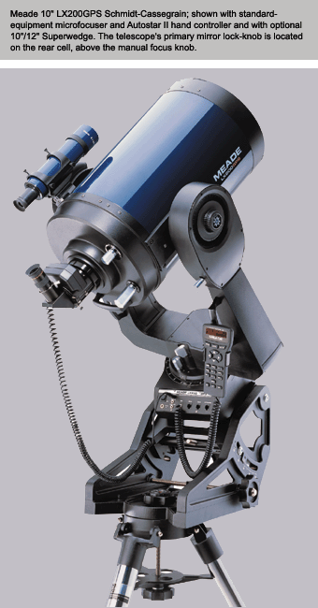
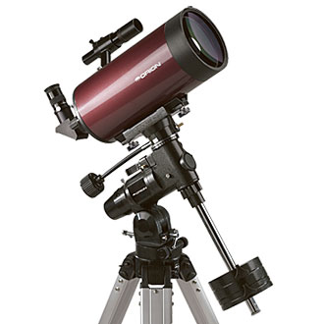
Catadioptric

Slide 29
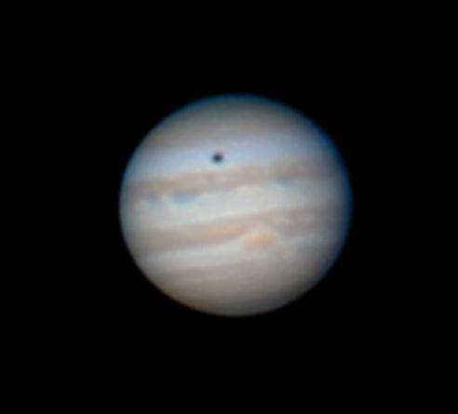
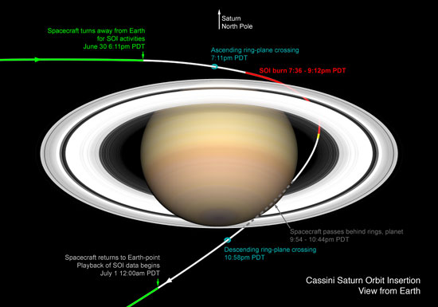
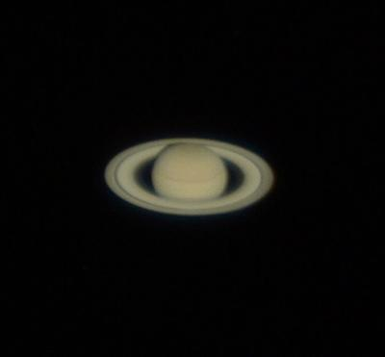
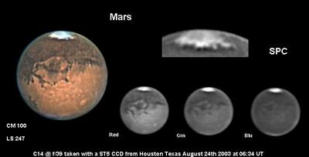
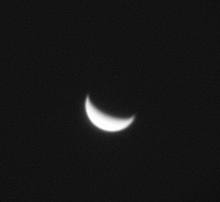
Planets
Saturn
Jupiter
Mars
Venus
All these photos were taken through amateur astronomers’ telescopes.

Slide 30
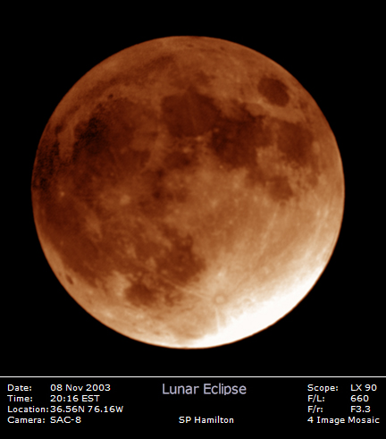
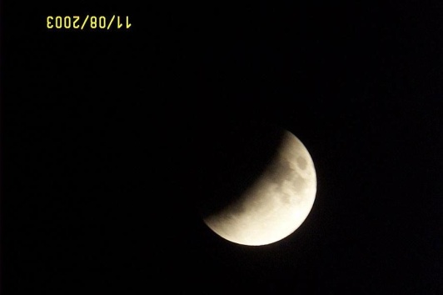
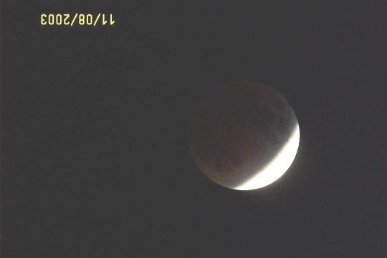
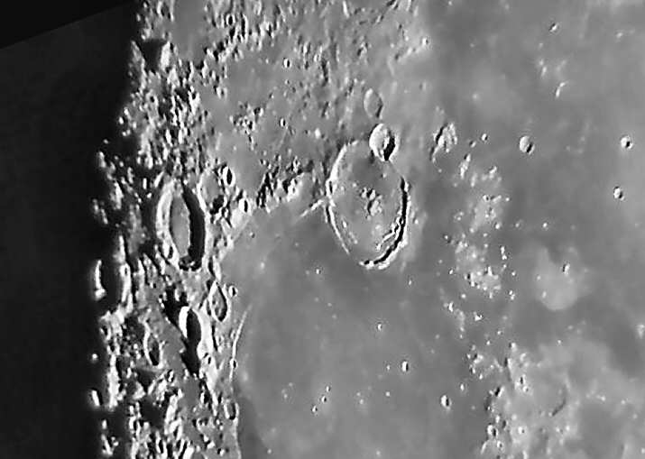
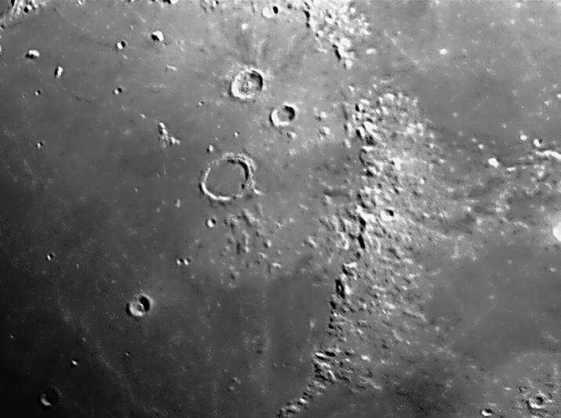
The Moon
Phases
Lunar Eclipse
Craters
Mountains
Photos by Dan Rodgers and Steve Hamilton

Slide 31
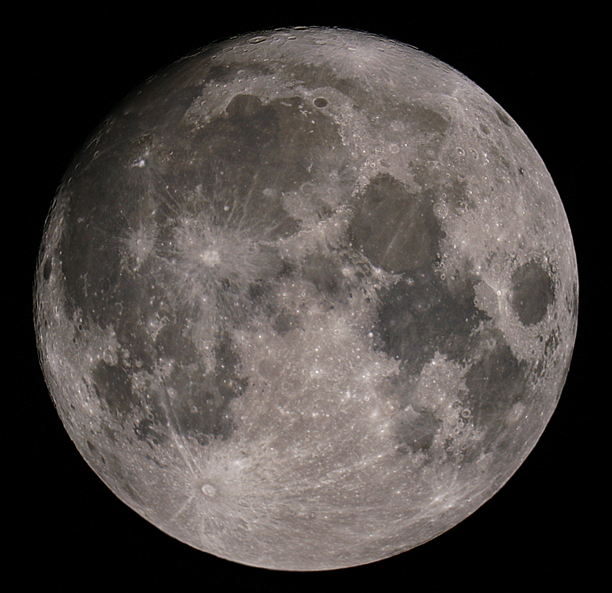
The Moon – The Whole Thing!
Steven P. Hamilton

Slide 32
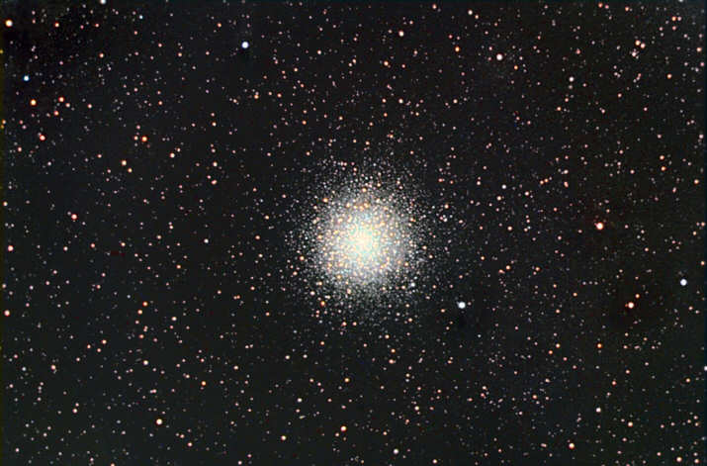
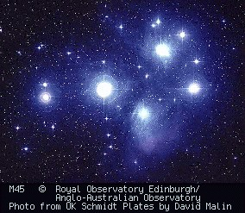
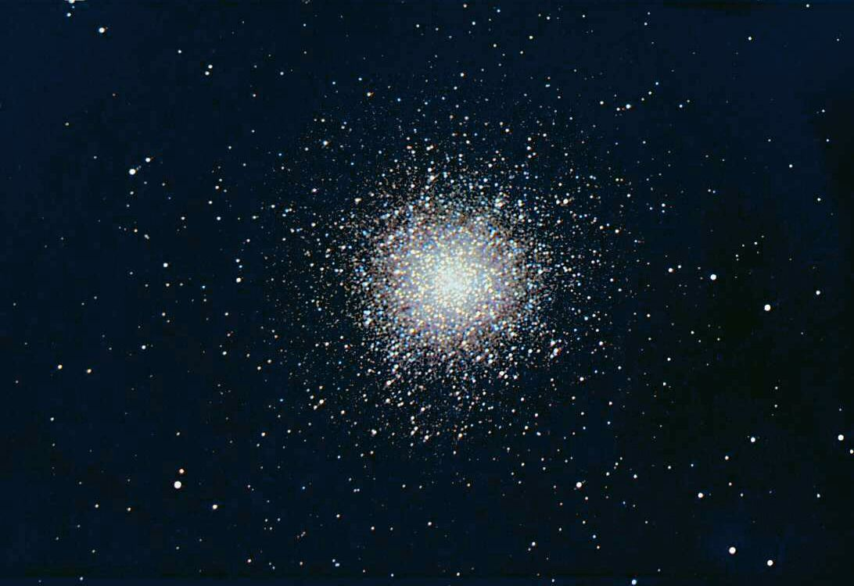
Star Clusters
M80 Globular in Scorpius
Open Cluster –
The Pleiades
Don Waid
M13 Globular in Hercules
Don Waid

Slide 33
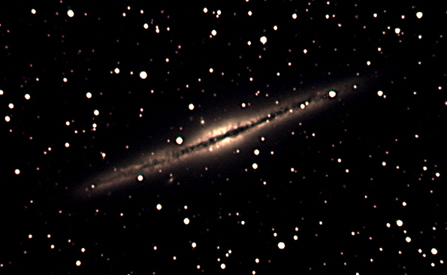
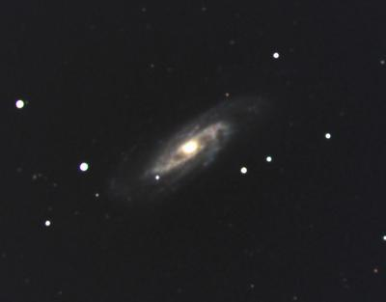
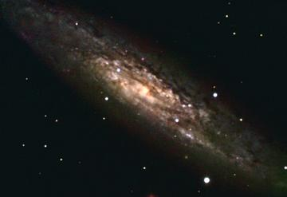
Galaxies
NGC891 Michelle Stone
NGC6946 Don Waid
NGC3192 Michelle Stone
NGC253 Don Waid

Slide 34
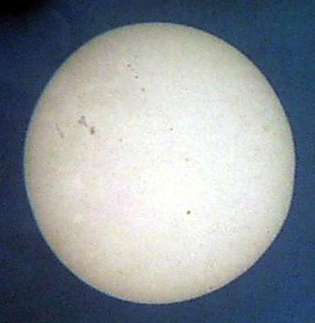
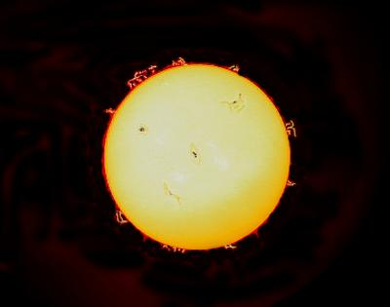
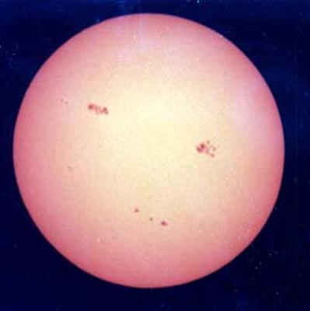
The Sun
CAUTION! NEVER look at the Sun directly without a proper filter!
Sunspots
Solar Flares
More Sunspots

Slide 35
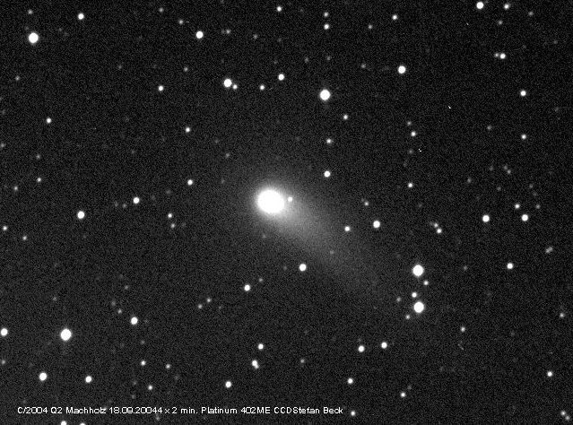
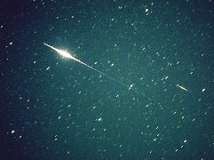
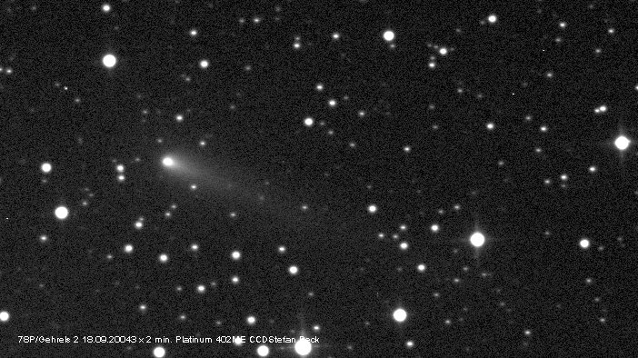
Comets, Meteors, & Satellites
Iridium Satellite
Comet Machholz 10/04/2004
Comet Gehrels 09/18/2004
Meteor + Sound
(67MHz radar echo)

Slide 36


Auroras and other Events
Aurora Borealis
Transit of Venus
Bill Dickinson
Dick Moncure

Slide 37

Photo image by Stephen P. Hamilton
Moon – Jupiter – Venus conjunction 11/9/04

Slide 38

STARS!
STARS!
Photo image by Stephen P. Hamilton

Slide 39

The Great Orion Nebula
Photo image by Richard Dickson
Notes:
The Great Orion Nebula, the “fuzzy star” in the “sword” of Orion the Hunter

Slide 40
Space Exploration . . .
The Final Frontier

Slide 41
Exciting Events for 2005 … and BEYOND!!
Dec 25, 2004 - Huygens probe release
        From the CASSINI spacecraft at Saturn
Dec 30, 2004 - Deep Impact Launch
Jan 14, 2005 - Huygens descent to Titan
Jun 21 - Cosmos 1 Solar Sail launch
July 4 - Deep Impact meets Comet
Jan 15, 2006 - Stardust Sample Return

Slide 42


Cassini Mission to Saturn

Slide 43


Slide 44


Slide 45


Slide 46


Slide 47

STARDUST
STARDUST Flyby of Comet Wild-2
January 2, 2004

Slide 48
The STARDUST Mission
First-ever Comet Sample Return
Launched 1999
Rendezvous Comet WILD-2 Jan. 2, 2004
Return Sample to Earth July 15, 2006
219 days to go!
Counting Down!

Slide 49



Mars Missions
Mars Global Surveyor
Mars Odyssey
Mars Exploration Rovers
“Spirit”
and “Opportunity”

Slide 50

The Mars Exploration Rovers
Opportunity
Spirit

Slide 51

The BBAA has been “bringing astronomy to the people” for more than 26 years.

Slide 52
BBAA
Back Bay Amateur Astronomers invite you to come out to a free public sky watch.
Check our web site for the schedule
http://groups.hamptonroads.com/BBAA/
Northwest River Park, Chesapeake
Use our scopes…
Beware of department store telescopes. Don’t buy one!

Slide 53

Your “Solar System Ambassador”
Thank You! . . . from
George Reynolds
and Matt, Kevin, & Tom…
We urge you . . .

Slide 54
Boldly GO!

