Slide 1
Progressively closer maps of proposed RRRT spot
Maps views made using
DeLorme Topo USA 5.0
Lat/Lon based on WGS84

Slide 2
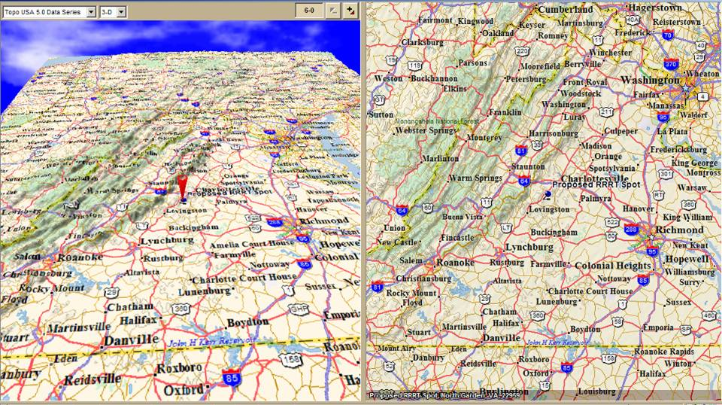
Looking North
Left view 3D rendering / Right Mercator projection

Slide 3
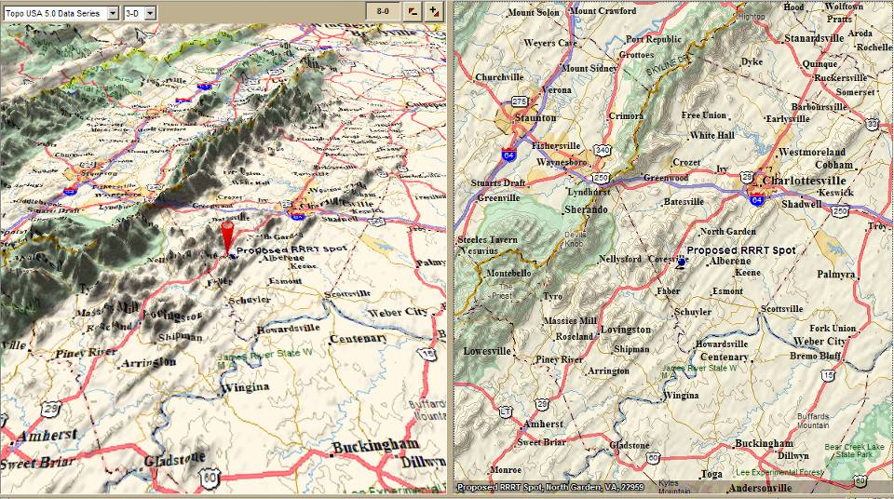
Looking North

Slide 4
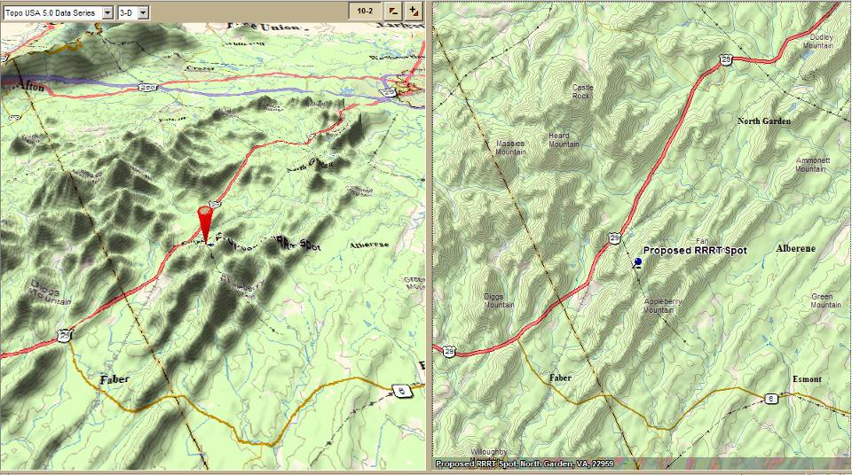
Looking North

Slide 5
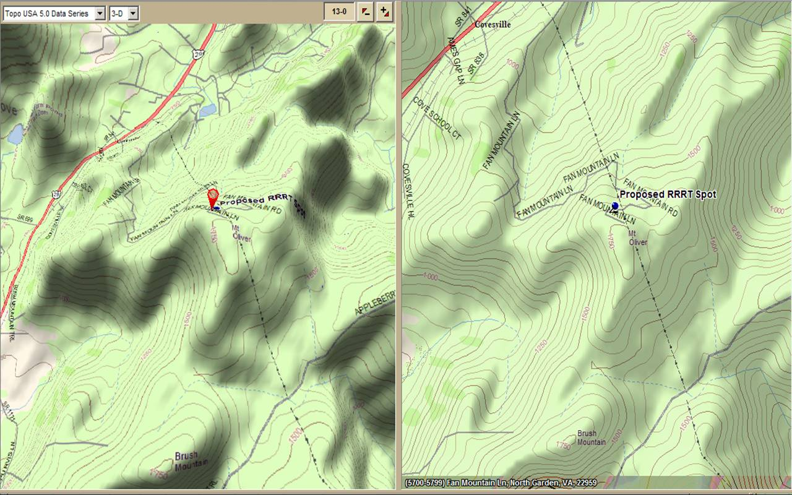
Looking North

Slide 6
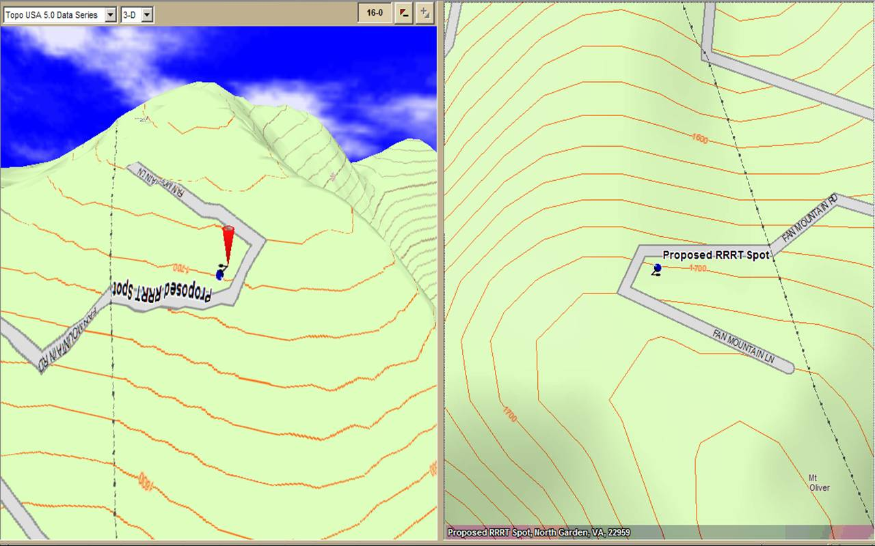
Left view looking South

Slide 7
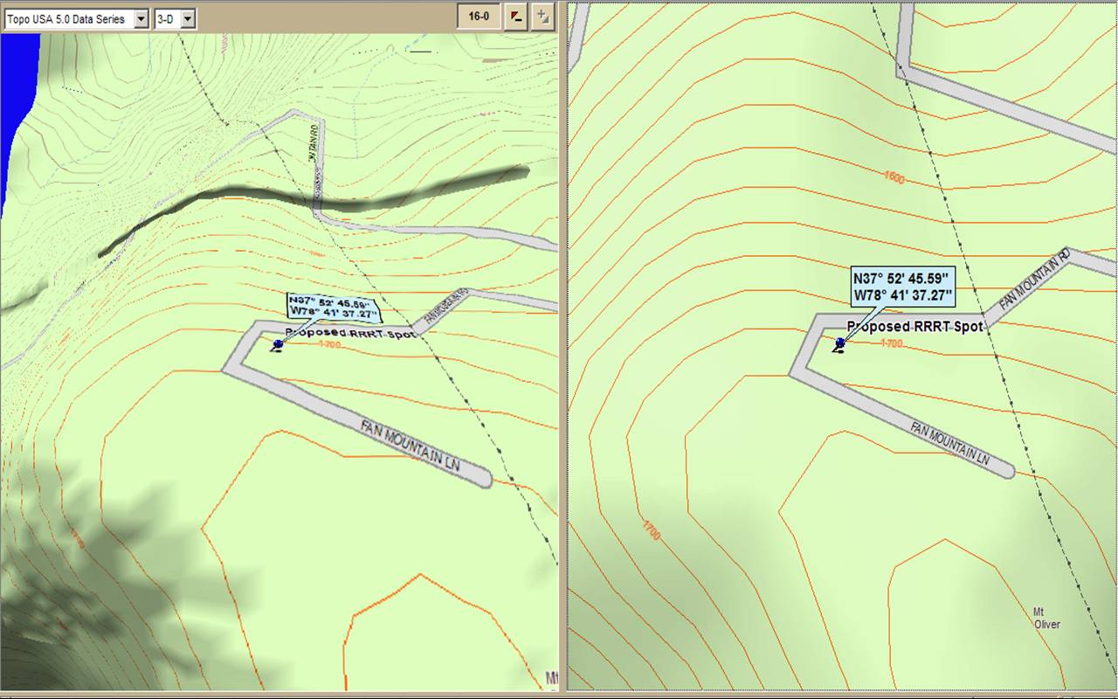
Looking North & Lat/Lon

