Slide 1
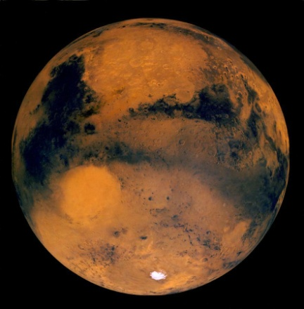
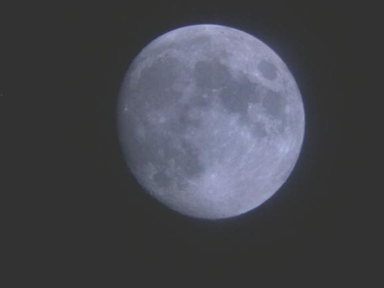
Seeing Into Space
A Presentation for
Greenbrier Intermediate School
February 24, 2004
Amateur Astronomy
Hubble Space Telescope
Space Exploration Missions – in 2004
Notes:
Stardust launched 1999; Comet Wild-2 rendezvous 2 Jan 2004; sample return 2006.
Mars missions ongoing: MGS, Mars Odyssey (already in orbit); Mars Express (ESA) to orbit Dec 2003; MER A & B “Spirit” and “Opportunity” to land 3 Jan and 23 Jan 2004; Nozomi (Japan) “early in 2004” according to the Nozomi home page, http://www.isas.ac.jp/e/enterp/missions/nozomi/index.shtml
Cassini-Huygens launched Oct 1997, will reach Saturn orbit July 2004; Huygens probe will dive to Titan Jan 2005
MESSENGER due to launch in 2004, will fly by Venus and Mercury and go into Mercury orbit in 2009 and carry out comprehensive measurements for one Earth year. Orbital data collection concludes in April 2010.

Slide 2
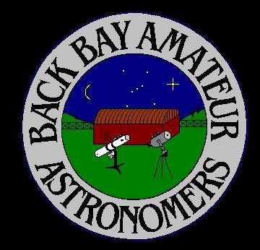
The Back Bay Amateur Astronomers
Bringing Astronomy to the People of Hampton Roads
The Back Bay Amateur Astronomers
PO Box 9877
Virginia Beach, VA 23450

Slide 3
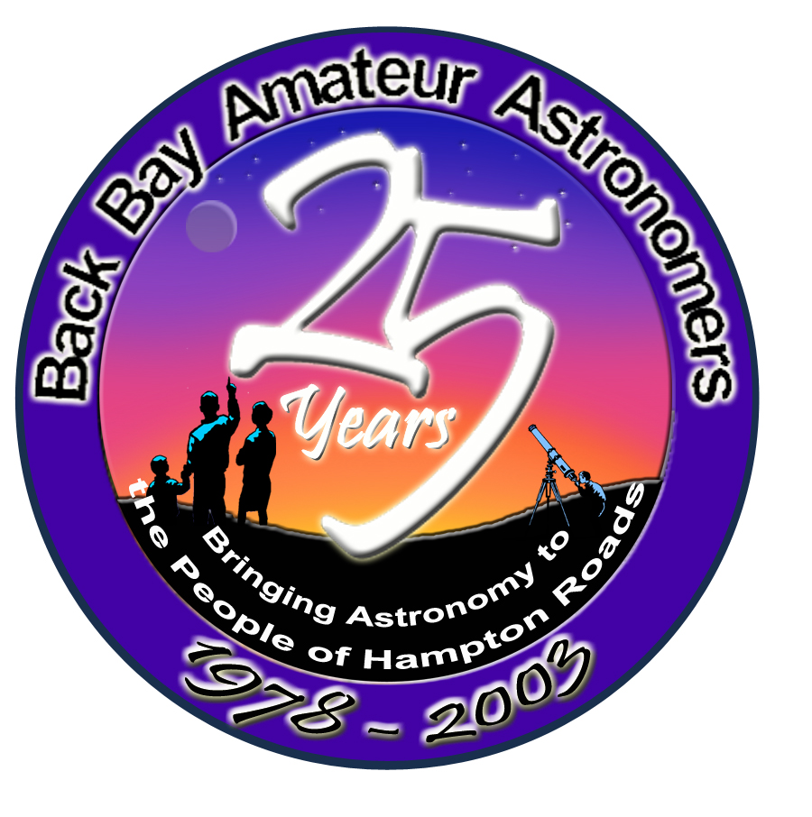
The BBAA has been “bringing astronomy to the people” for 25 years.

Slide 4
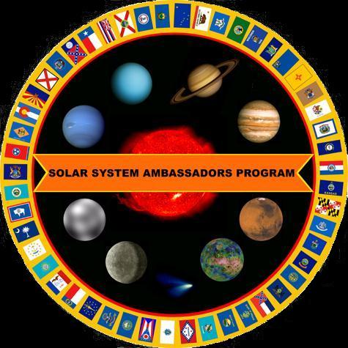
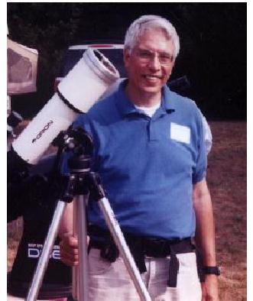
Your “Solar System Ambassador”
George Reynolds

Slide 5
“Solar System Ambassador”
George Reynolds
BBAA members
Ted Forte
Kevin Weiner
Rick Bish
Steve Hamilton

Slide 6
Seeing Into Space
Amateur Astronomy
  Binoculars
  Telescopes
Hubble Space Telescope
Space Exploration Missions – in 2004
  STARDUST
  Mars Missions
  Cassini – mission to Saturn
  MESSENGER – mission to Mercury
Notes:
Stardust launched 1999; Comet Wild-2 rendezvous 2 Jan 2004; sample return 2006.
Mars missions ongoing: MGS, Mars Odyssey (already in orbit); Mars Express (ESA) to orbit Dec 2003; MER A & B “Spirit” and “Opportunity” to land 3 Jan and 23 Jan 2004; Nozomi (Japan) “early in 2004” according to the Nozomi home page, http://www.isas.ac.jp/e/enterp/missions/nozomi/index.shtml
Cassini-Huygens launched Oct 1997, will reach Saturn orbit July 2004; Huygens probe will dive to Titan Jan 2005
MESSENGER due to launch in 2004, will fly by Venus and Mercury and go into Mercury orbit in 2009 and carry out comprehensive measurements for one Earth year. Orbital data collection concludes in April 2010. “MESSENGER” is a convoluted acronym for MErcury Surface, Space ENvironment, GEochemistry and Ranging mission.

Slide 7
Binoculars
Bi – both, or two
Ocular – eyes, relating to the eye
“Seeing with two (or both) eyes”

Slide 8
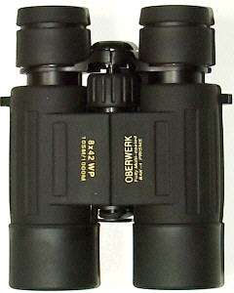
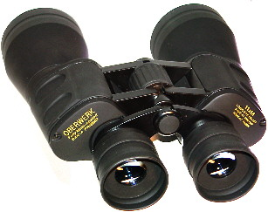
Binoculars
A great way to see the stars . . .
And learn the constellations
“A cheap pair of binoculars is better than a cheap telescope any day!”

Slide 9
Different Types of Telescopes?
There are three basic types of telescopes.
Refractors use lenses to focus light (when light passes through glass, it refracts).
Reflectors use mirrors to focus light (light reflects off of mirrors).
Catadioptric telescopes use some combination of lenses as well as mirrors

Slide 10
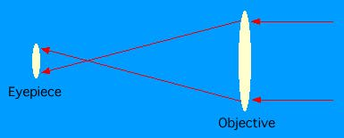
Refractors
A refractor in its simplest form is simply a large convex lens as the objective, and a smaller convex lens as the eyepiece. This form of the refractor telescope was first proposed in 1611 by Johann Kepler.

Slide 11
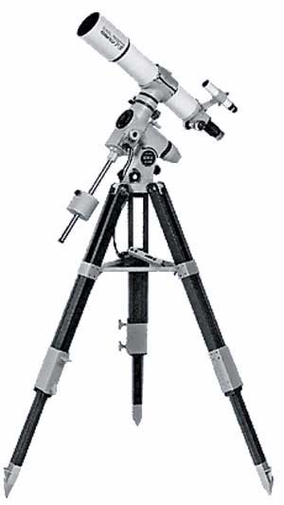
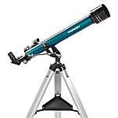
Refractor

Slide 12
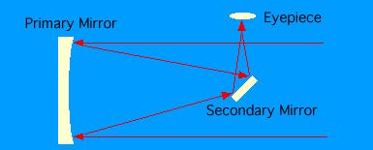
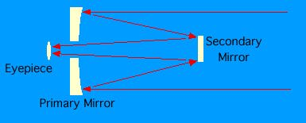
Reflectors
Newtonian
Cassegrain
There are several different types of reflecting telescopes, but all of them use mirrors to focus light. All of the really large telescopes in the world are reflectors, as are the vast majority of amateur telescopes. Invented by Isaac Newton about 1670, the Newtonian was the first successful reflecting type telescope ever built.

Slide 13
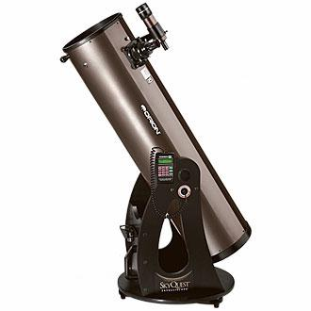
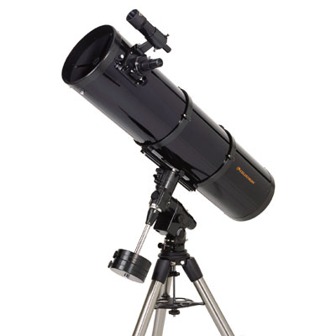
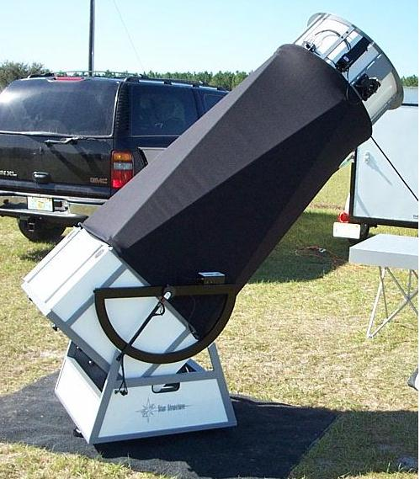
Reflector

Slide 14
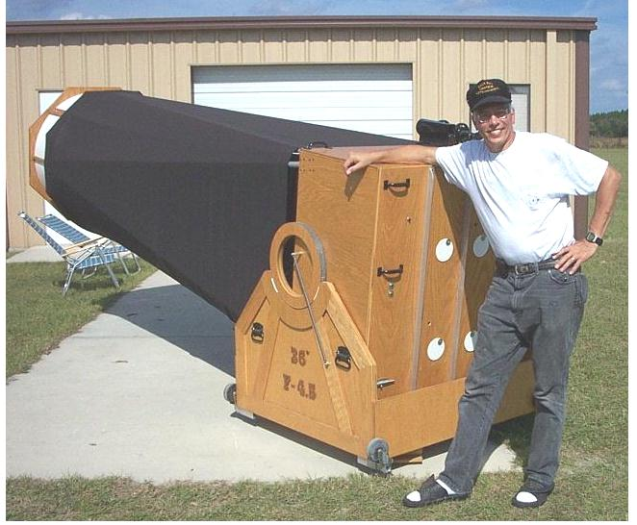
BIG Reflector!
The “YARD SCOPE” – 36-inch mirror
Here I am in Florida
with Tom Clark’s 36-inch
reflecting telescope he
calls the “Yard Scope”
Can you guess why?
  36 inches = 1 yard

Slide 15
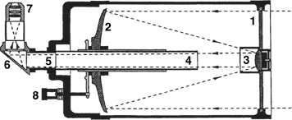
Catadioptric
1. Aspheric Corrector Lens,
2. Primary Mirror,
3. Secondary Mirror (curved out or "convex", and aspheric) and Baffle,
4. Primary Light Baffle Tube and support for Primary Mirror,
5. Rear Cell (accessory holder)
6. Prism or Mirror Diagonal,
7. Eyepiece
8. Focus Control Dial
Any of a number of combined telescope designs, using both a lens and mirrors. Examples are the Schmidt-Cassegrain and Maksutov-Cassegrain. Because the light path is folded twice, the telescope is very compact .

Slide 16
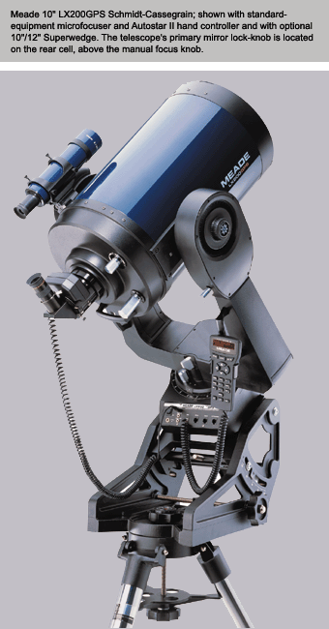
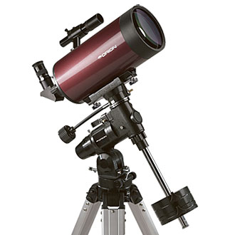
Catadioptric
Notes:
Maksutov-Cassegrain (Orion StarMax) on equatorial mount and Schmidt-Cassegrain (Meade LX200GPS) on fork mount.

Slide 17
What you can see with a Telescope
The Planets
Mars
Venus
Jupiter
Saturn
Uranus
Neptune

Slide 18
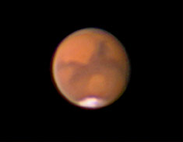
MARS

Slide 19
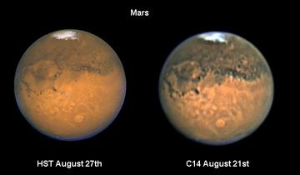
MARS
Comparison between Hubble Space Telescope and amateur Celestron-14 pictures of Mars.

Slide 20
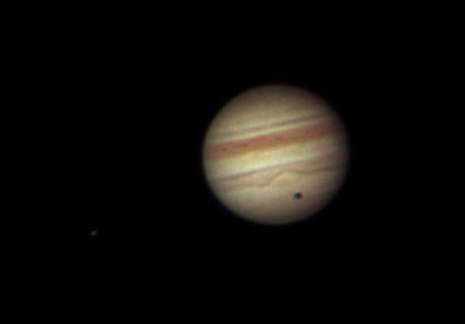
JUPITER

Slide 21
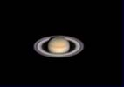
SATURN

Slide 22
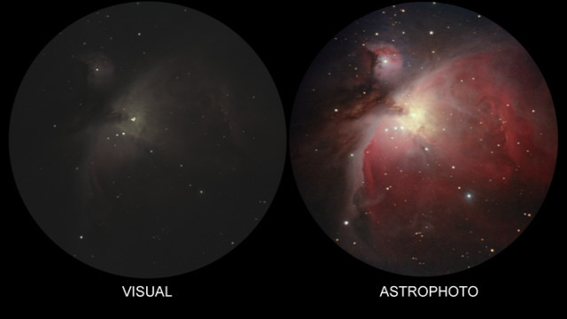
Deep Sky (The Orion Nebula)

Slide 23
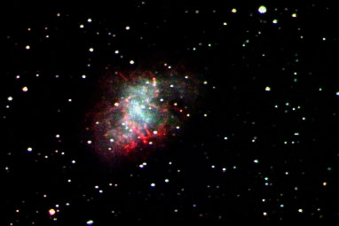
M1 – The Crab Nebula

Slide 24
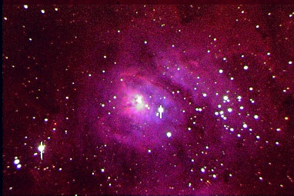
M8 – The Lagoon Nebula

Slide 25
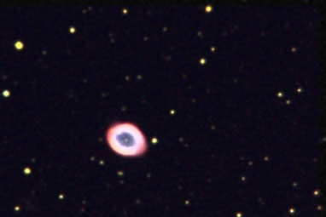
M57 – The Ring Nebula

Slide 26
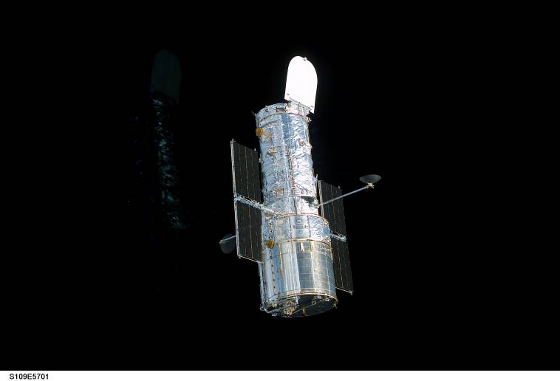
Hubble Space Telescope

Slide 27
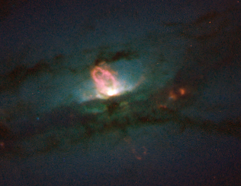
NGC 4438 – A galaxy in Virgo

Slide 28
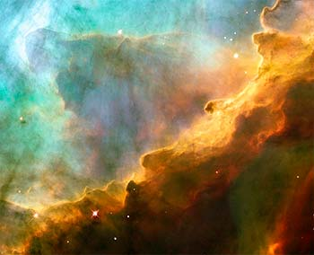
M17 – The Eagle Nebula

Slide 29
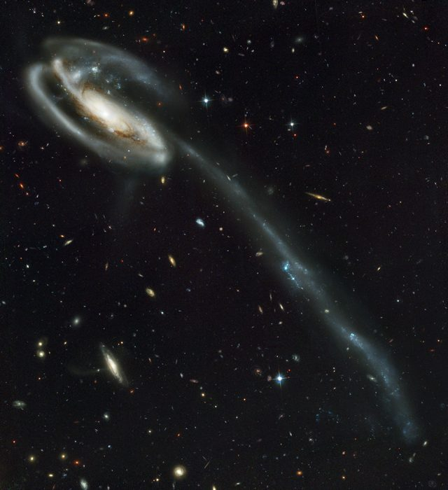
Tadpole Galaxy

Slide 30
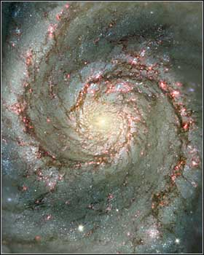
M51 – The Whirlpool Galaxy

Slide 31
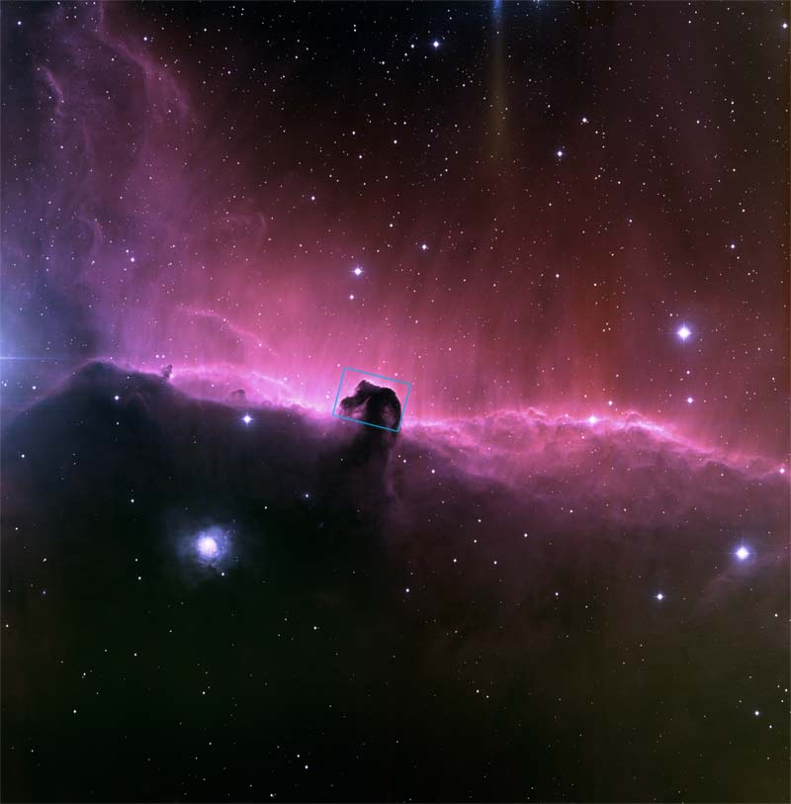
The Horsehead Nebula

Slide 32
Comparison of Hubble Space Telescope (HST) images with those seen through smaller, ground-based telescopes:

Slide 33
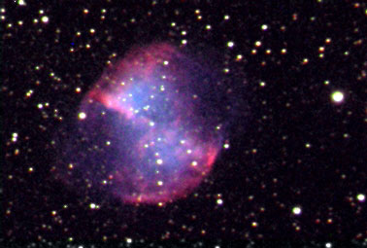
M27 – The Dumbbell Nebula (HST image)
M27 – The Dumbbell Nebula (view from a ground-based telescope)

Slide 34
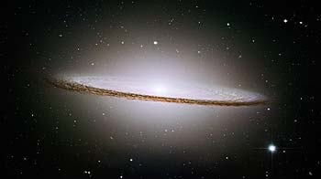
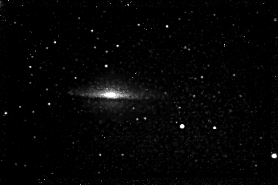
M104 Sombrero Galaxy (HST view)
M104 – The Sombrero Galaxy (ground-based telescope view)

Slide 35

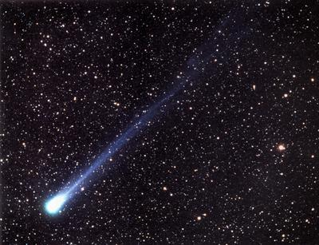
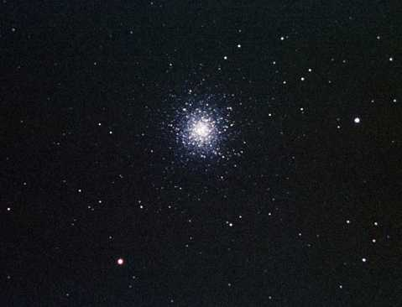
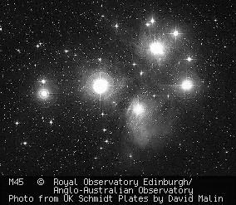
SPACE EXPLORATION:
Missions of Discovery

Slide 36
Exciting Events for 2004… and Beyond !!
January 2 -- STARDUST meets comet
January 3-4 – Spirit lands on Mars
January 23 – Opportunity lands on Mars
May 11-23 – MESSENGER Launch to Mercury
July 1 – Cassini orbits Jupiter
December 30 – Deep Impact Launch
Dec 25 – Huygens probe release
Jan 14, 2005 – Huygens descent to Titan
July 4, 2005 – Deep Impact to Hit Comet

Slide 37
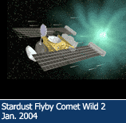
STARDUST

Slide 38
The STARDUST Mission
First-ever Comet Sample Return
Launched 1999
Rendezvous Comet WILD-2 1-2-2004
Return to Earth January 15, 2006
690 days to go!
Counting Down!

Slide 39
Mars Exploration Rover missions
(named Spirit and Opportunity)
Part of NASA's Mars Exploration Program, a long-term effort of robotic exploration of Mars.
Scientific goals: To search for evidence of water on Mars by analyzing rocks and soils that hold clues to past water activity on the red planet.
Spacecraft target: Sites that appear to have been affected by liquid water in the past
They were named by a 9-year old girl in a NASA contest to choose names for these two missions.

Slide 40
The primary science instruments on Spirit and Opportunity
Panoramic Camera (Pancam)
Miniature Thermal Emission Spectrometer (Mini-TES)
Mössbauer Spectrometer (MB)
Alpha Particle X-Ray Spectrometer (APXS)
Magnets: for collecting magnetic dust particles. They will also analyze the composition of magnetic minerals in airborne dust and rocks that have been ground by the Rock Abrasion Tool.
Microscopic Imager (MI): for obtaining close-up, high-resolution images of rocks and soils.
Rock Abrasion Tool (RAT): for removing dusty and weathered rock surfaces and exposing fresh material for examination by instruments onboard.

Slide 41
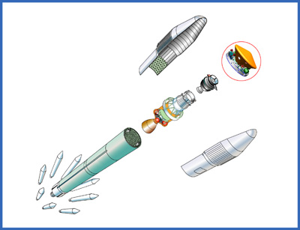
The launch vehicle
A launch vehicle provides the velocity needed by a spacecraft to escape Earth's gravity and set it on its course for Mars.

Slide 42
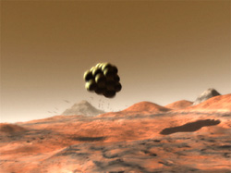
Airbags
Airbags used in the Mars Exploration Rover mission are the same type that Mars Pathfinder used in 1997. Airbags must be strong enough to cushion the spacecraft if it lands on rocks or rough terrain and allow it to bounce across Mars' surface at freeway speeds after landing. To add to the complexity, the airbags must be inflated seconds before touchdown and deflated once safely on the ground.

Slide 43
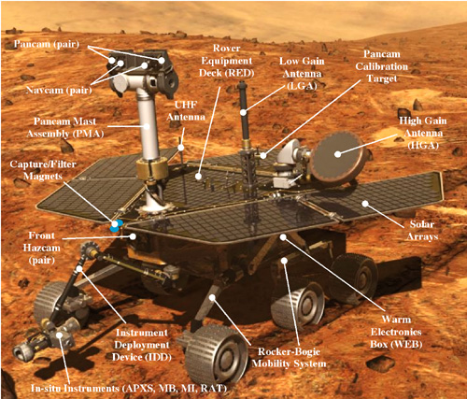
The Mars Exploration Rovers

Slide 44

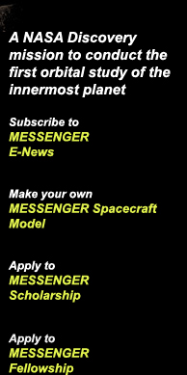
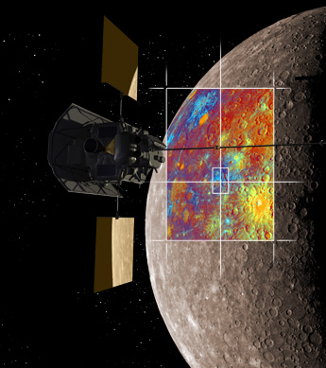
MESSENGER Scheduled Launch Window:
May 11-23, 2004

Slide 45
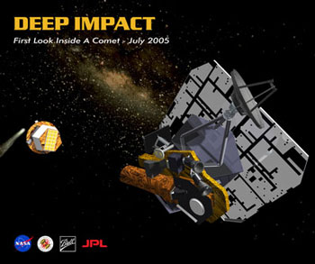
Deep Impact
Launch is planned for
December 30, 2004.
The projected impact is planned for July 4, 2005.

Slide 46

“KEEP LOOKING UP”
Learn the planets, stars and constellations
  Your own unaided eyes
Binoculars and a Planisphere
Telescopes
Watch for news of Space Exploration
We live in EXCITING times!

Slide 47
Your “Solar System Ambassador”
George Reynolds

