Slide 1
Please take your seat

Slide 2
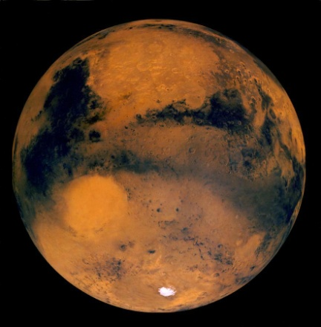

Seeing Into Space
A Presentation for
Ruffner Middle School
March 1, 2006
Amateur Astronomy Telescopes
Hubble Space Telescope
Notes:
Stardust launched 1999; Comet Wild-2 rendezvous 2 Jan 2004; sample return 2006.
Mars missions ongoing: MGS, Mars Odyssey (already in orbit); Mars Express (ESA) to orbit Dec 2003; MER A & B “Spirit” and “Opportunity” to land 3 Jan and 23 Jan 2004; Nozomi (Japan) “early in 2004” according to the Nozomi home page, http://www.isas.ac.jp/e/enterp/missions/nozomi/index.shtml
Cassini-Huygens launched Oct 1997, will reach Saturn orbit July 2004; Huygens probe will dive to Titan Jan 2005
MESSENGER due to launch in 2004, will fly by Venus and Mercury and go into Mercury orbit in 2009 and carry out comprehensive measurements for one Earth year. Orbital data collection concludes in April 2010.

Slide 3
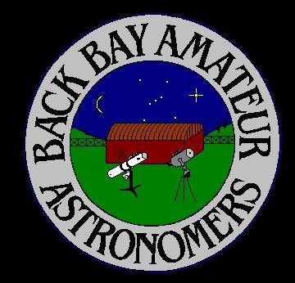
The Back Bay Amateur Astronomers
Bringing Astronomy to the People of Hampton Roads
The Back Bay Amateur Astronomers
PO Box 9877
Virginia Beach, VA 23450

Slide 4
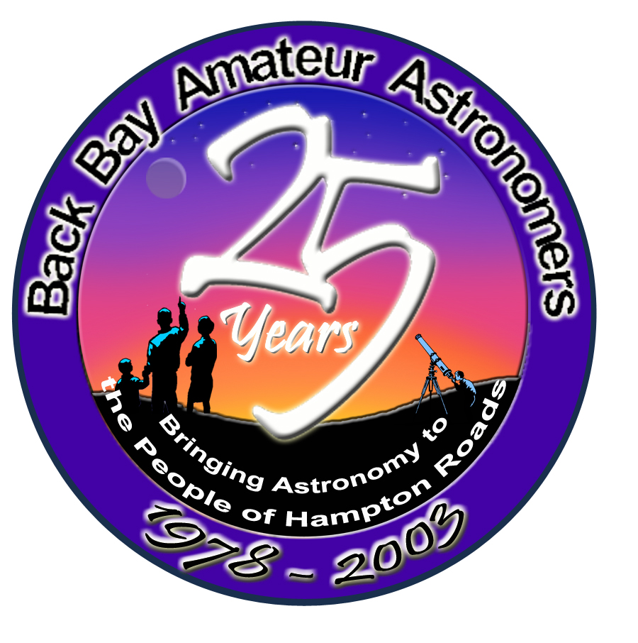
The BBAA has been “bringing astronomy to the people” for 28 years.

Slide 5
Presented by BBAA members…
Matt McLaughlin
Kevin Weiner

Slide 6
Seeing Into Space
Locating things on Earth
Locating things in Space
Celestial Coordinate System
Earth’s Motion
Sky Mechanics
  Sidereal and Solar days
Solstices
Amateur Astronomy
  Binoculars
  Telescopes
Hubble Space Telescope
Notes:
Stardust launched 1999; Comet Wild-2 rendezvous 2 Jan 2004; sample return 2006.
Mars missions ongoing: MGS, Mars Odyssey (already in orbit); Mars Express (ESA) to orbit Dec 2003; MER A & B “Spirit” and “Opportunity” to land 3 Jan and 23 Jan 2004; Nozomi (Japan) “early in 2004” according to the Nozomi home page, http://www.isas.ac.jp/e/enterp/missions/nozomi/index.shtml
Cassini-Huygens launched Oct 1997, will reach Saturn orbit July 2004; Huygens probe will dive to Titan Jan 2005
MESSENGER due to launch in 2004, will fly by Venus and Mercury and go into Mercury orbit in 2009 and carry out comprehensive measurements for one Earth year. Orbital data collection concludes in April 2010.

Slide 7
What do we need to know to find something in the sky?
Latitude
Longitude
Right Ascension
Declination
Date
Time
We also need to know something called the Ephemeris datum.

Slide 8
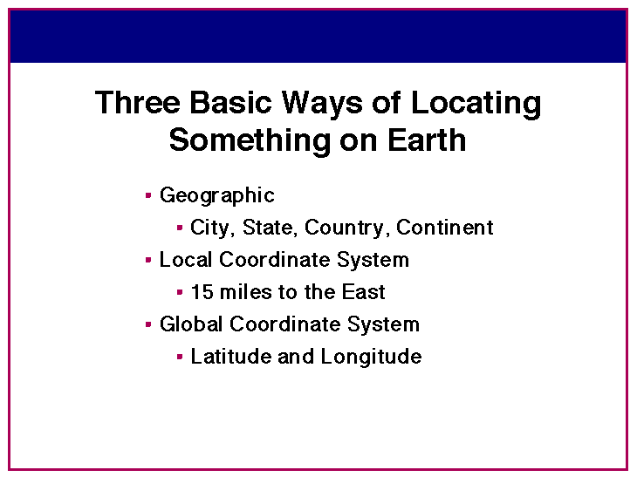

Slide 9
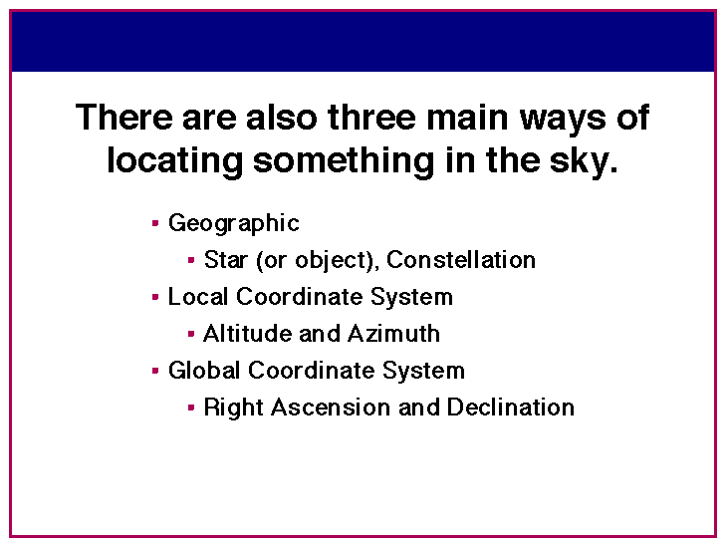

Slide 10
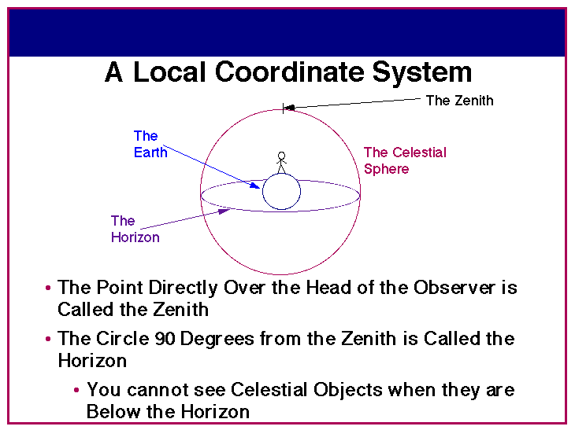

Slide 11
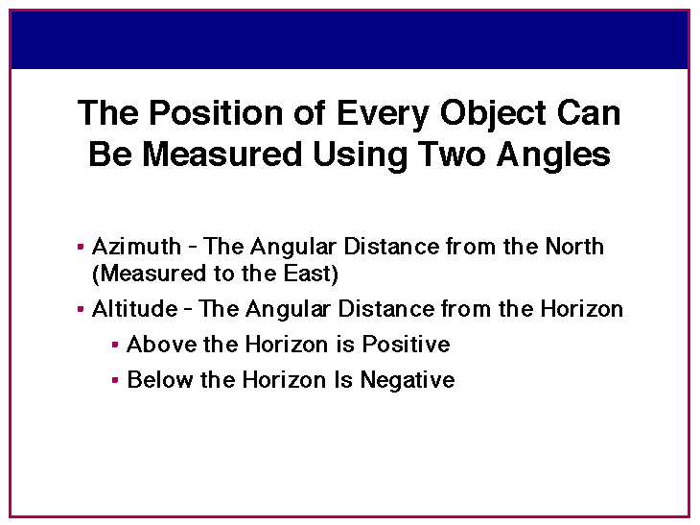

Slide 12
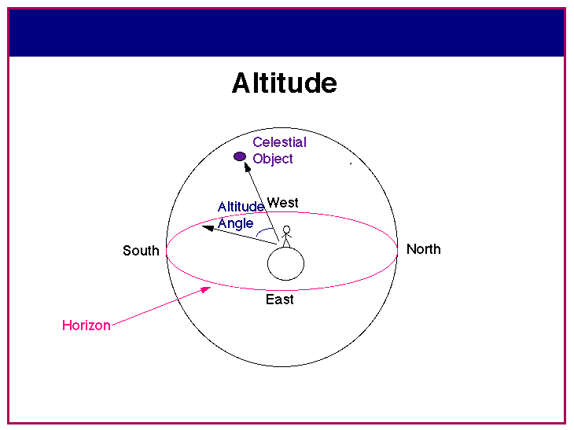

Slide 13
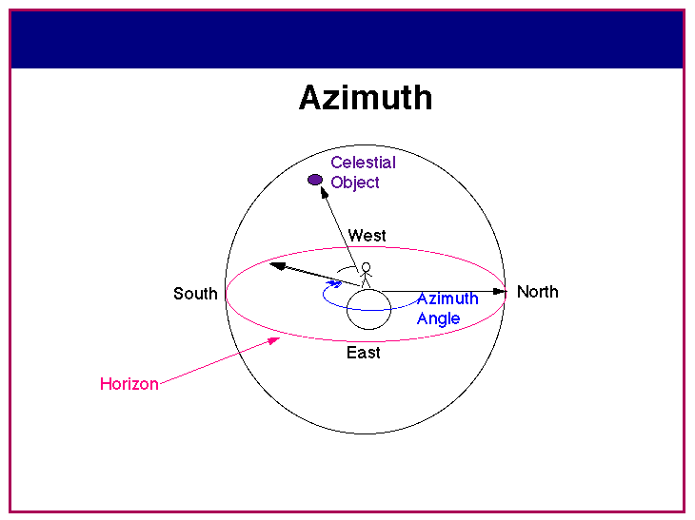

Slide 14
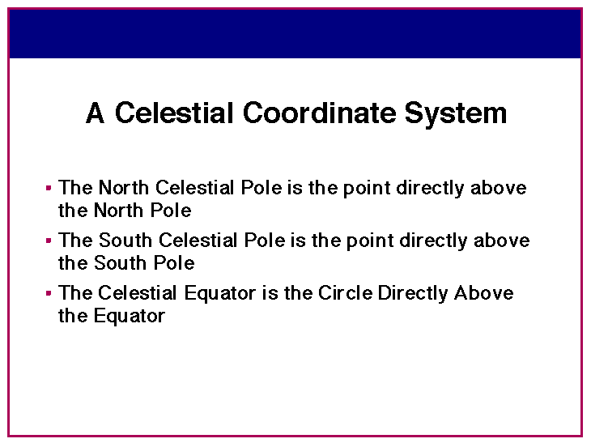

Slide 15
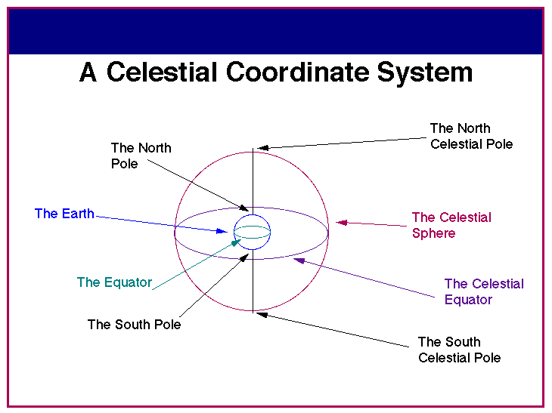

Slide 16
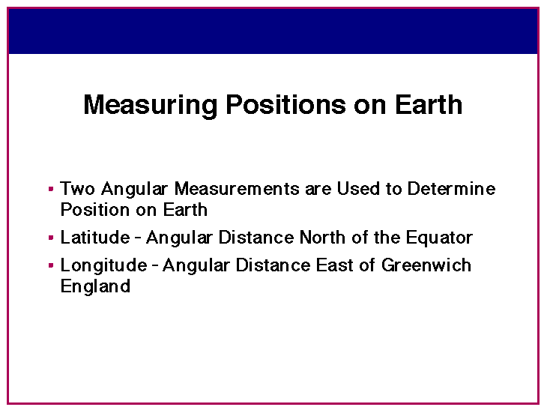

Slide 17
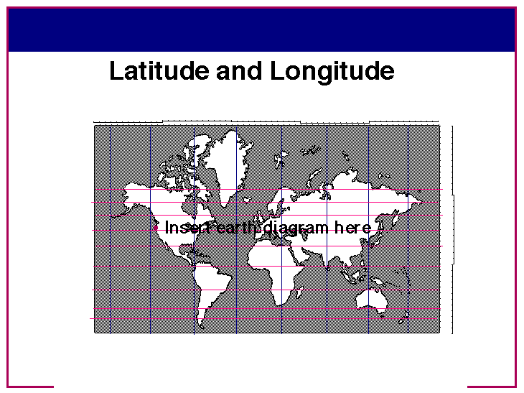
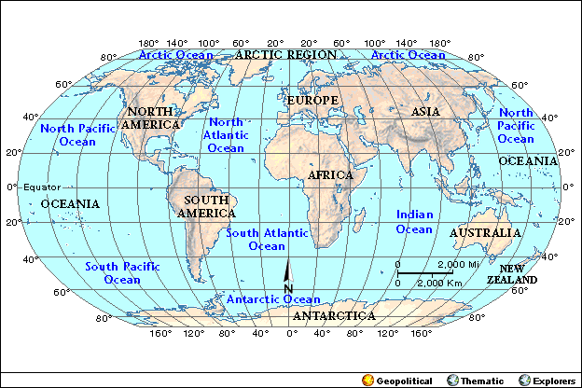

Slide 18
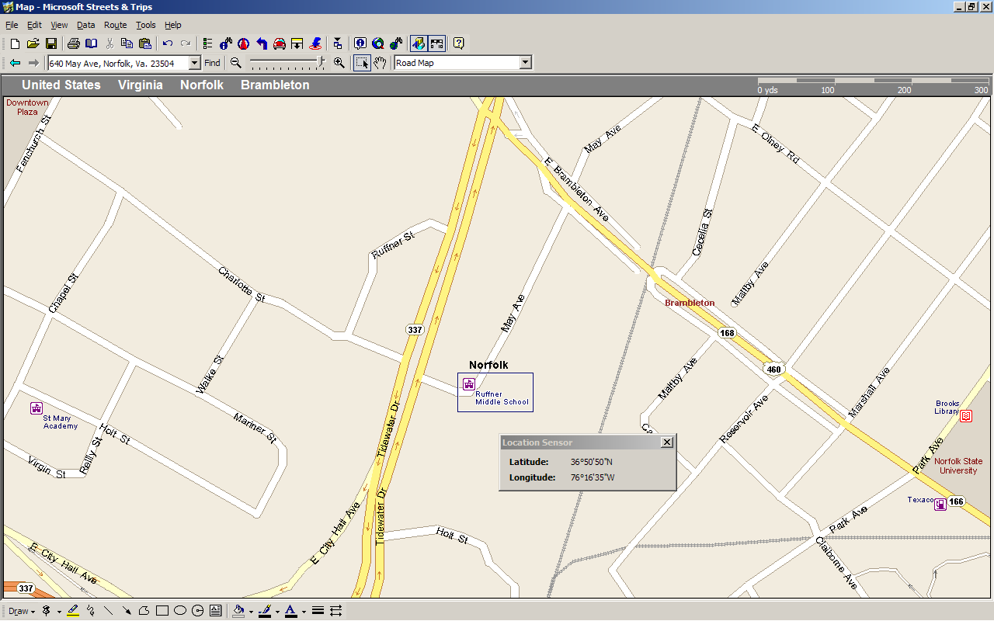
Where are we?
35º 50” 50” N / 076º 16’ 35” W

Slide 19
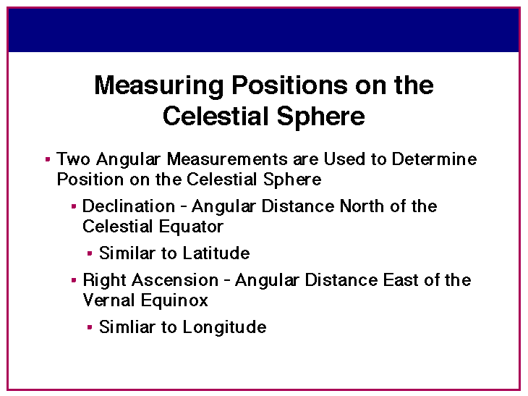

Slide 20
Declination and Right Ascension
The coordinates of stars and other objects on the celestial sphere are called right ascension and declination. These coordinates are similar to those used on Earth: longitude and latitude. Right ascension is measured in hours, declination is measured in degrees. You will notice that 24 hours of right ascension corresponds to 360 degrees, or simply that 1 hour of right ascension is 15 degrees.
RA can be used to determine a star's location and to determine how long it will take for a star to reach a certain point in the sky. For example, if a star with RA = 01:30:00 is at your meridian, then a star with RA = 20:00:00 will be in the meridian 18.5 sidereal hours later.

Slide 21
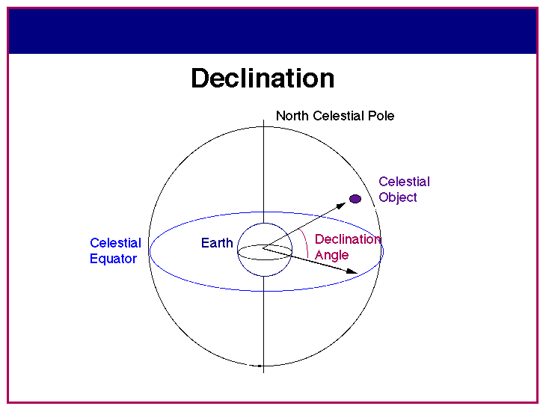

Slide 22
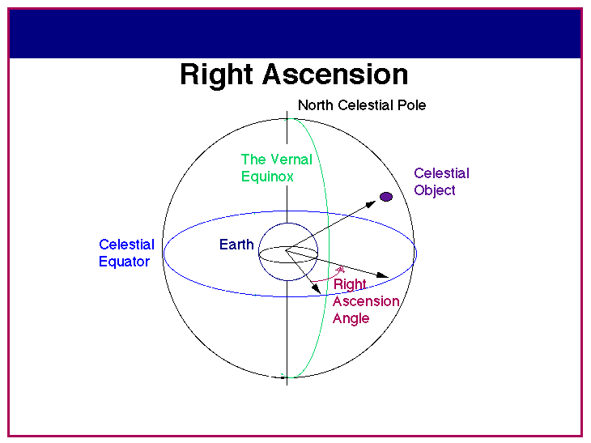

Slide 23
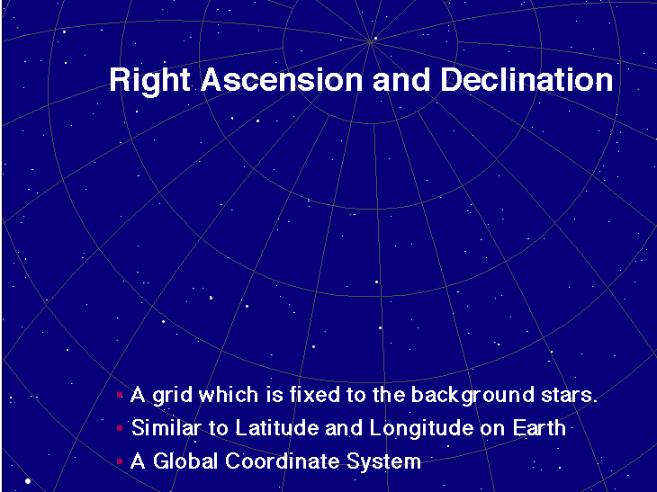

Slide 24
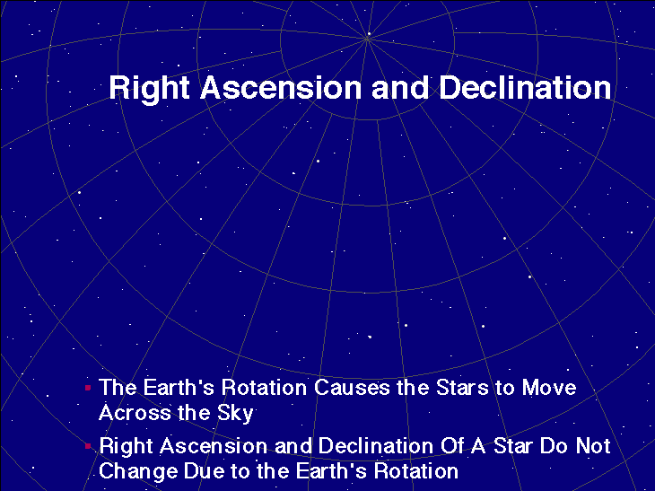

Slide 25
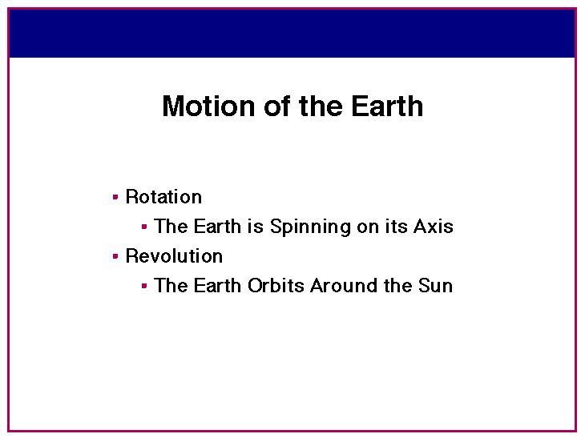

Slide 26
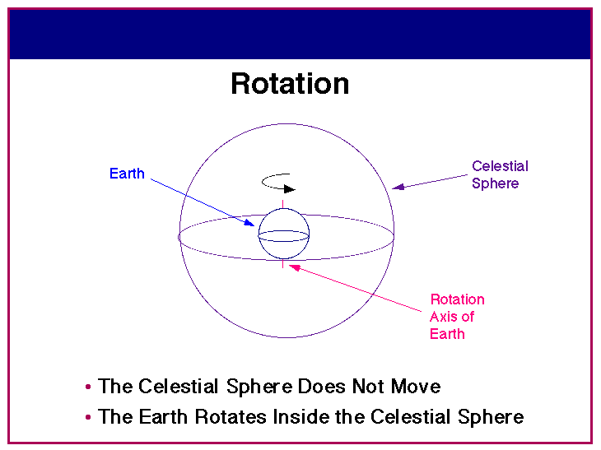

Slide 27
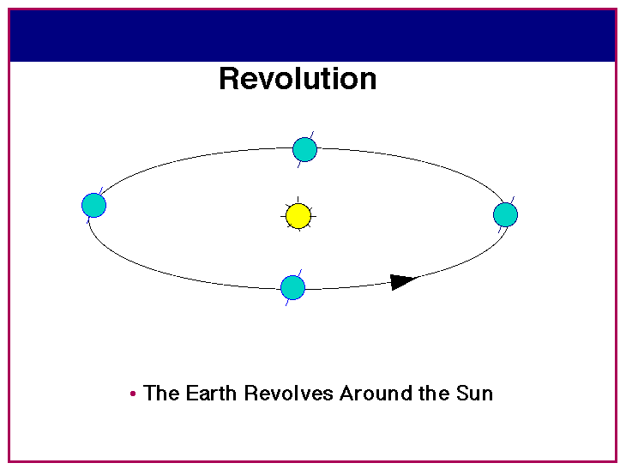

Slide 28
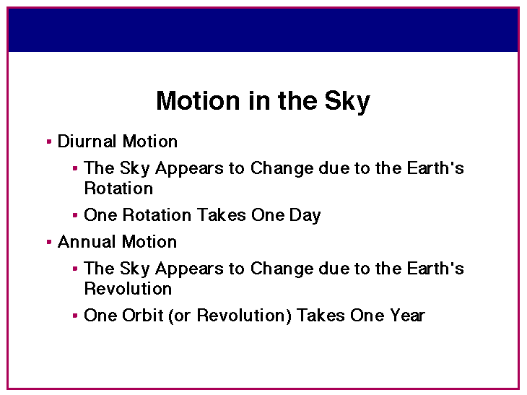

Slide 29
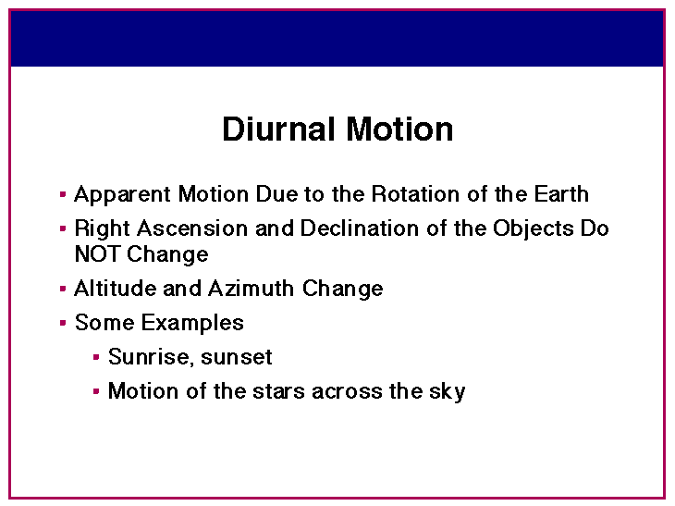

Slide 30
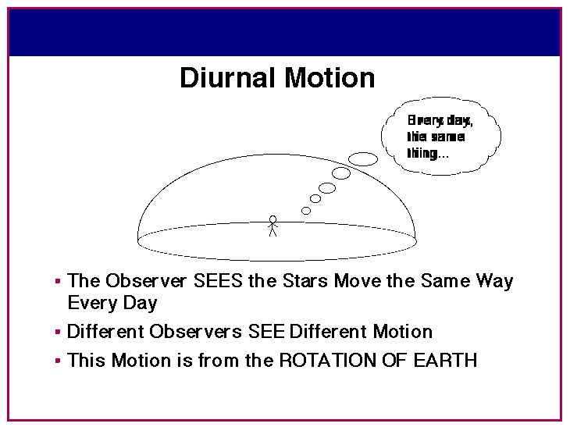
Every day,
the same
thing…

Slide 31
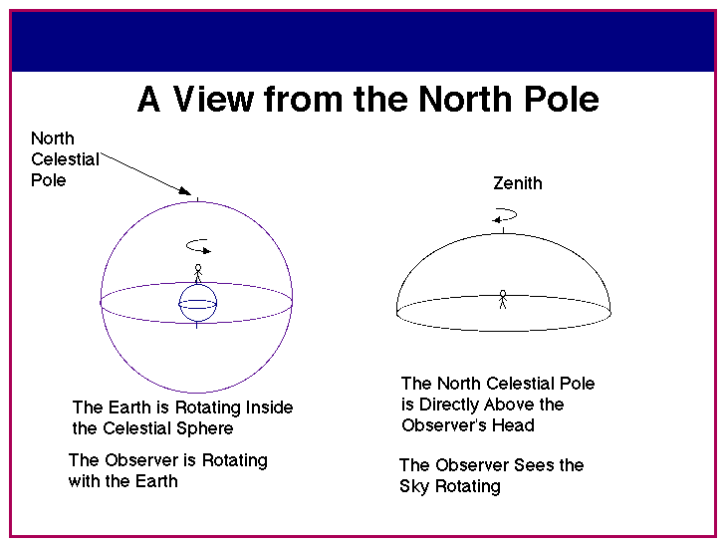

Slide 32
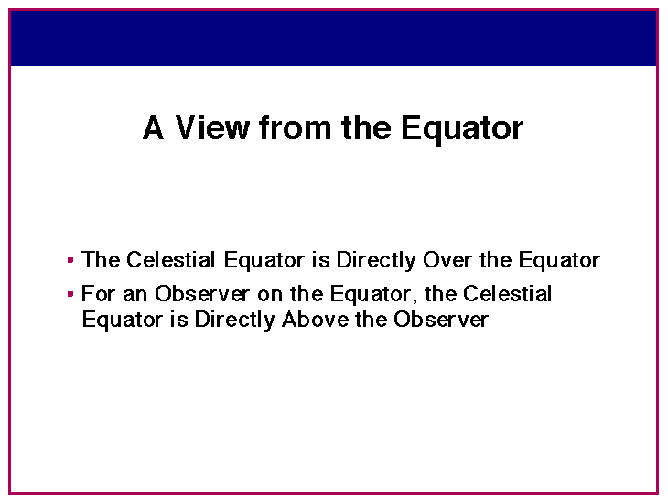

Slide 33
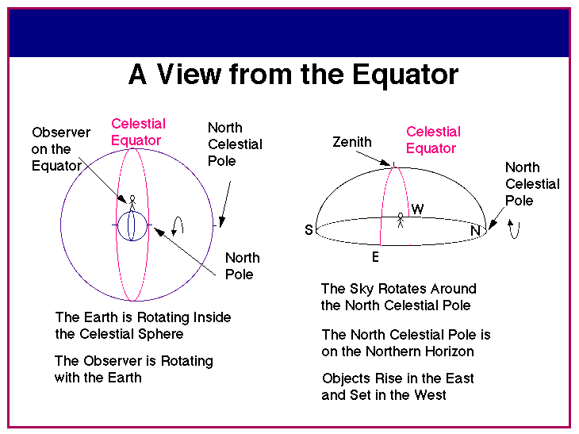

Slide 34
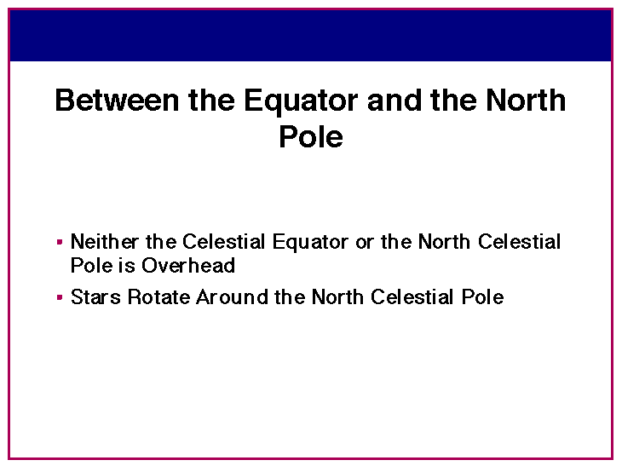

Slide 35
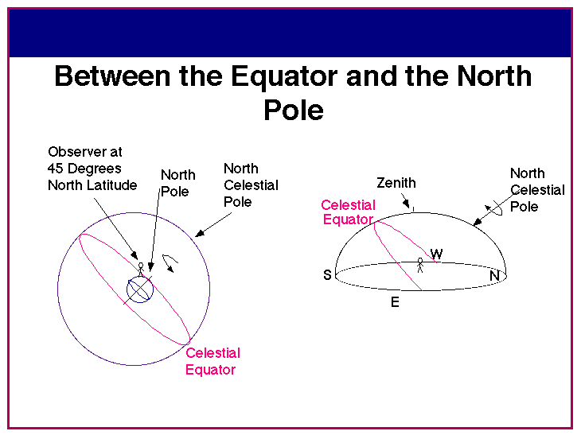

Slide 36
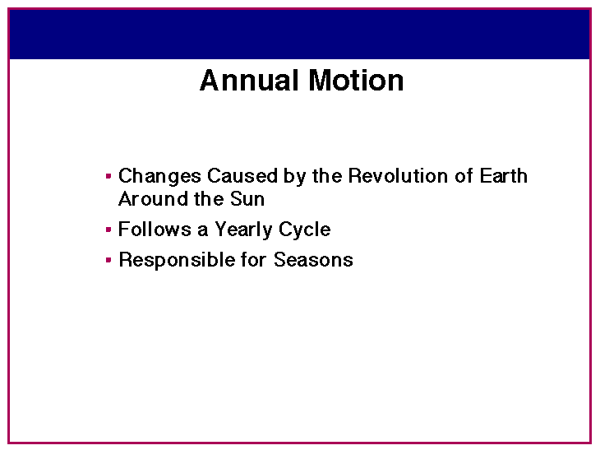

Slide 37
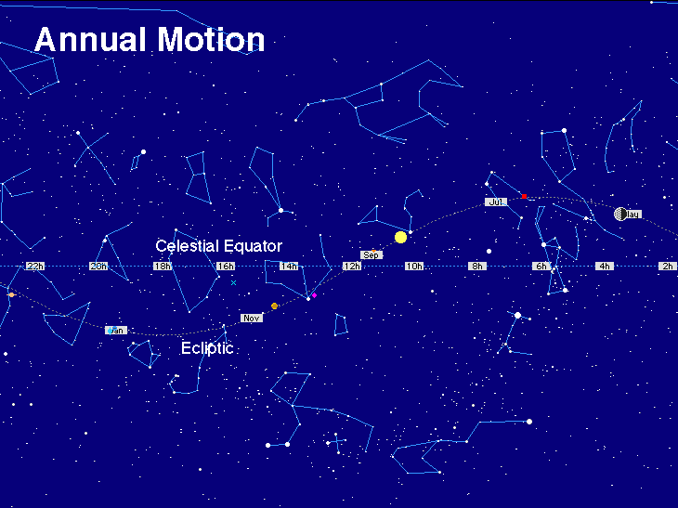

Slide 38
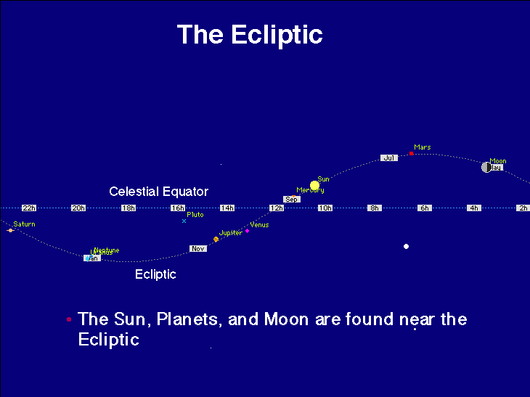

Slide 39
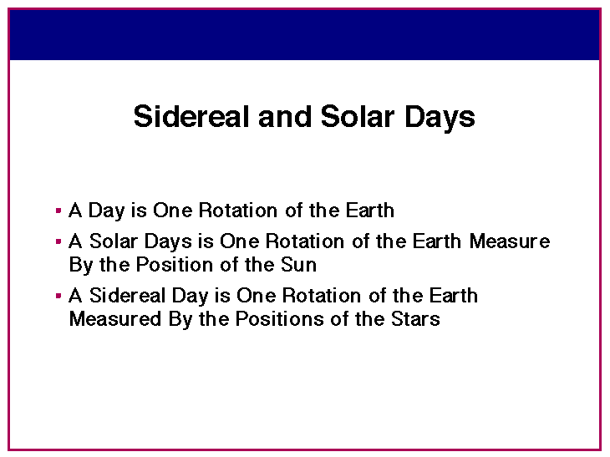

Slide 40
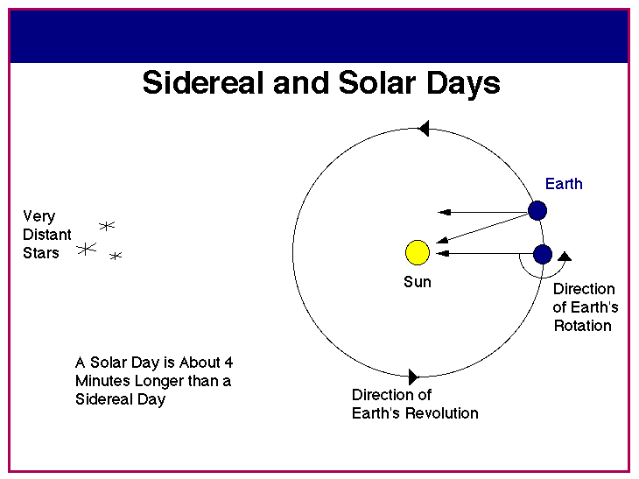

Slide 41
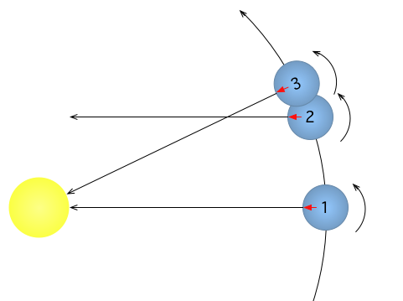
Sidereal and Solar days

Slide 42
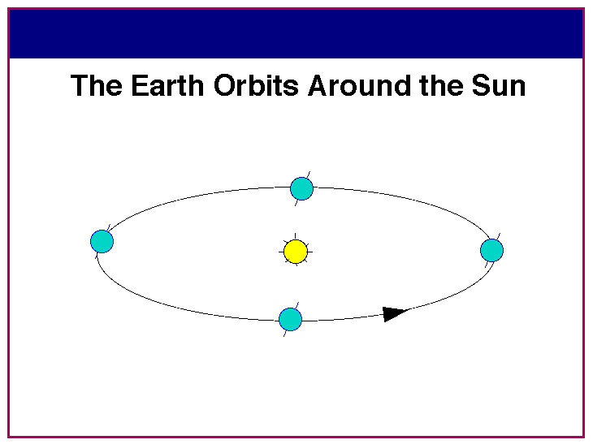

Slide 43
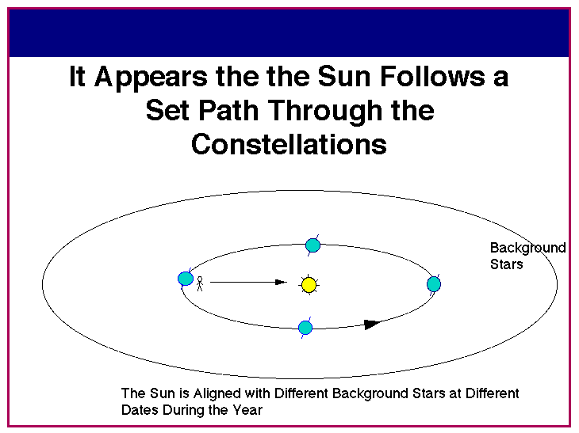

Slide 44
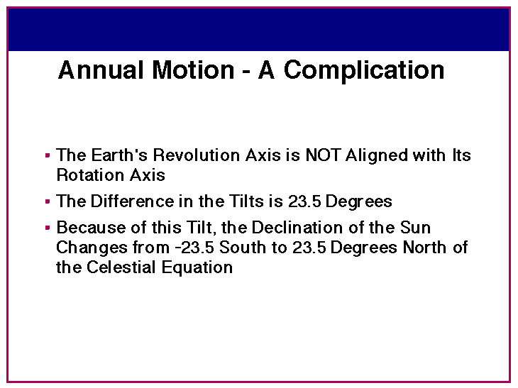

Slide 45
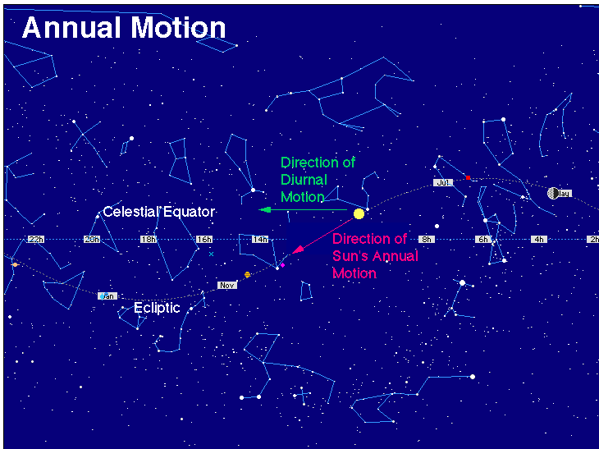

Slide 46
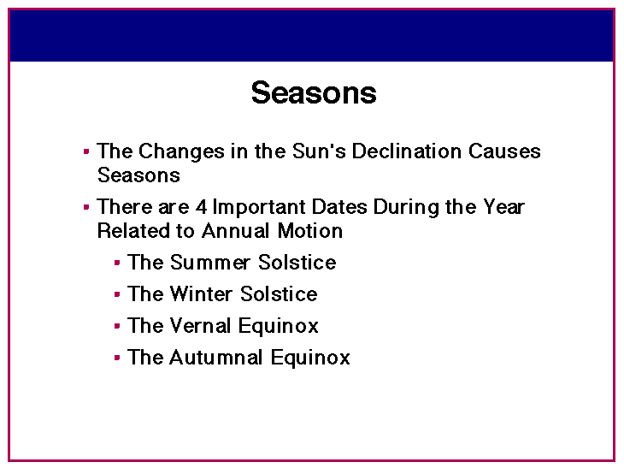
Longest Day (Shortest Night)
Shortest Day (Longest Night)
Day and Night same length

Slide 47
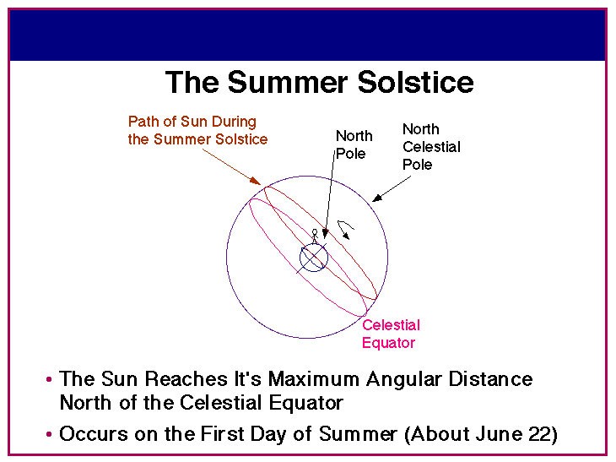

Slide 48
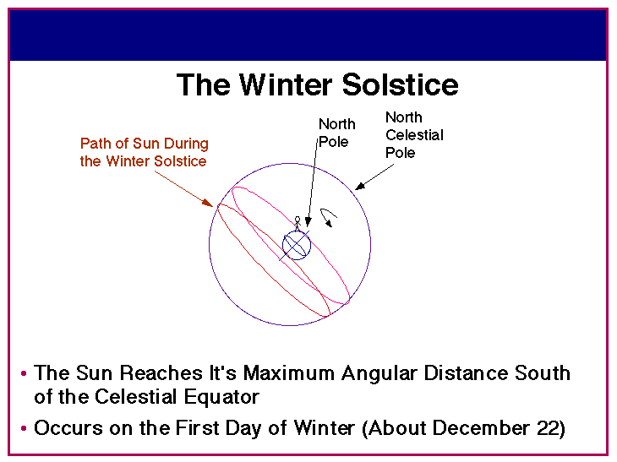

Slide 49
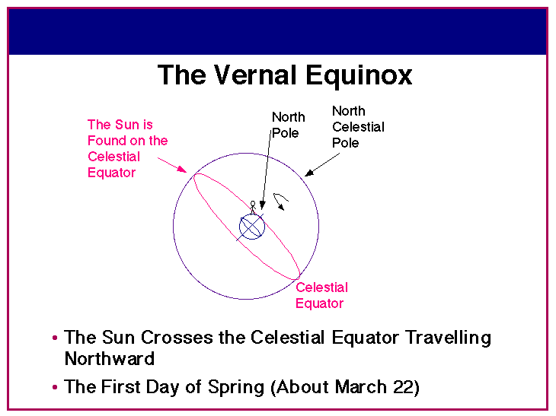

Slide 50
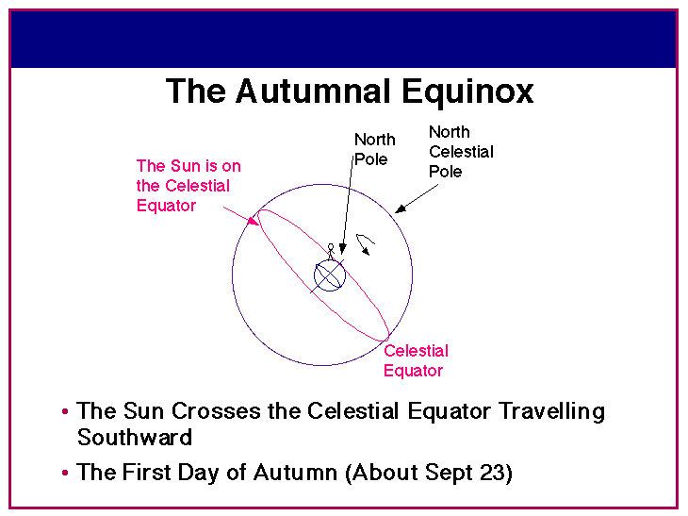

Slide 51
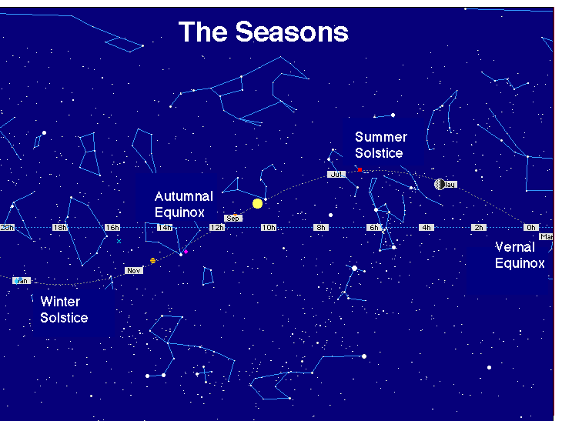

Slide 52
Binoculars
Bi – both, or two
Ocular – eyes, relating to the eye
“Seeing with two (or both) eyes”

Slide 53
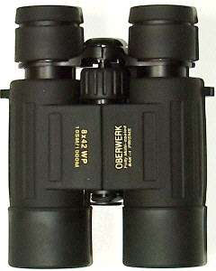
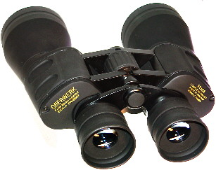
Binoculars
A great way to see the stars . . .
And learn the constellations
“A cheap pair of binoculars is better than a cheap telescope any day!”

Slide 54
Different Types of Telescopes?
There are three basic types of telescopes.
Refractors use lenses to focus light
(when light passes through glass, it refracts).
Reflectors use mirrors to focus light
(light reflects off of mirrors).
Catadioptric telescopes use some combination of lenses as well as mirrors (folds the light path).

Slide 55
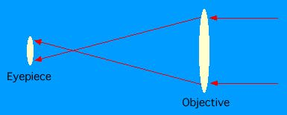
Refractors
A refractor in its simplest form is simply a large convex lens as the objective, and a smaller convex lens as the eyepiece. This form of the refractor telescope was first proposed in 1611 by Johann Kepler.

Slide 56


Refractor

Slide 57


Reflectors
Newtonian
Cassegrain
There are several different types of reflecting telescopes, but all of them use mirrors to focus light. All of the really large telescopes in the world are reflectors, as are the vast majority of amateur telescopes. Invented by Isaac Newton about 1670, the Newtonian was the first successful reflecting type telescope ever built.

Slide 58



Reflector

Slide 59


Catadioptric
Any of a number of combined telescope designs, using both a lens and mirrors. Examples are the Schmidt-Cassegrain and Maksutov-Cassegrain. Because the light path is folded twice, the telescope is very compact .

Slide 60


Catadioptric

Slide 61

Yerkes Observatory
Antique Refractor with on a GEM

Slide 62

200-inch Hale Telescope

Slide 63

Sir Isaac Newton Telescope

Slide 64
What you can see with a Telescope
The Planets
Mars
Venus
Jupiter
Saturn
Uranus
Neptune

Slide 65

MARS

Slide 66

JUPITER

Slide 67

SATURN

Slide 68

Deep Sky (The Orion Nebula)

Slide 69

M27 – The Dumbbell Nebula

Slide 70

Hubble Space Telescope

Slide 71

M17 – The Eagle Nebula

Slide 72

M51 – The Whirlpool Galaxy

Slide 73

M104 Sombrero Galaxy

Slide 74

Tadpole Galaxy

Slide 75

The Horsehead Nebula

Slide 76
Comparison of Hubble Space Telescope (HST) images with those seen through smaller, ground-based telescopes:

Slide 77

M27 – The Dumbbell Nebula
HST
Earth based

Slide 78

M104 Sombrero Galaxy
HST
Earth based

Slide 79

“KEEP LOOKING UP”
Learn the planets, stars and constellations
  Your own unaided eyes
Binoculars and a Planisphere
Telescopes
Watch for news of Space Exploration
We live in EXCITING times!

Slide 80
BBAA
Back Bay Amateur Astronomers invite you to come out to a free public sky watch.
Check our web site for the schedule
http://www.backbayastro.org
Northwest River Park
Use our scopes…
Beware of department store telescopes.

