Slide 1
Please take your seat

Slide 2
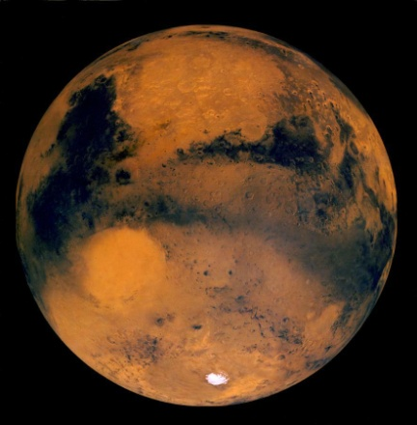

Seeing Into Space
A Presentation for
Greenbrier Middle School
December 12, 2003
Amateur Astronomy
Hubble Space Telescope
Space Exploration Missions – in 2004
Notes:
Stardust launched 1999; Comet Wild-2 rendezvous 2 Jan 2004; sample return 2006.
Mars missions ongoing: MGS, Mars Odyssey (already in orbit); Mars Express (ESA) to orbit Dec 2003; MER A & B “Spirit” and “Opportunity” to land 3 Jan and 23 Jan 2004; Nozomi (Japan) “early in 2004” according to the Nozomi home page, http://www.isas.ac.jp/e/enterp/missions/nozomi/index.shtml
Cassini-Huygens launched Oct 1997, will reach Saturn orbit July 2004; Huygens probe will dive to Titan Jan 2005
MESSENGER due to launch in 2004, will fly by Venus and Mercury and go into Mercury orbit in 2009 and carry out comprehensive measurements for one Earth year. Orbital data collection concludes in April 2010.

Slide 3
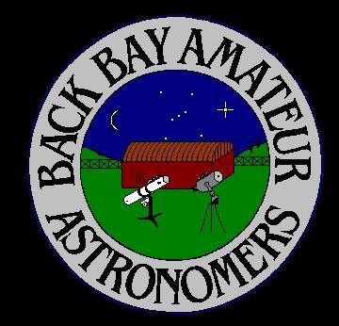
The Back Bay Amateur Astronomers
Bringing Astronomy to the People of Hampton Roads
The Back Bay Amateur Astronomers
PO Box 9877
Virginia Beach, VA 23450

Slide 4

The BBAA has been “bringing astronomy to the people” for 25 years.

Slide 5
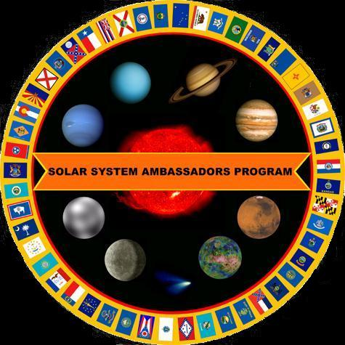
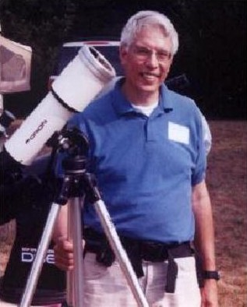
Your “Solar System Ambassador”
George Reynolds

Slide 6
“Solar System Ambassador”
George Reynolds
Assisted by BBAA members…
Steve Hamilton
Matt McLaughlin
Kevin Weiner

Slide 7
Seeing Into Space
Amateur Astronomy
  Binoculars
  Telescopes
Hubble Space Telescope
Space Exploration Missions – in 2004
  STARDUST
  Mars Missions
  Cassini – mission to Saturn
  MESSENGER – mission to Mercury
Notes:
Stardust launched 1999; Comet Wild-2 rendezvous 2 Jan 2004; sample return 2006.
Mars missions ongoing: MGS, Mars Odyssey (already in orbit); Mars Express (ESA) to orbit Dec 2003; MER A & B “Spirit” and “Opportunity” to land 3 Jan and 23 Jan 2004; Nozomi (Japan) “early in 2004” according to the Nozomi home page, http://www.isas.ac.jp/e/enterp/missions/nozomi/index.shtml
Cassini-Huygens launched Oct 1997, will reach Saturn orbit July 2004; Huygens probe will dive to Titan Jan 2005
MESSENGER due to launch in 2004, will fly by Venus and Mercury and go into Mercury orbit in 2009 and carry out comprehensive measurements for one Earth year. Orbital data collection concludes in April 2010.

Slide 8
Binoculars
Bi – both, or two
Ocular – eyes, relating to the eye
“Seeing with two (or both) eyes”

Slide 9
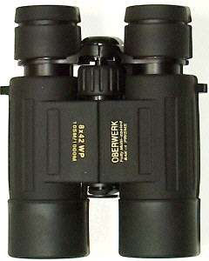
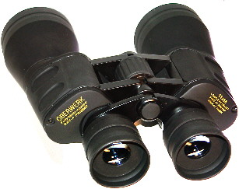
Binoculars
A great way to see the stars . . .
And learn the constellations
“A cheap pair of binoculars is better than a cheap telescope any day!”

Slide 10
Different Types of Telescopes?
There are three basic types of telescopes.
Refractors use lenses to focus light
(when light passes through glass, it refracts).
Reflectors use mirrors to focus light
(light reflects off of mirrors).
Catadioptric telescopes use some combination of lenses as well as mirrors (folds the light path).

Slide 11
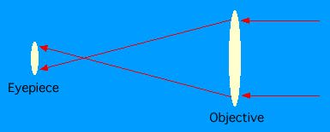
Refractors
A refractor in its simplest form is simply a large convex lens as the objective, and a smaller convex lens as the eyepiece. This form of the refractor telescope was first proposed in 1611 by Johann Kepler.

Slide 12
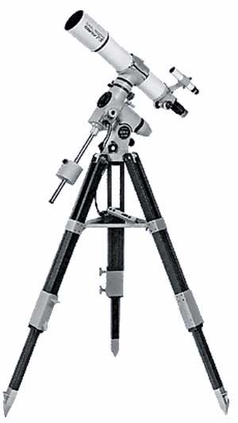
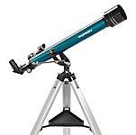
Refractor

Slide 13
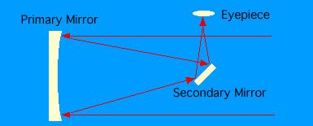
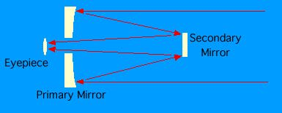
Reflectors
Newtonian
Cassegrain
There are several different types of reflecting telescopes, but all of them use mirrors to focus light. All of the really large telescopes in the world are reflectors, as are the vast majority of amateur telescopes. Invented by Isaac Newton about 1670, the Newtonian was the first successful reflecting type telescope ever built.

Slide 14
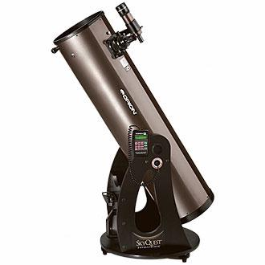
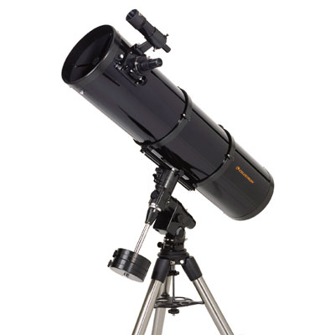
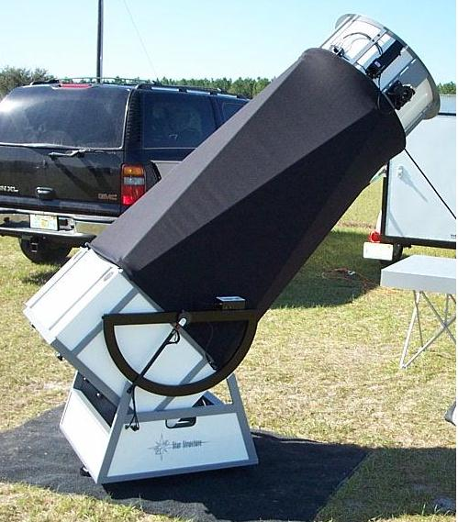
Reflector

Slide 15
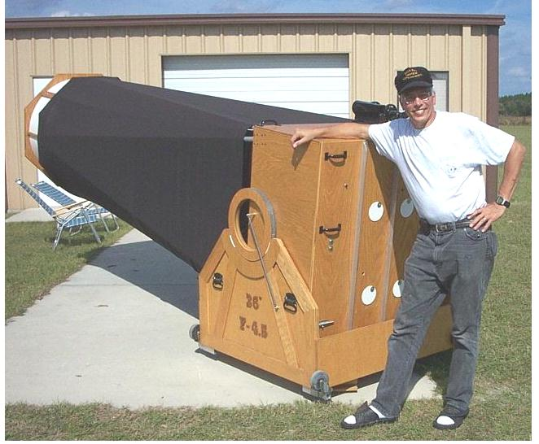
BIG Reflector!
The “YARD SCOPE” – 36-inch mirror
Here I am in Florida
with Tom Clark’s 36-inch
reflecting telescope he
calls the “Yard Scope”
Can you guess why?
  36 inches = 1 yard

Slide 16
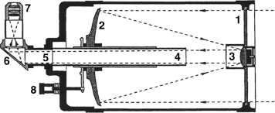
Catadioptric
1. Aspheric Corrector Lens,
2. Primary Mirror,
3. Secondary Mirror (curved out or "convex", and aspheric) and Baffle,
4. Primary Light Baffle Tube and support for Primary Mirror,
5. Rear Cell (accessory holder)
6. Prism or Mirror Diagonal,
7. Eyepiece
8. Focus Control Dial
Any of a number of combined telescope designs, using both a lens and mirrors. Examples are the Schmidt-Cassegrain and Maksutov-Cassegrain. Because the light path is folded twice, the telescope is very compact .

Slide 17
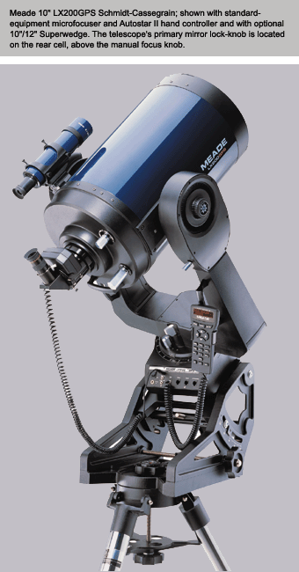
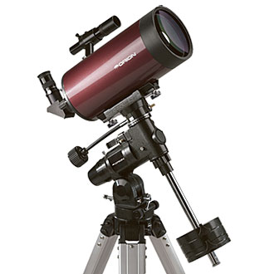
Catadioptric

Slide 18
What you can see with a Telescope
The Planets
Mars
Venus
Jupiter
Saturn
Uranus
Neptune

Slide 19
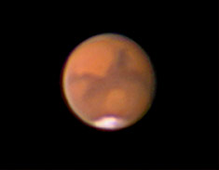
MARS

Slide 20
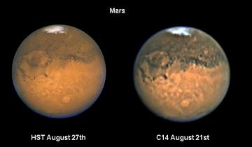
MARS
Comparison between Hubble Space Telescope and amateur Celestron-14 pictures of Mars.

Slide 21
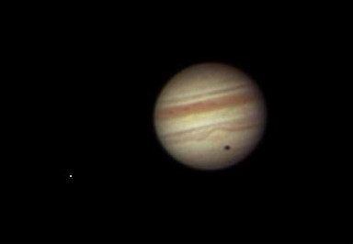
JUPITER

Slide 22

SATURN

Slide 23
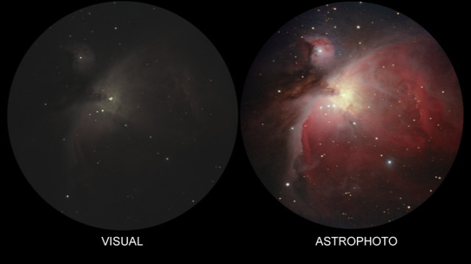
Deep Sky (The Orion Nebula)

Slide 24
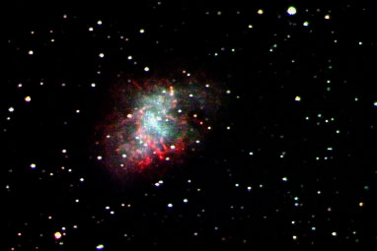
M1 – The Crab Nebula

Slide 25
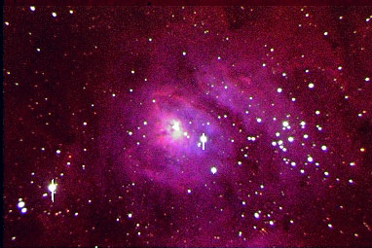
M8 – The Lagoon Nebula

Slide 26
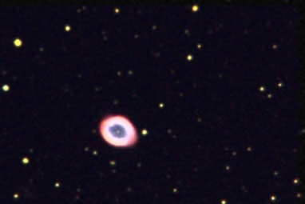
M57 – The Ring Nebula

Slide 27
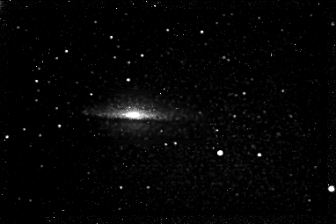
M104 – The Sombrero Galaxy

Slide 28
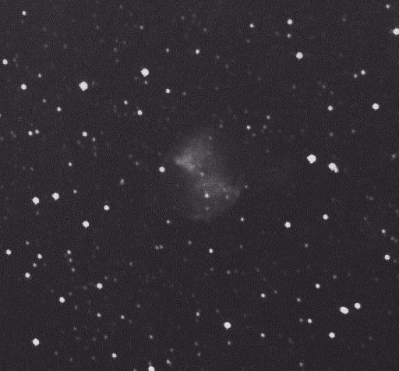
M27 – The Dumbbell Nebula

Slide 29
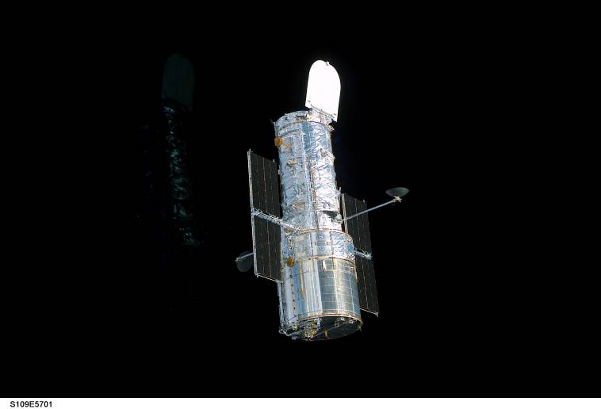
Hubble Space Telescope

Slide 30
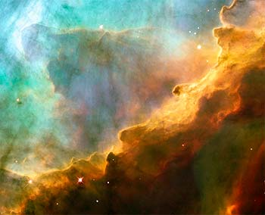
M17 – The Eagle Nebula

Slide 31
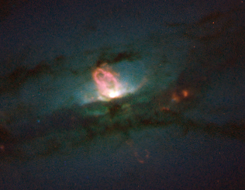
NGC 4438 – A galaxy in Virgo

Slide 32
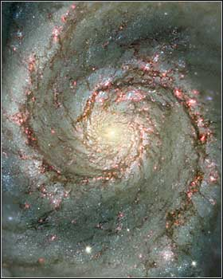
M51 – The Whirlpool Galaxy

Slide 33
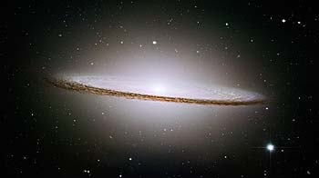
M104 Sombrero Galaxy

Slide 34
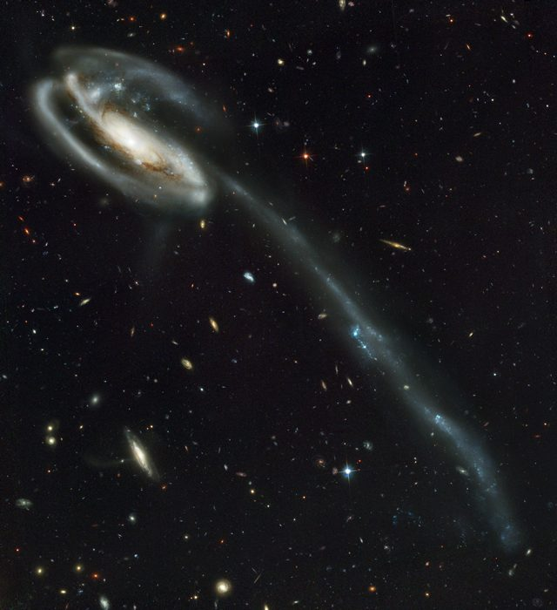
Tadpole Galaxy

Slide 35
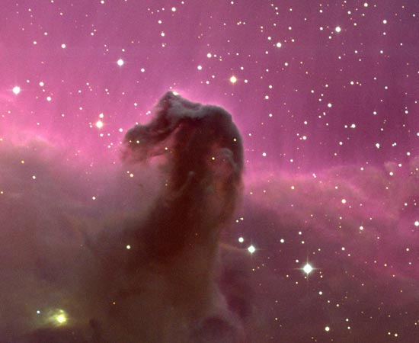
The Horsehead Nebula

Slide 36
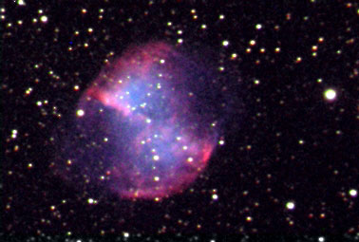
M27 – The Dumbbell Nebula

Slide 37
Comparison of Hubble Space Telescope (HST) images with those seen through smaller, ground-based telescopes:

Slide 38
M27 – The Dumbbell Nebula
HST
Earth based

Slide 39
M104 Sombrero Galaxy
HST
Earth based

Slide 40

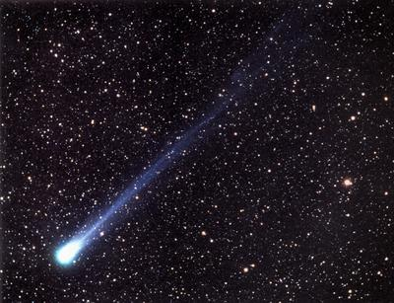
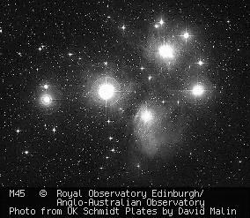
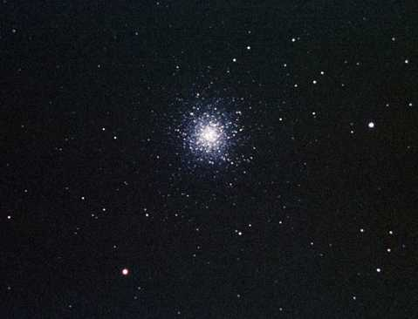
SPACE EXPLORATION:
Missions of Discovery

Slide 41
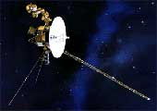
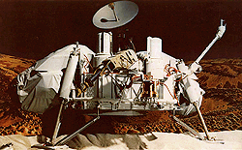
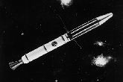
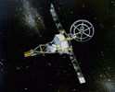
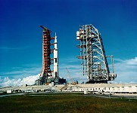
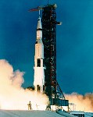
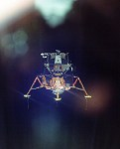
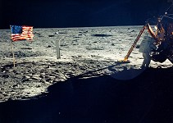
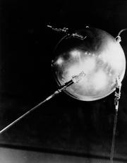
Historic Space Missions
1957 – Sputnik 1 (USSR)
1958 – Explorer 1 (USA)
1964-69 – Mariner flybys & orbits of Mars
1969 – Apollo 11 – First man on the Moon
1976 – Viking 1 & 2 land on Mars
1980s – Voyager flybys of outer planets

Slide 42
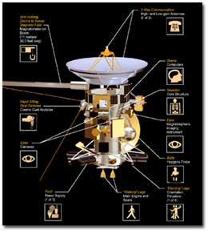
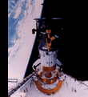
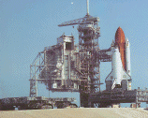


Historic Space Missions
(continued)
1981 – First Space Shuttle Orbital Flight
1986 – Challenger Disaster
1989 – Hubble Telescope
1989 – Galileo Launched
1995 – Galileo Orbits Jupiter
1997 – Cassini Launched : 9 year mission

Slide 43





Historic Space Missions
(continued)
1997 – Mars Pathfinder/Sojourner Rover
1997 – Mars Global Surveyor
1999 – STARDUST Launched
2001 – Mars Odyssey
2003 – Launch of Mars missions:
    Spirit and Opportunity with Rovers
    Mars Express/Beagle 2 Lander (ESA)
      (Landing Christmas Eve, December 24, 2003)

Slide 44
Exciting Events for 2004!!
January 2 -- STARDUST meets comet
January 3-4 – Spirit lands on Mars
January 23 – Opportunity lands on Mars
July 1 – Cassini orbits Saturn
August - MESSENGER Launch to Mercury
Dec 25 – Huygens probe release
Jan 14, 2005 – Huygens descent to Titan

Slide 45

STARDUST

Slide 46
The STARDUST Mission
First-ever Comet Sample Return
Launched 1999
21 days to go!
Counting Down!
Rendezvous Comet WILD-2 Jan. 2, 2004
Return Sample to Earth July, 2006

Slide 47
Mars Exploration Rover missions
(named Spirit and Opportunity)
Part of NASA's Mars Exploration Program, a long-term effort of robotic exploration of Mars.
Scientific goals: To search for evidence of water on Mars by analyzing rocks and soils that hold clues to past water activity on the red planet.
Spacecraft target: Sites that appear to have been affected by liquid water in the past.
They were named by a 9-year old girl in a NASA contest to choose names for these two missions.

Slide 48
The primary science instruments
Panoramic Camera (Pancam)
Miniature Thermal Emission Spectrometer (Mini-TES)
Mössbauer Spectrometer (MB)
Alpha Particle X-Ray Spectrometer (APXS)
Magnets: for collecting magnetic dust particles. They will also analyze the composition of magnetic minerals in airborne dust and rocks that have been ground by the Rock Abrasion Tool.
Microscopic Imager (MI): for obtaining close-up, high-resolution images of rocks and soils.
Rock Abrasion Tool (RAT): for removing dusty and weathered rock surfaces and exposing fresh material for examination by instruments onboard.

Slide 49

The launch vehicle
A launch vehicle provides the velocity needed by a spacecraft to escape Earth's gravity and set it on its course for Mars.

Slide 50


Airbags
Airbags used in the Mars Exploration Rover mission are the same type that Mars Pathfinder used in 1997. Airbags must be strong enough to cushion the spacecraft if it lands on rocks or rough terrain and allow it to bounce across Mars' surface at freeway speeds after landing. To add to the complexity, the airbags must be inflated seconds before touchdown and deflated once safely on the ground.

Slide 51

The Mars Exploration Rovers

Slide 52

“KEEP LOOKING UP”
Learn the planets, stars and constellations
  Your own unaided eyes
Binoculars and a Planisphere
Telescopes
Watch for news of Space Exploration
We live in EXCITING times!

Slide 53
BBAA
Back Bay Amateur Astronomers invite you to come out to a free public sky watch.
Check our web site for the schedule
http://groups.hamptonroads.com/BBAA/
Northwest River Park
Use our scopes…
Beware of department store telescopes.

Slide 54
Your “Solar System Ambassador”
George Reynolds

