Slide 1

Welcome to GardenStars
An Evening Under the Stars
Presented by
The Norfolk Botanical Garden
And
Back Bay Amateur Astronomers

Slide 2
STAR CLUSTERS
A GardenStars Presentation
Ted Forte
Back Bay Amateur Astronomers

Slide 3
Questions to Consider
What is a star cluster?
Why do astronomers study star clusters?
What should you look for in the telescope when viewing a star cluster?

Slide 4
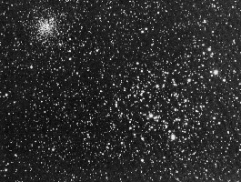
Definition
The Star Cluster M35 in
the constellation Gemini
with NGC 2158
Star clusters are groupings of stars that were formed together, are bound together by gravity, and are moving together through space.

Slide 5
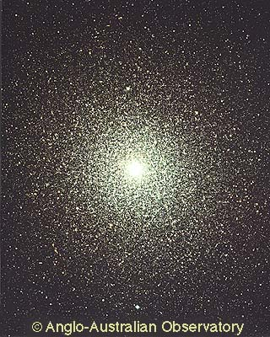
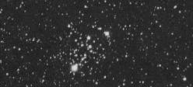
Clusters come in two main varieties that have different things to reveal about our galaxy. “Open Clusters” and “Globular Clusters”. Open Clusters are also called “Galactic Clusters”
Left: Globular Cluster 47 Tucane
Above: Open Cluster M103

Slide 6
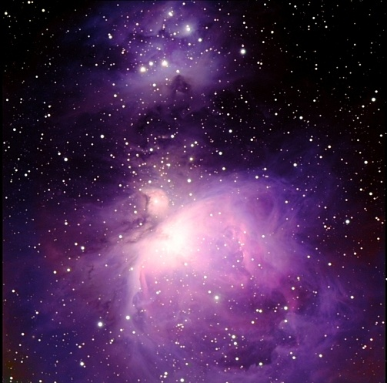
Stars form when a cold cloud of molecular hydrogen collapses under its own gravity. Very often these collapsing clouds are so huge (Giant Molecular Clouds) that they form a great many stars at the same time (over a couple million years).
In spiral galaxies, like our Milky Way, GMC are found in the spiral arms, and this is where stars are born and open clusters form.

Slide 7
The stars that form together will be gravitationally bound together.
They will remain together for several million years as a cluster.

Slide 8
Therefore we can say:
1. The stars in the cluster are all the same age (approximately)
2. They have similar chemical makeup (initially)
3. They are all at the same (approximate) distance from us

Slide 9
And that is what makes them important laboratories for studying the life cycle of stars

Slide 10
In a cluster, we are provided with a group of stars where the only difference is the mass of the stars.
Age, distance and chemical makeup are held constant.
Mass is what determines how a star develops and evolves, how long it will shine, and how it will end its life

Slide 11
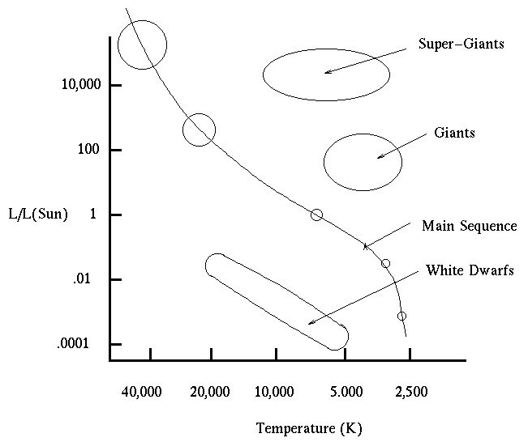
The “H.R.” Diagram
Astronomers use a color-luminosity plot called the Hertsprung Russel Diagram to graphically organize the characteristics of stars.

Slide 12
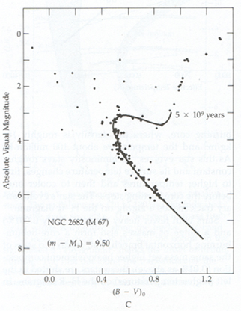
When an HR diagram is prepared for the stars in a cluster, astronomers can tell the age of the cluster by noting what classes of stars are missing.
More massive stars compress their cores more tightly, producing higher temperatures than lower mass stars and consequently they burn themselves out faster.
The age of the cluster is estimated by identifying the hottest class of star it contains.

Slide 13
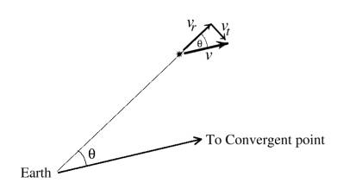
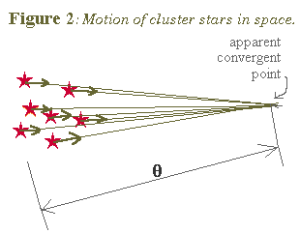
The distance to a star cluster is easier to determine than the distance to a single star. We can use “parallax”, “convergence”, or main-sequence matching to determine the distance to star clusters.
Once the distance is known we can calibrate the brightness of Cephid Variables – important “Standard Candles”

Slide 14
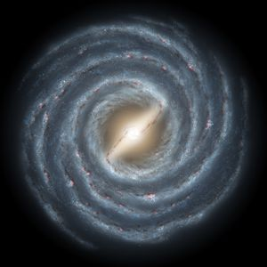
Mapping the Galaxy with Clusters
Since open clusters form in the spiral arms of our galaxy, their distance, position, velocity and age can be used to map the structure of the galactic arms and provide clues to how they formed.

Slide 15
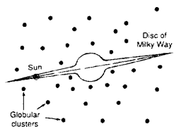
Globular clusters are very large balls of stars that orbit our galaxy in a roughly spherical shell. Their distribution was used by Harlow Shapley to determine our position in the galaxy.

Slide 16
How and why globular clusters formed is still a bit of a mystery. They seem to be as old as the galaxy itself, and may even predate it.
In the 80’s and 90’s, the age of globular clusters was at the heart of a controversy. Cosmologists favored an age for the universe that was YOUNGER than the age astronomers favored for the globular clusters.
The Hubble Space Telescope helped to settle the question, providing evidence that the universe is old enough to contain globular clusters.

Slide 17
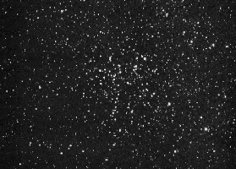
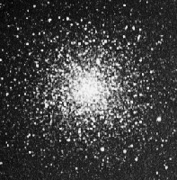
The two types of clusters look and are different. Globular clusters are like small galaxies containing hundreds of thousands of stars. They are tens of thousands of light years distant. Open clusters contain from 10 to 3000 stars and are just hundreds of light years away.

Slide 18
When viewing a globular cluster in the telescope these are the things to consider:
How well is the cluster resolved? (How far into the center are individual stars picked out).
What is the density distribution? (How much of what you see is concentrated in the center)
Are there features like dark lanes or streamers of stars radiating away?
Do you see any color?
How does its size and brightness compare with other globular clusters?

Slide 19
Consider these questions when viewing open clusters:
Detachment: Does the cluster stand out from the background stars?
Concentration: How densely packed is it?
Brightness distribution: Are the members the same brightness or is there a range of brightness?
What colors are the stars?
How many stars are there?
Is there any nebulosity?

Slide 20
Some clusters out tonight …
M13 (NGC 6205) “The Great Hercules Cluster” is high overhead. This globular is about 23,000 l.y. distant and contains up to half a million stars.
M3 (NGC 5272) A globular in Canes Venatici is about 32,000 l.y. away and also contains about a half million stars.
M11 (NGC 6705) The “Wild Duck Cluster” in Scutum is about 5,400 l.y. away and has about 3,000 stars.
M29 (NGC 6913) is 4,400 l.y. away and shows about a dozen bright stars.

Slide 21
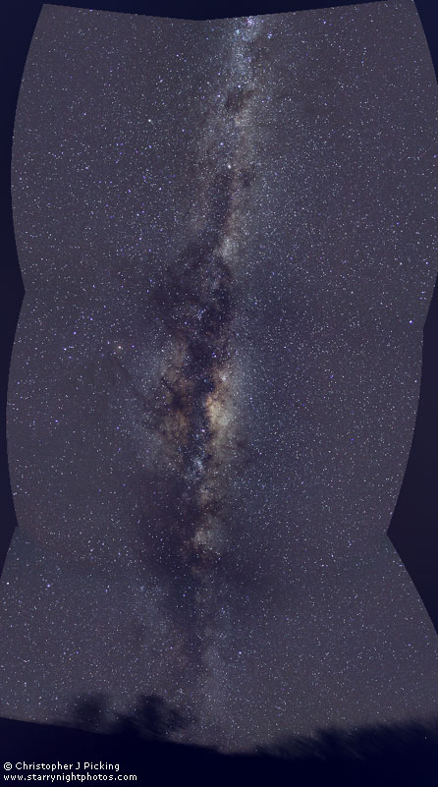
On summer nights (in dark skies) the Milky Way is prominent, stretching from Cassiopeia in the north, along the line of Cygnus the Swan and then glowing brilliantly to the southern horizon between the “teapot” of Sagittarius and the scorpion.
The line of the Milky Way outlines the spiral arms of our galaxy, along which a great many open clusters are found. The globular clusters are concentrated toward the center of our galaxy which is located in the direction of Sagittarius.

Slide 22
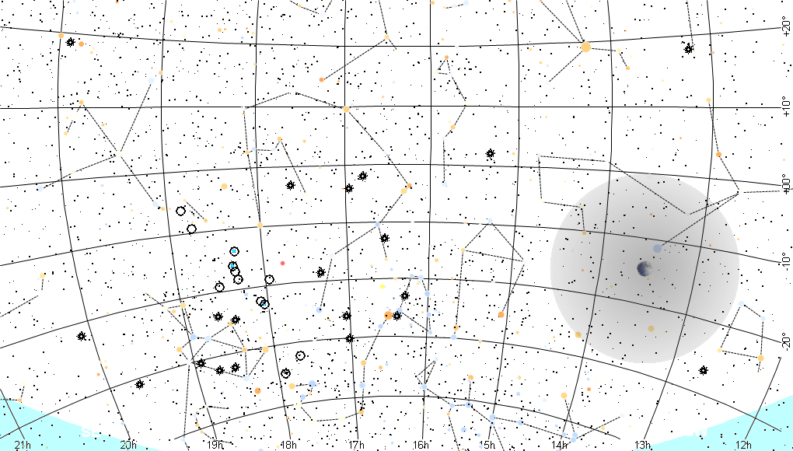
The Sky Tonight (July 21) Looking South

Slide 23
Safety First!
We will go outside in just a moment.
Please remember, Safety First!
Please do not run or horseplay around the water fountains and telescopes.
Please remember, Safety First!
Please do not run or horseplay around the water fountains and telescopes.

Slide 24
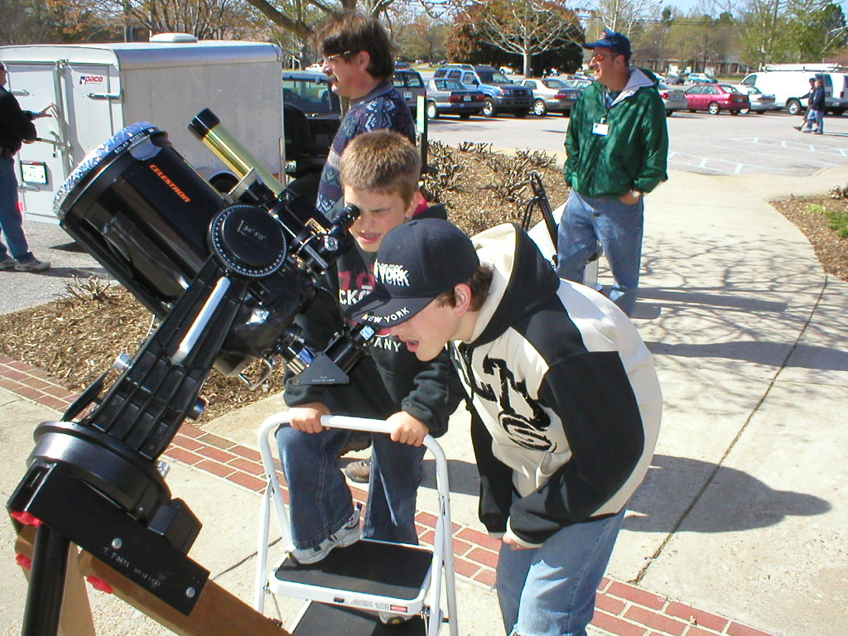
Telescope Etiquette
Please take care not to bump the scopes (and knock them off target).
Don’t grab the eyepiece, you will pull the scope off target, or could damage the drive gears.
And most important of all, please be careful not to touch the optics!

Slide 25

THANK
YOU!
Are There Questions?
BACK BAY AMATEUR ASTRONOMERS
PO BOX 9877
VIRGINIA BEACH VIRGINIA 23450-9877
http://groups.hamptonroads.com/bbaa
Bringing Astronomy to the People of Hampton Roads

