Slide 1
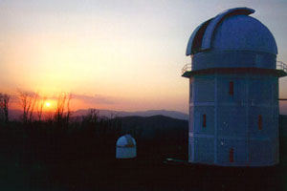
NSU RAPID RESPONSE ROBOTIC TELESCOPE
AT FAN MOUNTAIN OBSERVATORY
Carlos Salgado:Department of Physics:NSU

Slide 2
Measurement are made in seconds
of object discovery
Rapid Response
Robotic
Telescope
Telescope can act in fully scripted mode
(no human intervention)
Main Research Goal:
Photometry and Polarimetry of Gamma-Ray Bursts Optical
Afterglows in collaboration with NASA’s Swift and GLAST
missions.
But also
to study all other transient phenomena

Slide 3
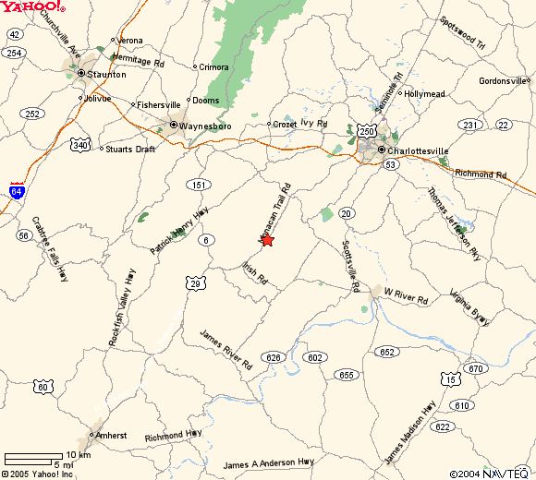
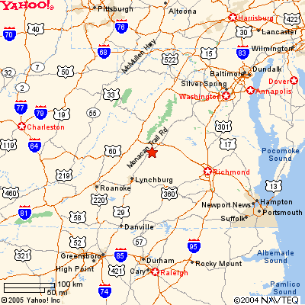
Covesville, Virginia: 17 miles South of Charlottesville by Road 29

Slide 4
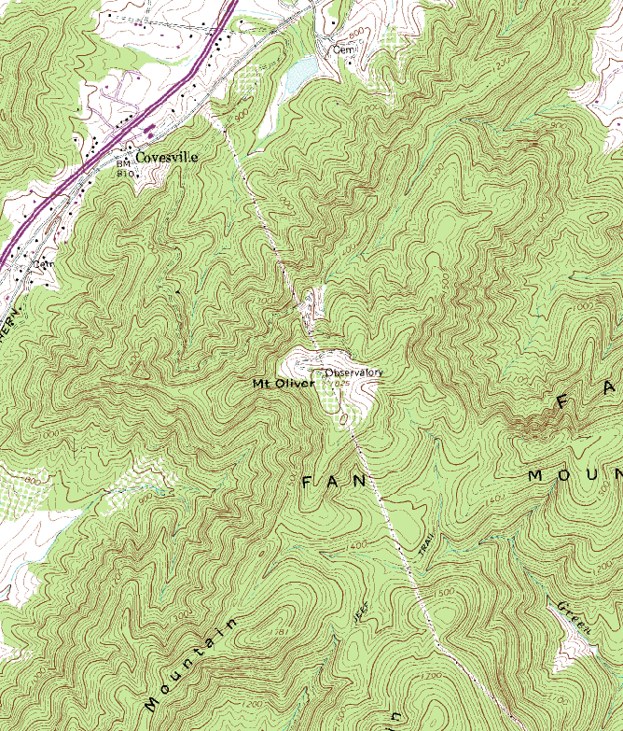
Charlottesville
29

Slide 5
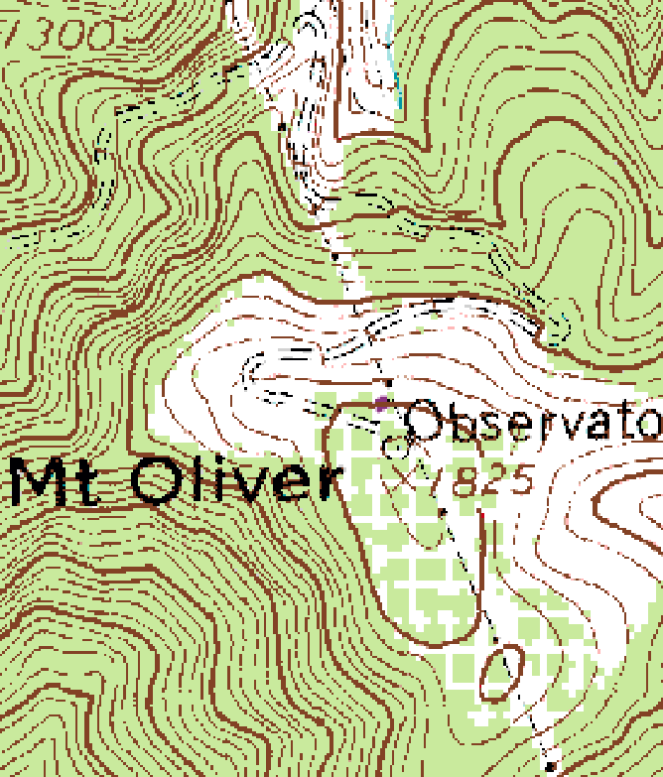
24” RRRT
UVA 40”
UVA 31”

Slide 6
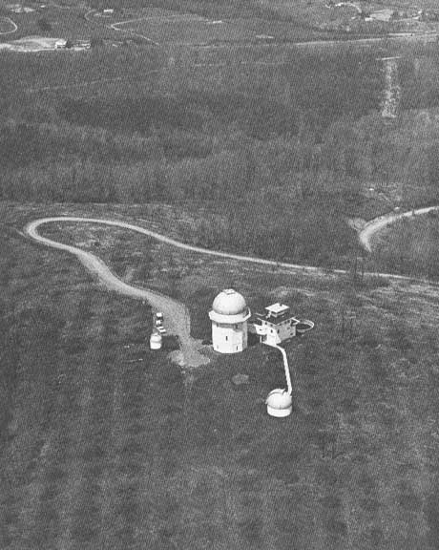
FAN MOUNTAIN OBSERVATORY
NSU RRRT
Guest House
40”
31”

Slide 7
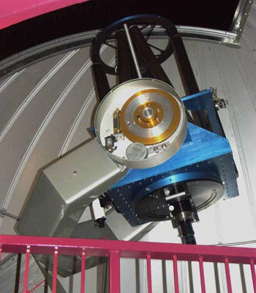
Telescope: 24” Optical Guidance System, Ritchey-Chretien

Slide 8
Optical Guidance Systems : RC24-140F
Specs
♦ Optical System: Ritchey-Chretien
♦ Primary Diameter: 24.0"
Specular Precision: 1/25, or better, (wave front RMS)
Mirror Substrate Near-zero expansion ceramic
♦ Focal Ratio: f/8.0
F: 4876.8 mm
♦ Image Scale 42.1 arc sec/mm
Tube (Open truss) Diameter 29"
Focuser Tube I.D. : 4.2"
♦ Available Back Focus: 11.5" (+/= 2”)
Secondary Diameter: 8.5"
Sec. Focus Range (electric standard): 12"
Focus Stabilization, w. Al tube Invar 36
♦ Mounting OGS-140 Equatorial Fork (steel)
Aux. Instrument Cap.: 75 lbs.
R. A. Drive 18" 570 tooth Byers worm gear & ball bearing worm
DEC Drive 15" 360 tooth Byers worm gear & ball bearing worm
Shafts 6.0" Ø (140mm at R. A. bearing ends; 75mm at DEC ends)
Motors Five-phase nano-step / servo
Axis Intersection 72" from base of pier (at 40°)
Fork Swing Clearance 18"
Weight (system) 1025 lbs.
R. A. Counterweights 2 x 5 lbs.
Pier 32" high

Slide 9
Optical Guidance Systems : RC24-140F
Specs (Cont)
♦ Pointing error of approx. 30 arc sec RMS or better for 80 degrees from
zenith and less than 20 arc sec RMS 45 degrees around the zenith.
♦ Tracking/Guiding (RA and Dec)
Sidereal/Moon/Planets/Sun
within 1 arc sec for 300 sec, 0.3 arc sec over 100 sec
able to be controlled with auto-guiding input
tracking rates up to 2 degrees per second for programmed satellite tracking.
slewing rates up to 6 degrees/second (90 degrees in 15 sec)

Slide 10
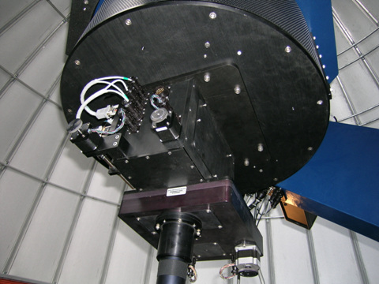
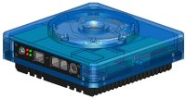
MAIN INSTRUMENTATION
Finder-guider
Dual Filter Wheel
A.C.E.
Apogee Alta E42 (Back-illuminated)

Slide 11
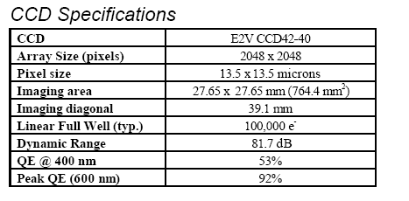
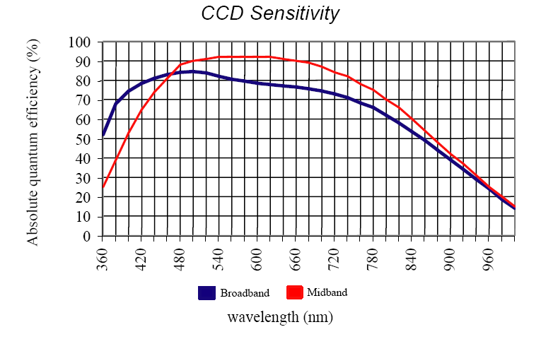
Imaging Photometry and Polarimetry
Alta E42

Slide 12
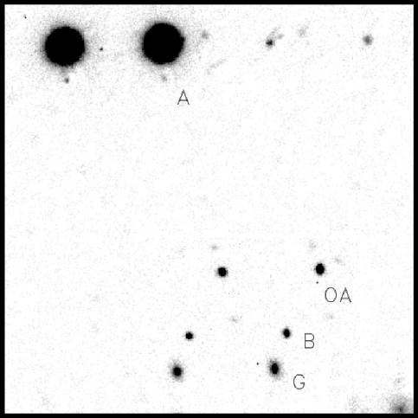
Imaging Polarimetry Using
Double Refraction
Field of view : 30 min arc (diagonal)
Field of view /pixel: 0.6 sec arc
An optically corrected calcite prism produces double polarized images which can be analysed by aperture photometry to give the polarization of each object in the field.

Slide 13
Other instruments (already acquired):
CCD Cameras: SBIG - 10E
SBIG – STV
Meade DSI
SBIG Self-guided Spectrograph
SBIG AO7 Adaptive Optics
SBIG Color (8) Filter Wheel
RGB & UBVRI filters
Several eyepieces, filters, …
Software: Hartmann Mask
Lucy-Richardson CCD Sharp
CCD Ops
AIP4WIN (Berry et al.)
IRAF
Telescopes: 12” Meade SC LX200GPS (altazimut) – comp. control
14” Celestron SC (equatorial) – comp. control
16” Meade DST Newtonian (equatorial)
3x 10” Meade SC
8x 8” Meade SC

Slide 14
Control System (Bisque Software)
MKS 4000 Telescope Motion Control System, (TMCS)
The Sky6, Orchestrate, TPoint, CCDSoft
SBOS - Software Integration
Software Bisque's Observatory Suite (SBOS) is an integrated suite of software
applications designed for complete control of observatory equipment. The core
software applications include:
TheSky6 Professional Edition
CCDSoft CCD Astronomy Software Version 5
TPoint Telescope Pointing Analysis Software
Orchestrate Scripting Software
And these additional applications build on the core to allow remote control of your
observatory:
Internet Astronomy Software Client and Server Applications (for local-area or
wide-area network observatory control).
Browser Astronomy (patent pending) for web-based remote observatory control.
AutomaDome Dome Control Software
These applications include all the functionality necessary to control the hardware at
an observatory, including telescopes, CCD cameras, Autoguiders, video cameras,
SBIG's Adaptive Optics device, color filter wheels, focusers domes, etc. Most main
stream observatory hardware is supported out of the box. In addition, the suite has
standardized application programming interface (API) for hardware communications
allowing the integration of custom observatory hardware by third parties willing to
write their own implementation of the APIs.

Slide 15
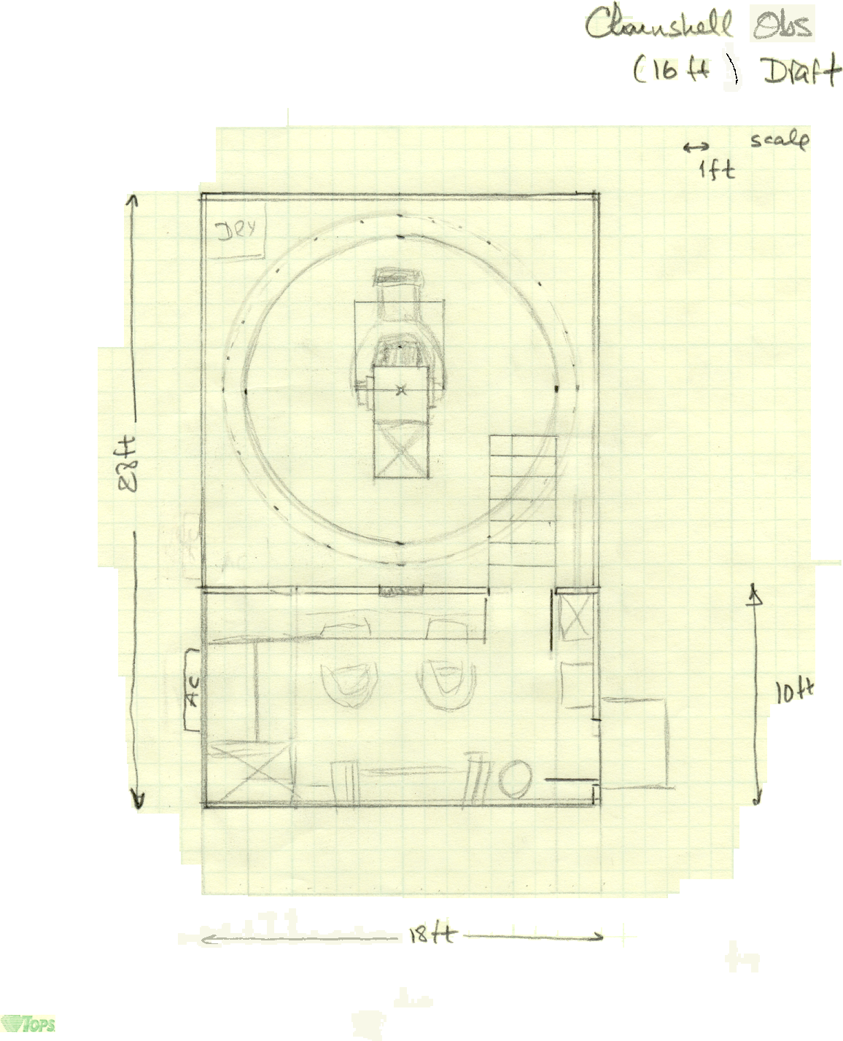
Clamshell
Observatory

Slide 16
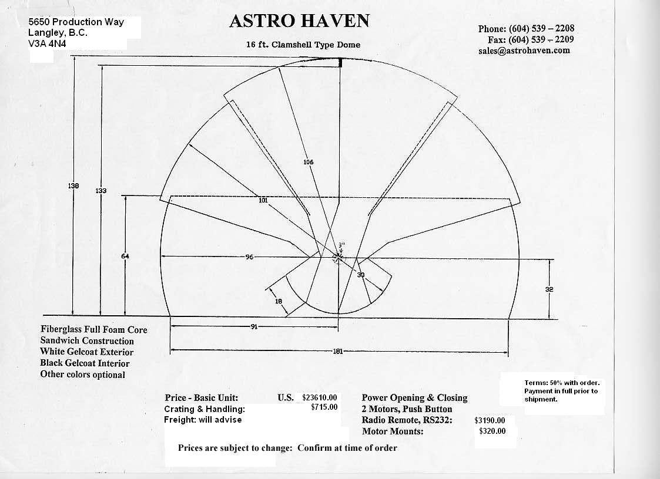

Slide 17
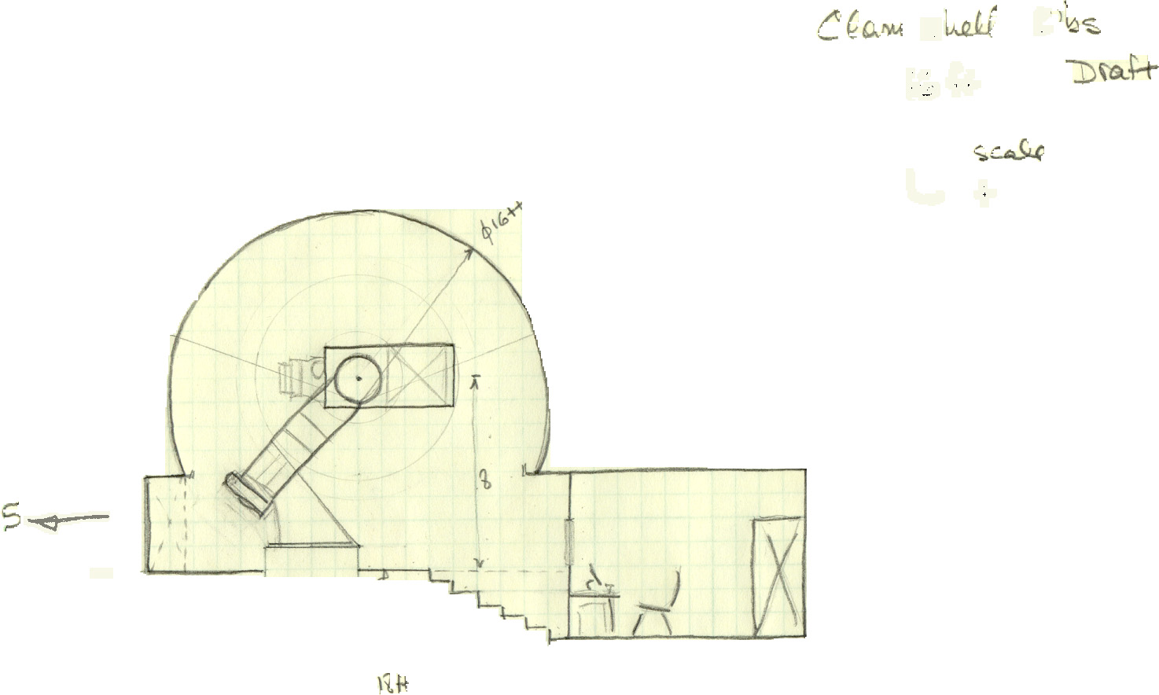

Slide 18
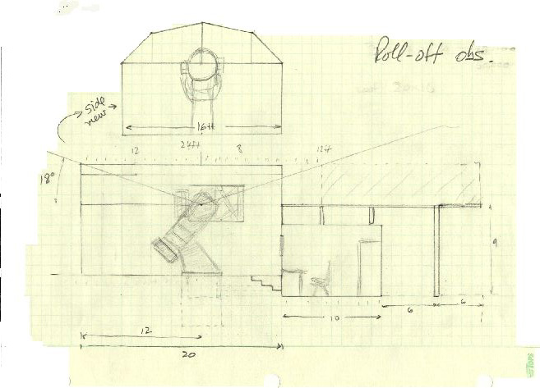
Roll-off Observatory

Slide 19
Schedule:
Telescope installation by November 2005
Calibrations (about first three months)
Summer 2005: Enclosure construction
Tailpiece design and construction
Start on-site sky studies (Using UVA and NSU telescopes)
Atmospheric extinction coefficients
Seeing and transparencies
Atmospheric variability
♦ FORM RESEARCH GROUPS (NEXT)

Slide 20
Research Topics (Groups)
Gamma-Ray Bursts – Optical Afterglows
Near-Earth Objects
Variable Stars
Supernovae Search
Astrophotography
Other Transients
Atmospheric monitors
Education/Outreach

