Slide 1
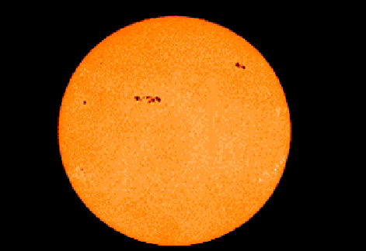
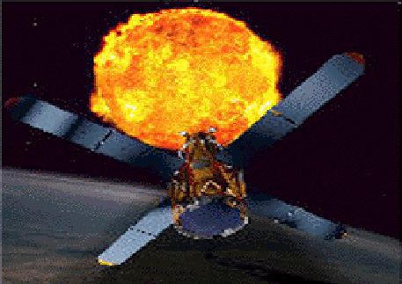
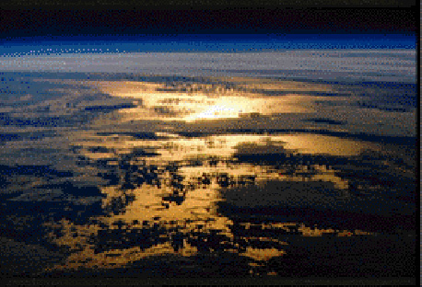
Introduction
Sun-Earth Connection:
A New Perspective

Slide 2
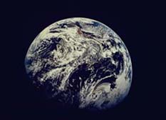
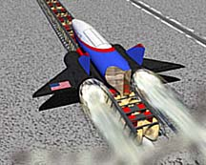
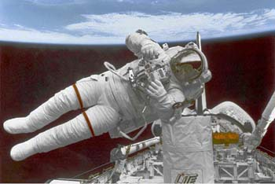
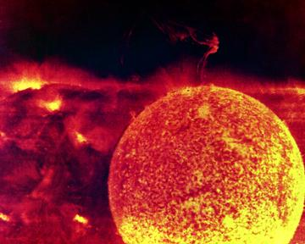
Main Areas Of Research
Earth Science
Aerospace Technology
Space Science
Human Exploration And Development Of Space

Slide 3
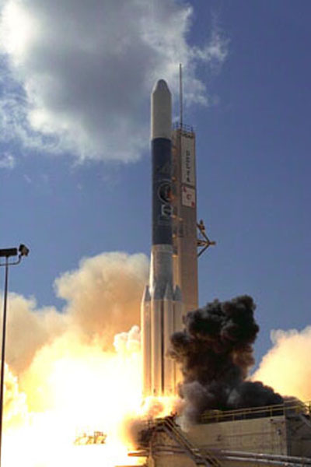
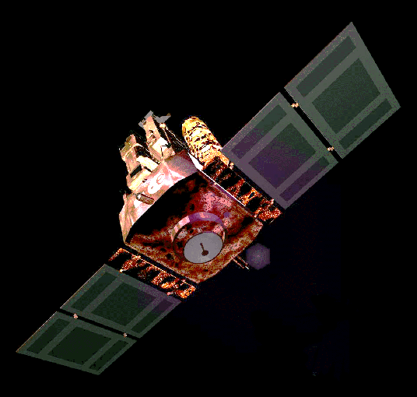
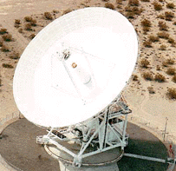
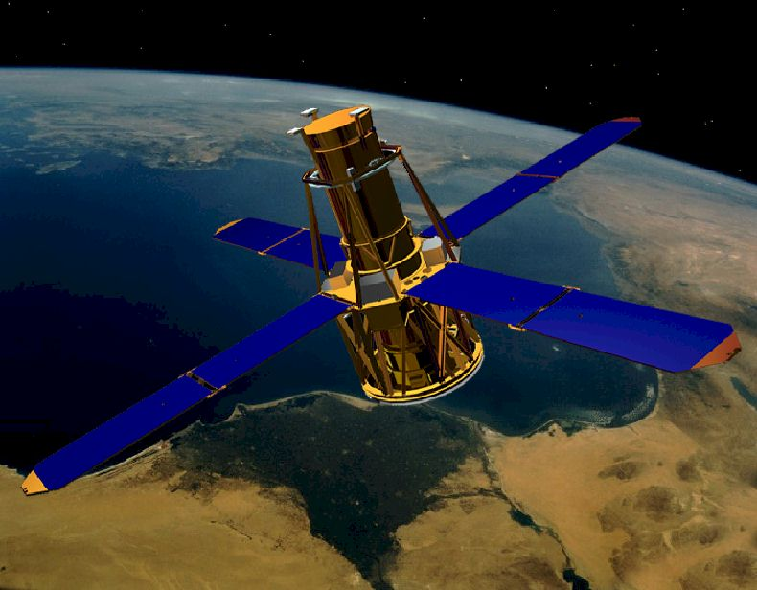
Importance of Space Technology
Better Observation Of The Sun And Earth

Slide 4
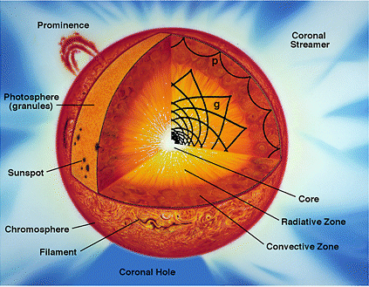
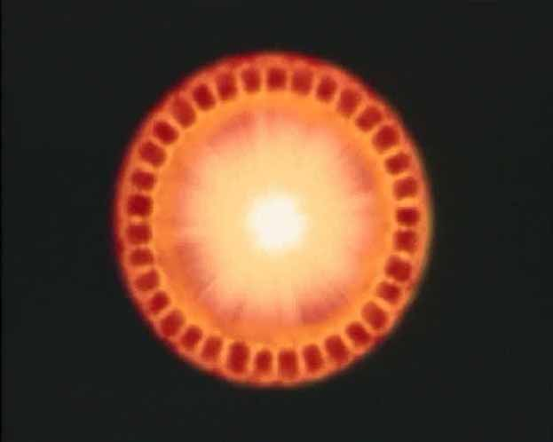
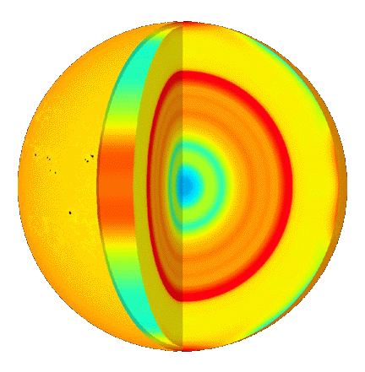
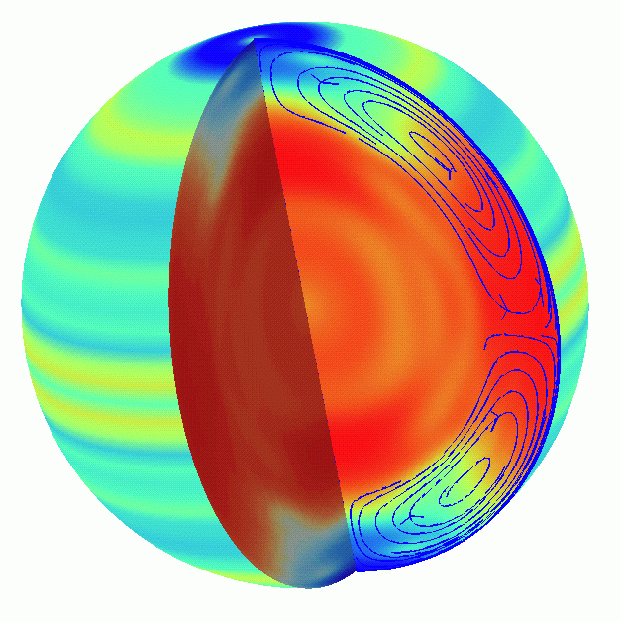
Sun’s Internal Structure
The globes to the left and right represent variations in temperature and rotation of the Sun based on MDI data.

Slide 5
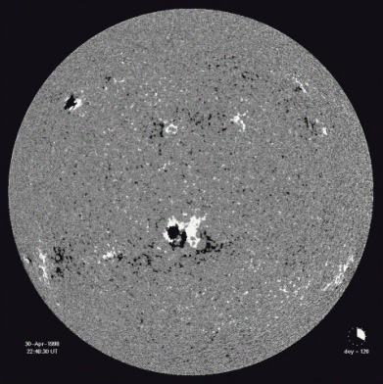
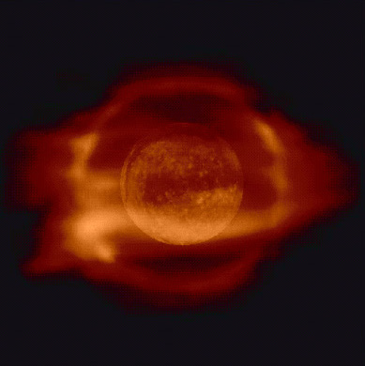
Surface And Atmosphere
Of The Sun

Slide 6
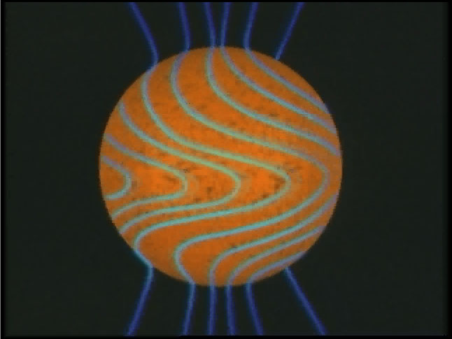
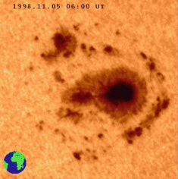
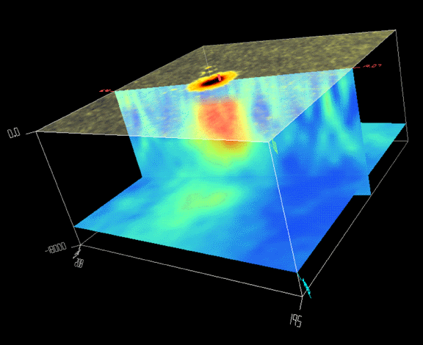
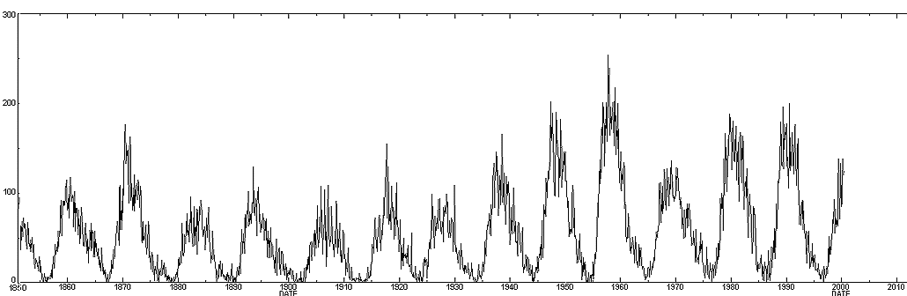
Sunspots
Sun’s Magnetic Field
Sunspots
Sunspot Structure
Solar Cycle
1850 1860 1870 1880 1890 1900 1910 1920 1930 1940 1950 1960 1970 1980 1990 2000

Slide 7
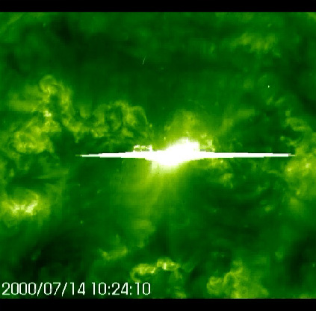
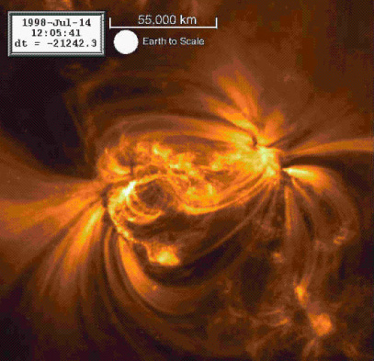
Solar Flares

Slide 8
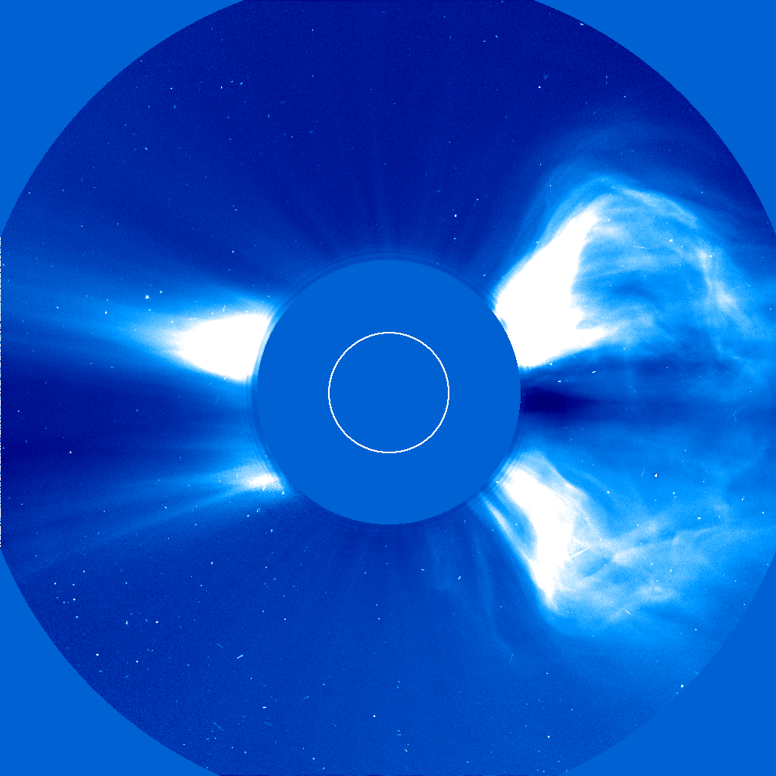
Coronal Mass Ejections

Slide 9
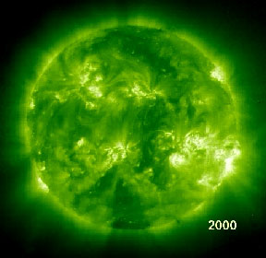
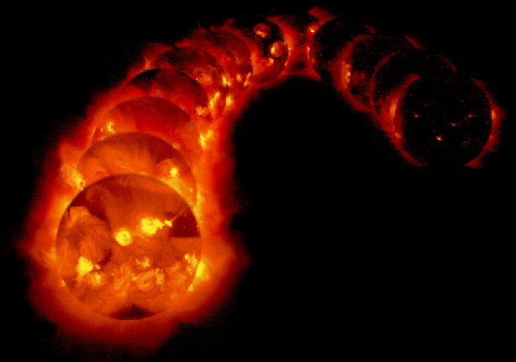
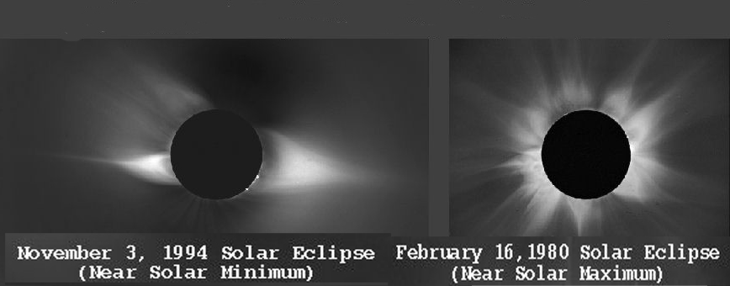
Solar Cycles
1992
1996
Minimum 6 Maximum 6

Slide 10
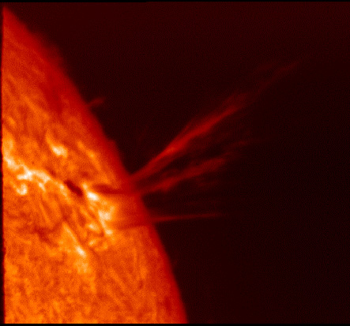
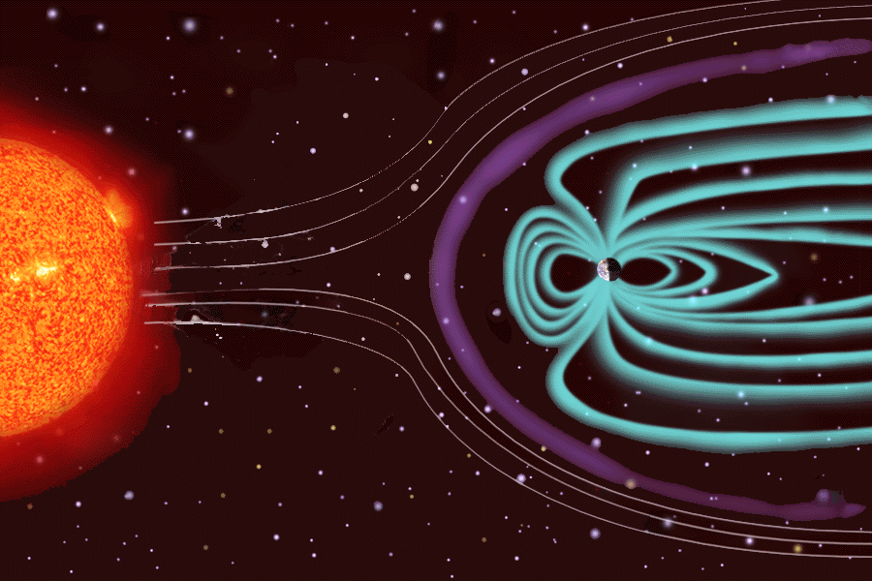
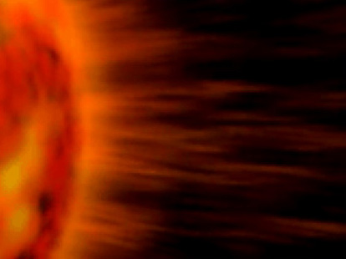
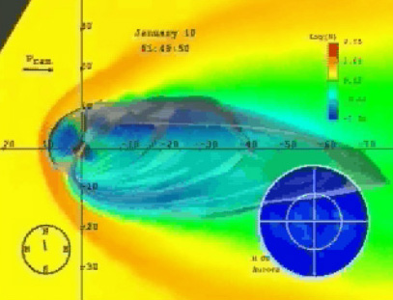
Solar Wind
The solar wind consists of plasma that is continually being released from the Sun.

Slide 11
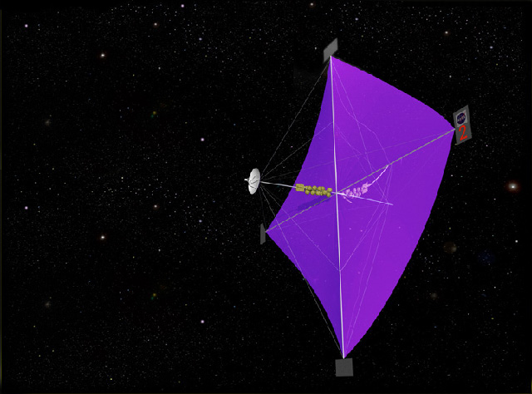
Solar Sail
Interstellar Exploration
A proposed spacecraft would use light from the Sun to accelerate to high velocity and explore deep space.

Slide 12
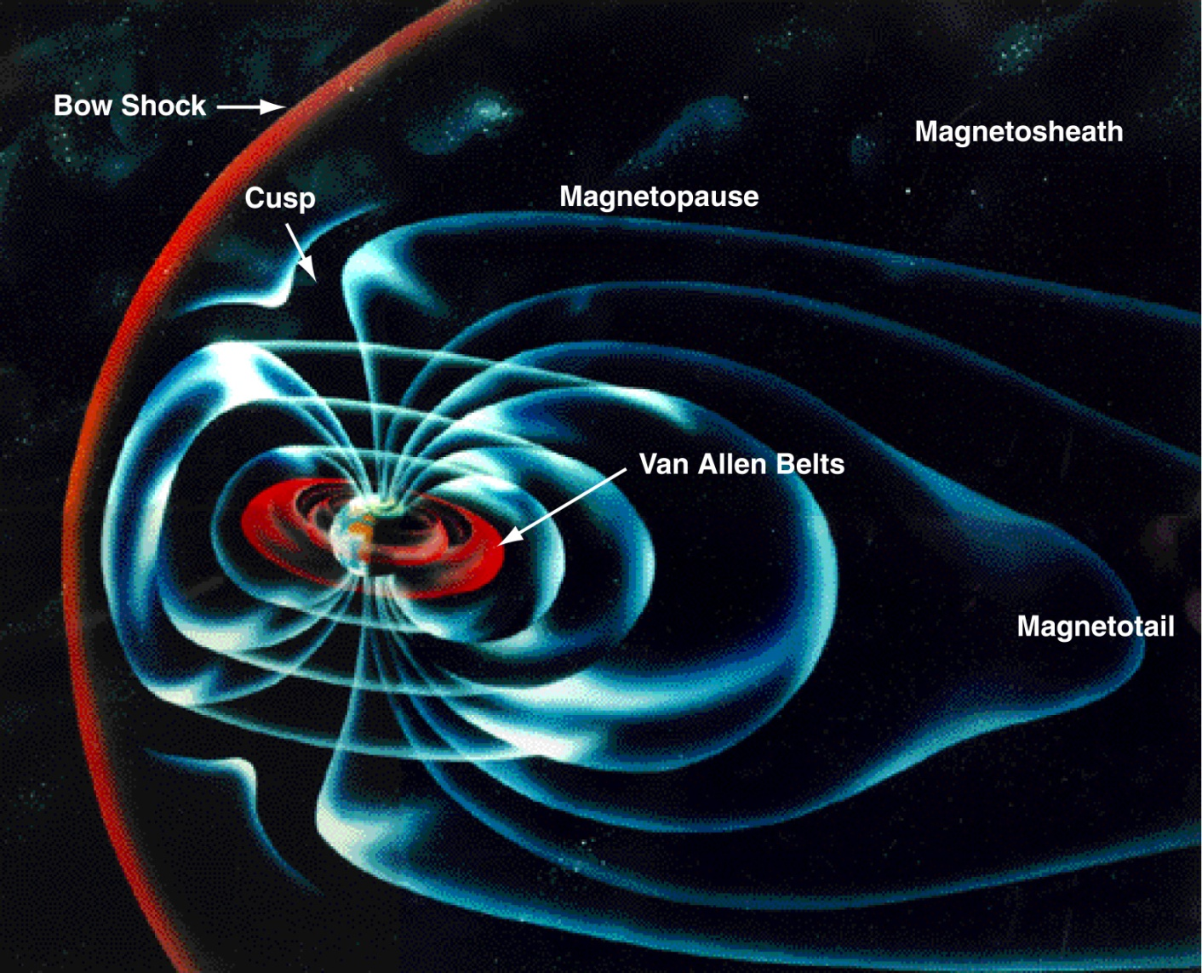
Earth’s Magnetosphere

Slide 13
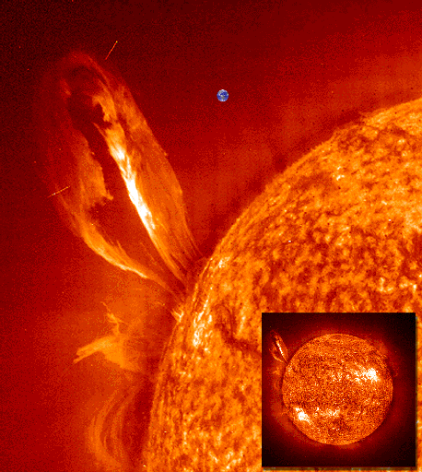
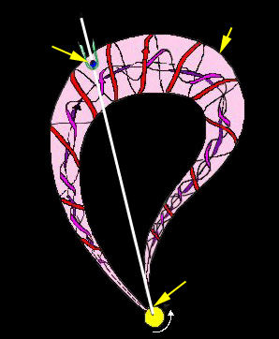
Coronal Mass Ejections:
Crossing the Earth’s Path
Earth Is Shown For Size Comparison
Magnetic Cloud
Earth
Coronal
Mass
Ejection
SUN

Slide 14
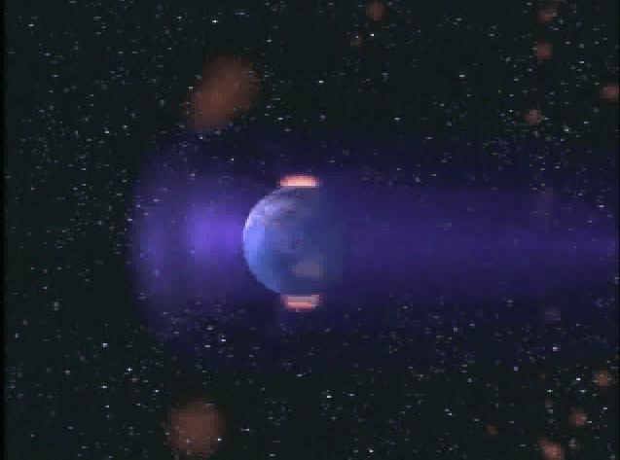
Coronal Mass Ejections:
Impact On Earth

Slide 15
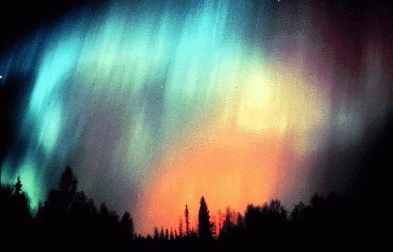
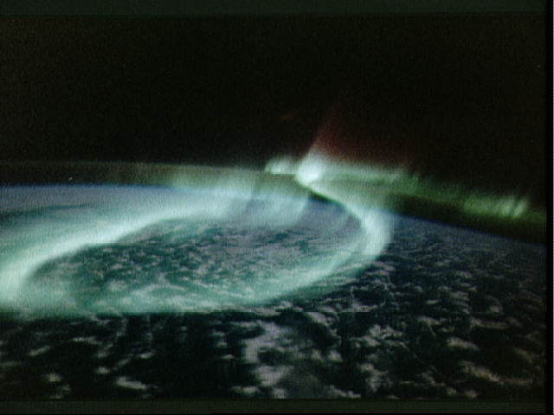
Aurora:
Points of View
View From Earth
View From Space

Slide 16
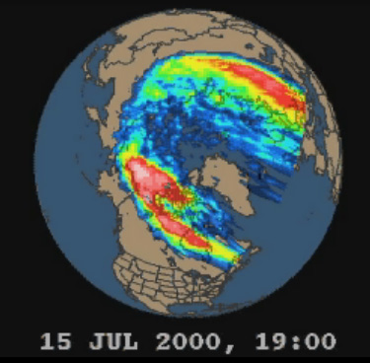
Aurora:
Lights in Motion

Slide 17
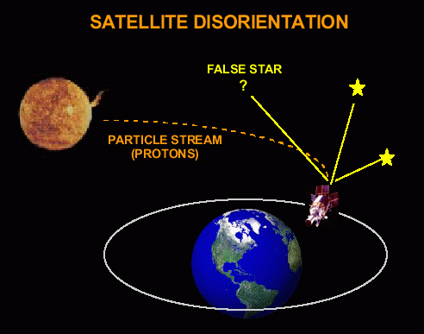
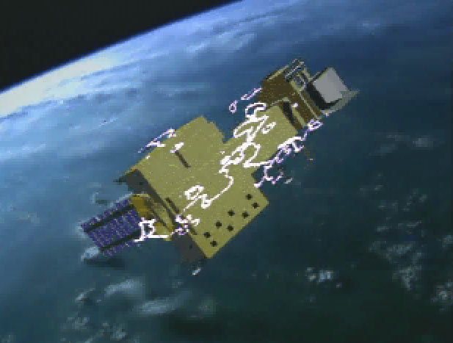
Space Weather :
Effects On Orbiting Spacecraft

Slide 18
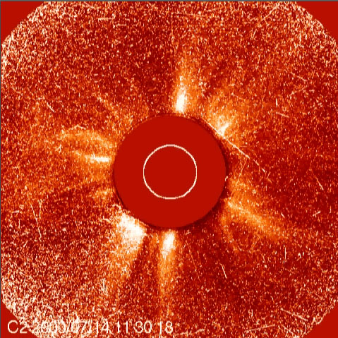
Space Weather :
Effects On Satellite Sensors

Slide 19
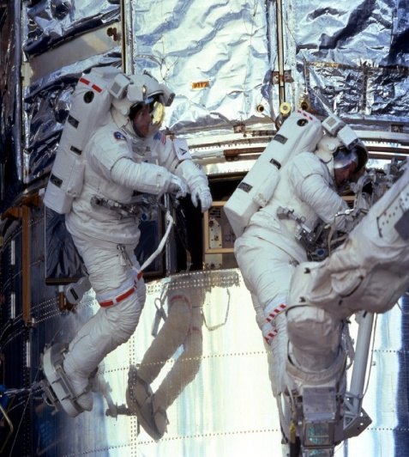
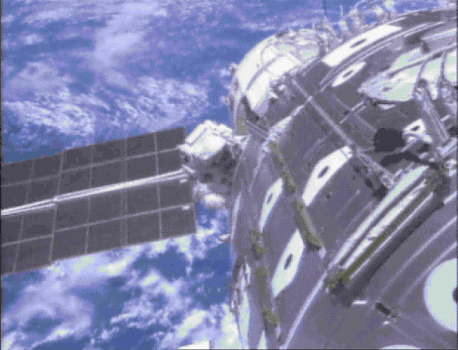
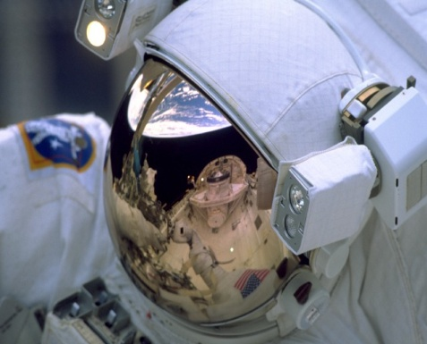
Solar Storms:
Effects on Humans in Space

Slide 20
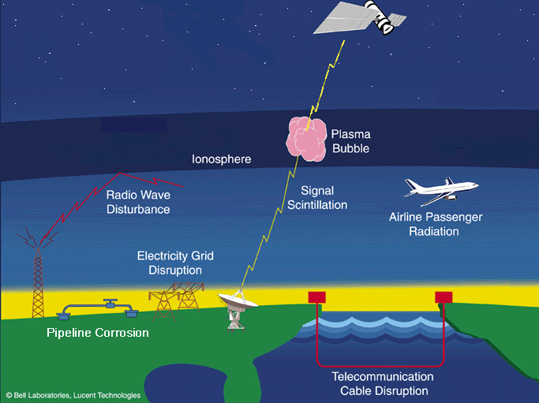

Solar Storms:
Effects On Societal Systems

Slide 21
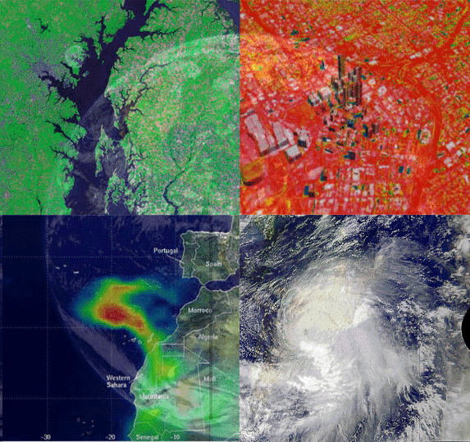
The Sun’s Energy:
Driver of Earth Weather
Water Level In
The Chesapeake Bay
Infrared Image Of
Atlanta, Georgia
Sahara Dust Plume
Off The African Coast
Hurricane In
The Atlantic Ocean

Slide 22
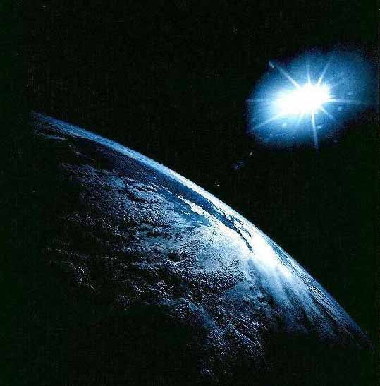
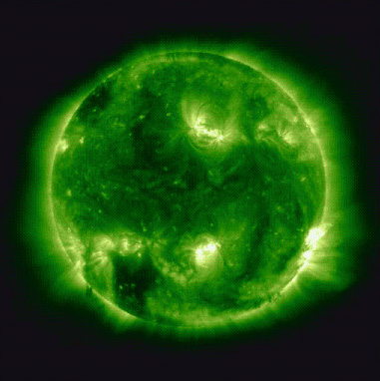
Sun-Earth Connection

Slide 23
The End

